Slide 1
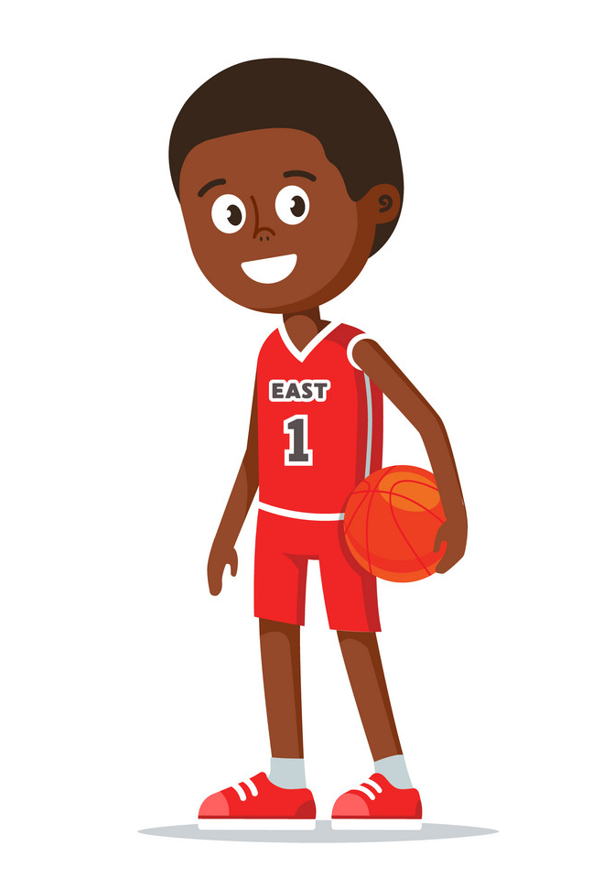
Conquering the court! An In Vivo Basketball Game
Created by: Emily Tilstra-Ferrell

Slide 2
The Object of the Game
Shoot as many “hoops” as you can by facing safe situations that remind you of stressful events.

Slide 3
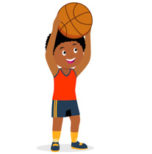
Example
Billy loved to play basketball. He played for years with his buddy, Jim. He didn’t know that Jim had a heart condition called HCM. Unfortunately, one day while playing basketball, Jim passed away on the court-- while playing-- because of his heart condition. Now, Billy doesn’t want to play basketball anymore. Since he lost Jim, Billy won’t touch a basketball, go on a court, or hang out with his friends because those things remind him of what happened.

Slide 4
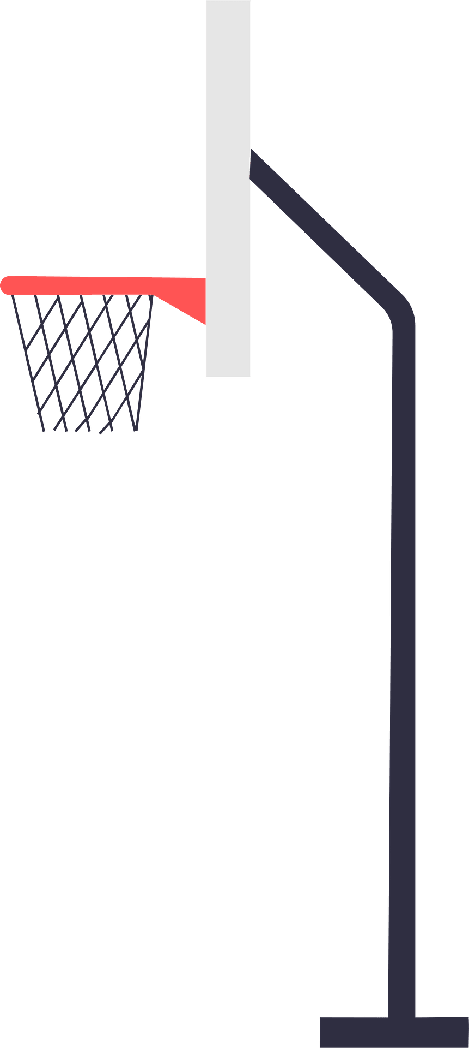
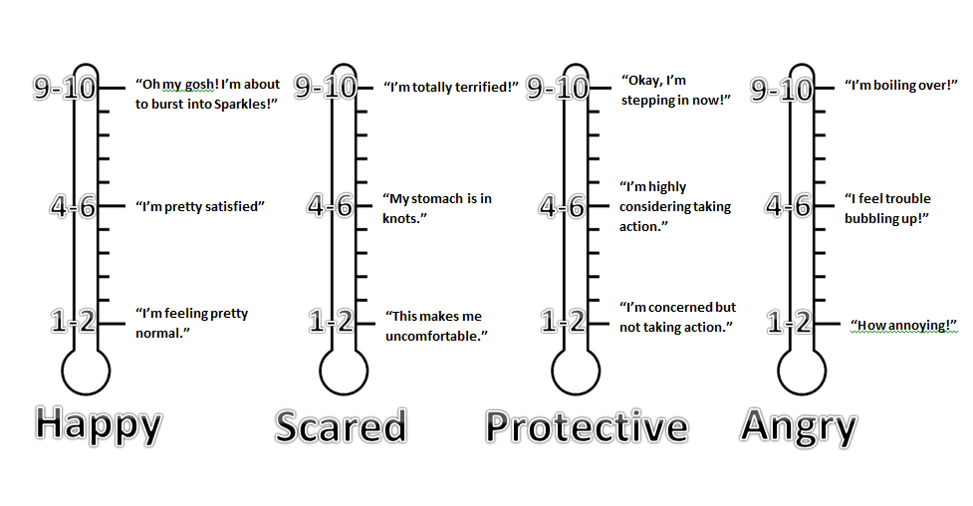
What are Subjective Units of Distress (SUDS)?

Slide 5
Billy’s Basketball Ladder
Most Scary
Suds = 10 (actually playing basketball again on the court)
Very Scary
Suds = 8 (thinking about what happened to Jim)
Step One: Billy held a basketball for 30 minutes in his house.
His SUDS for this activity = 2
Medium Scary
Suds = 6 (talking to basketball friends)
A Bit Scary
Suds = 4 (going to the court)
Not Very Scary
Suds = 2 (holding a basketball)

Slide 6
Billy’s Basketball Ladder
Most Scary
Suds = 10 (actually playing basketball again on the court)
Very Scary
Suds = 8 (thinking about what happened to Jim)
Step Two: Billy went back to the basketball court. He took his friend to help.
His SUDS for this activity = 4
Medium Scary
Suds = 6 (talking to basketball friends)
A Bit Scary
Suds = 4 (going to the court)
Not Very Scary
Suds = 2 (holding a basketball)

Slide 7
Billy’s Basketball Ladder
Most Scary
Suds = 10 (actually playing basketball again on the court)
Very Scary
Suds = 8 (thinking about what happened to Jim)
Step Three: Billy spent time with his basketball friends who he had not spoken to since Jim died.
His SUDS for this activity = 6
Medium Scary
Suds = 6 (talking to basketball friends)
A Bit Scary
Suds = 4 (going to the court)
Not Very Scary
Suds = 2 (holding a basketball)

Slide 8
Billy’s Basketball Ladder
Most Scary
Suds = 10 (actually playing basketball again on the court)
Very Scary
Suds = 8 (talking to friends about what happened to Jim)
Step Four: Billy talked to his friends about what happened to Jim and how he felt about what happened.
His SUDS for this activity = 8
Medium Scary
Suds = 6 (talking to basketball friends)
A Bit Scary
Suds = 4 (going to the court)
Not Very Scary
Suds = 2 (holding a basketball)

Slide 9
Billy’s Basketball Ladder
Most Scary
Suds = 10 (actually playing basketball again on the court)
Very Scary
Suds = 8 (thinking about what happened to Jim)
Medium Scary
Suds = 6 (talking to basketball friends)
Step Five: Billy played a scrimmage game with his team on the basketball court where Jim died.
His SUDS for this activity = 10
A bit scary
Suds = 4 (going to the court)
Not very scary
Suds = 2 (holding a basketball)

Slide 10
What have you been avoiding since the scary thing happened in your life?
Do you try not to go to certain places?
Are there things that you used to do that you are not doing anymore because of what happened?
What about things you avoid thinking about?
What about things that you are really afraid of since the event happened?

Slide 11
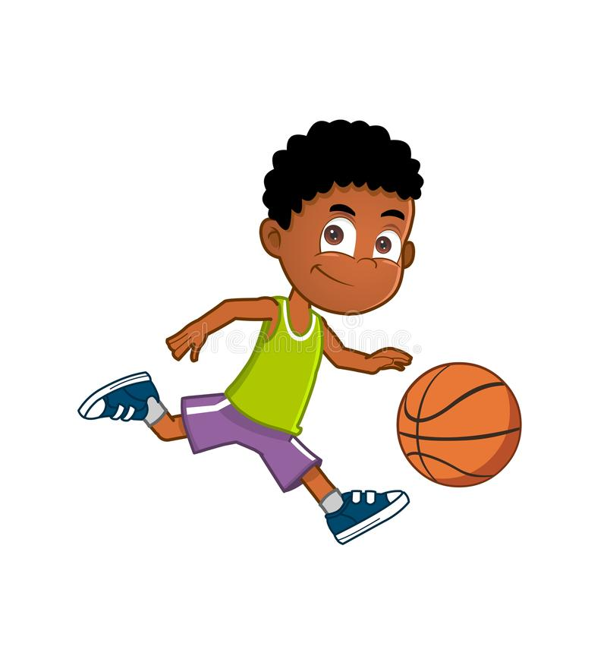
Let’s make YOUR
Basketball Ladder
Most Scary
Suds = 10
Very Scary
Suds = 8
Medium Scary
Suds = 6
A Bit Scary
Suds = 4
Not Very Scary
Suds = 2

Slide 12
Why should I do this?
Avoiding “taking a basketball shot” or facing our fears keeps us from doing things that are important to us, like spending time with friends and family or doing things we enjoy.
When you face the things that you fear the most...
they become less scary!
you learn new ways to think about the object, activity, or situation
you learn that you can face it!
you will feel good about facing your fear!
you will be able to practice your skills!
you will be able to do a lot more things… Can you think of some things you can’t do right now because of avoidance?

Slide 13
PRO TIP
Our memories remind us of how we felt when the trauma happened and the scary moment.
BUT
The memory of what happened is NOT dangerous.
It is just a memory. A memory cannot hurt you
(even though it is hard to face)!

Slide 14
How to Win the Game
Work your way up the court to make as many shots as possible.
Every week that you do an activity on your basketball ladder, you get to… [YOU PICK THE REWARD].
Ideas for rewards:
Play a game during a session of your choice
Watch a favorite video during the last 10 minutes of session
Listen to your favorite music for 10 minutes during session
Get your therapist to do something silly that you both agree to

Slide 15
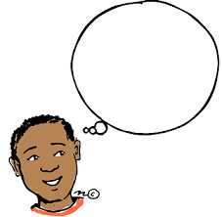
Plan Ahead
What day/time will you do your activity?
Where will you do your activity?
For how long?
Will you have someone with you?
Is there anything that might get in
the way of you doing it?
Let’s put in a phone reminder.

Slide 16
Keeping Score!
Reward for doing 2 SUDS activity:
Not Very Scary
Suds = 20 (holding a basketball)

Slide 17
Next week: We will...
Do your reward!
Talk about
how it went (SUDS)
any challenges you experienced
the skills you used
what you learned about the activity and yourself

