Slide 1

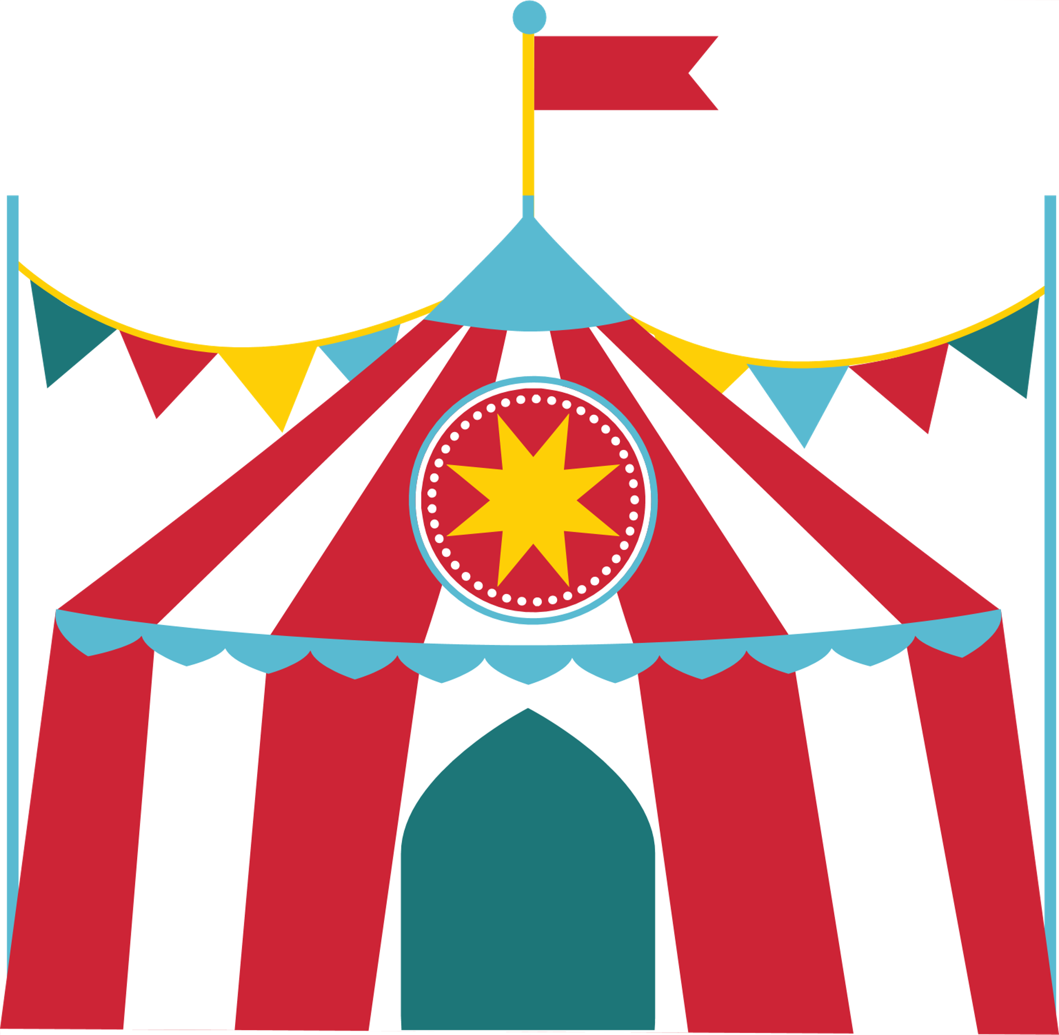
A DAY AT THE CARNIVAL
Progressive Muscle Relaxation

Slide 2
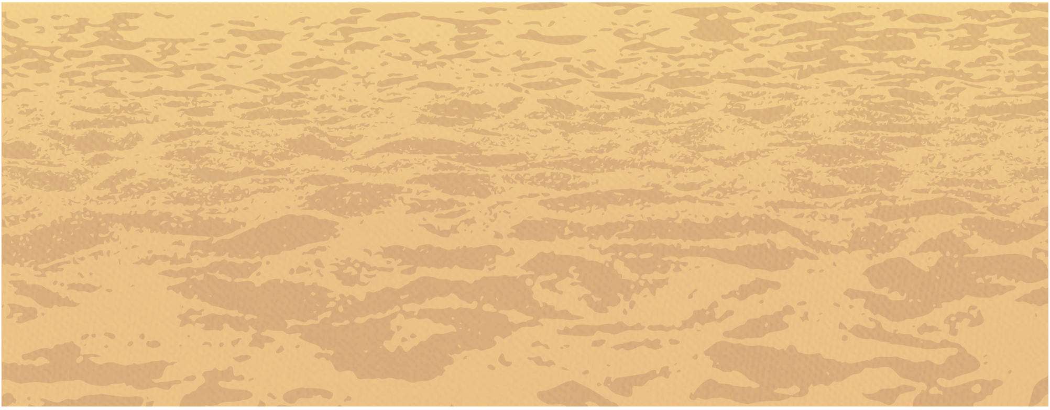
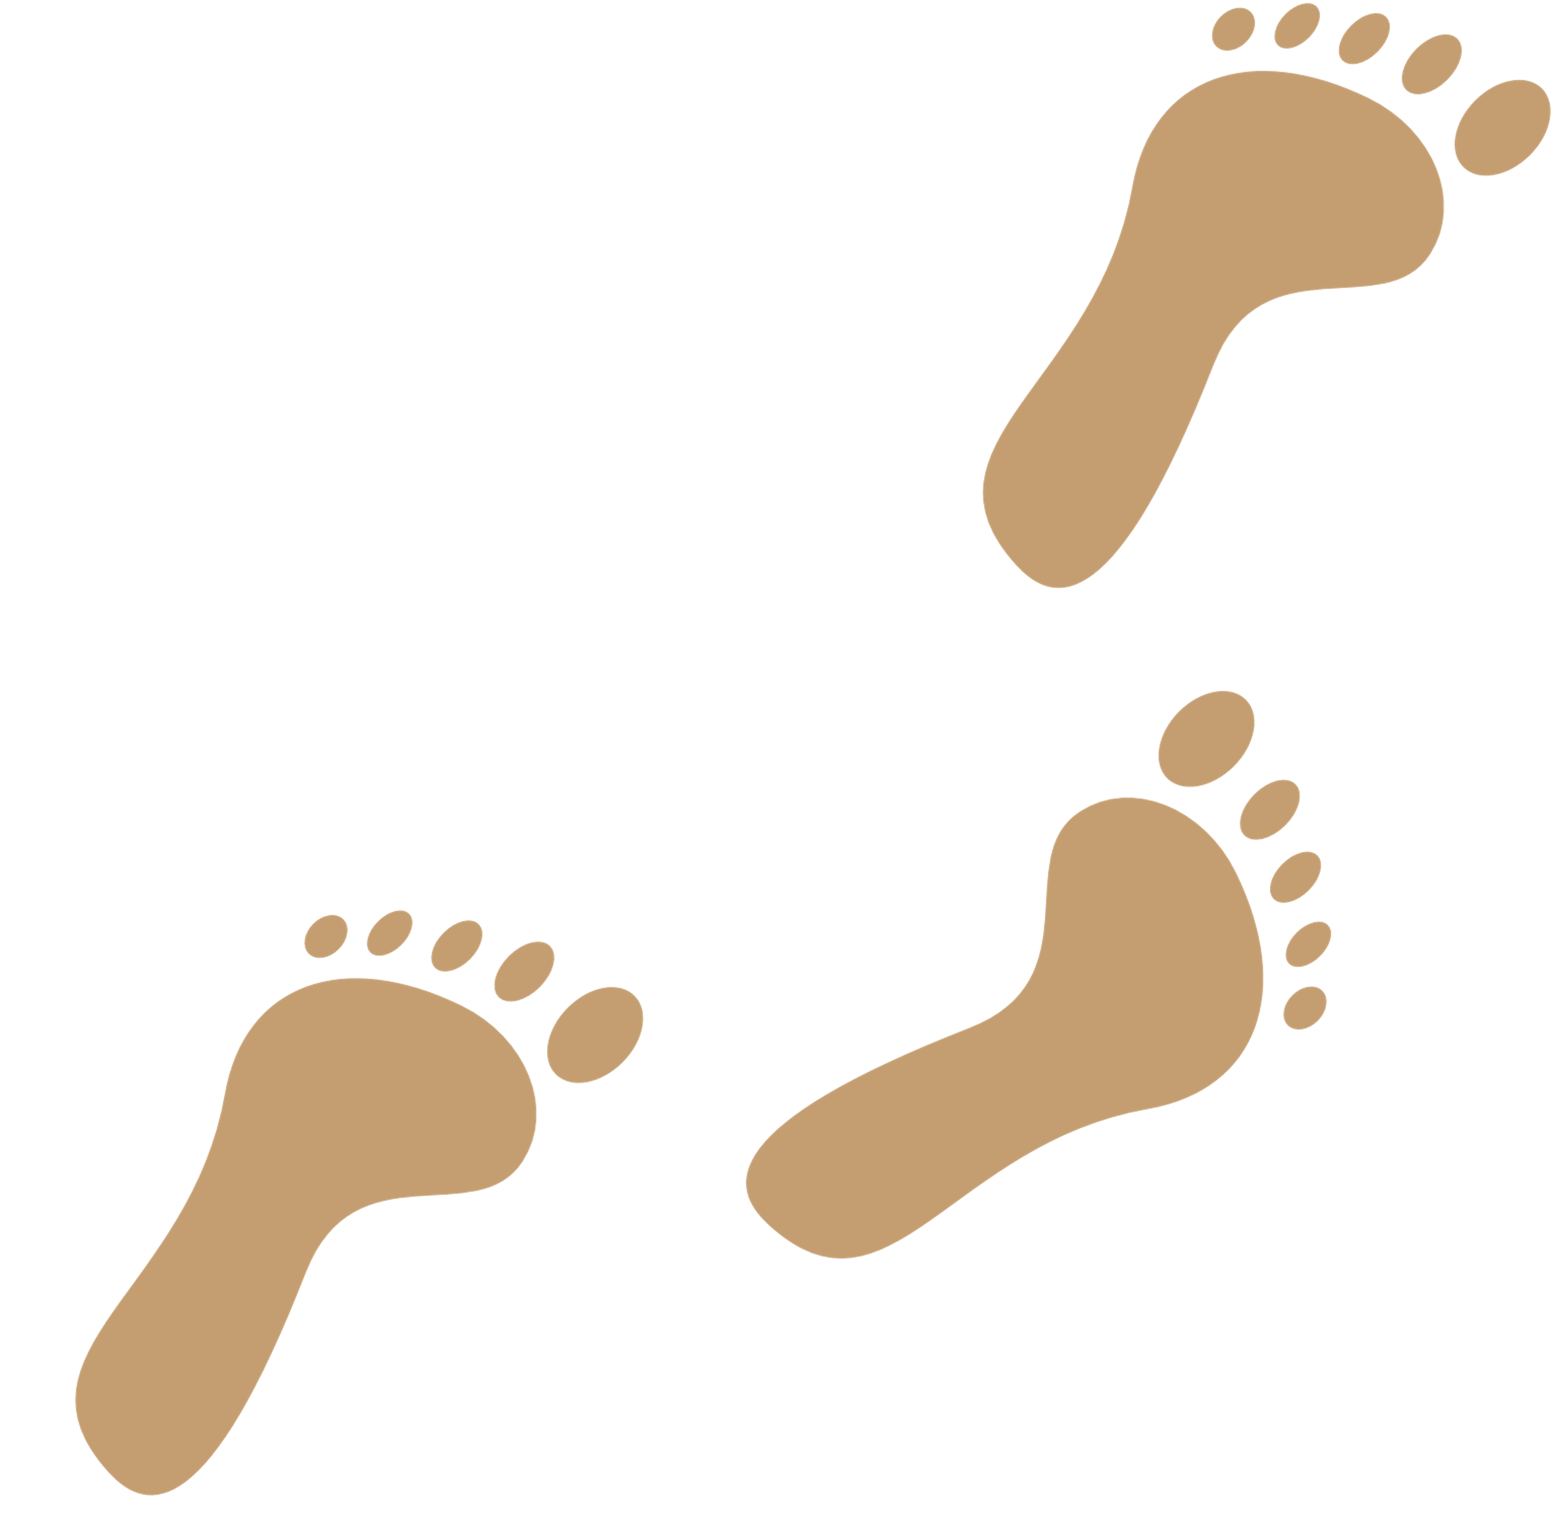
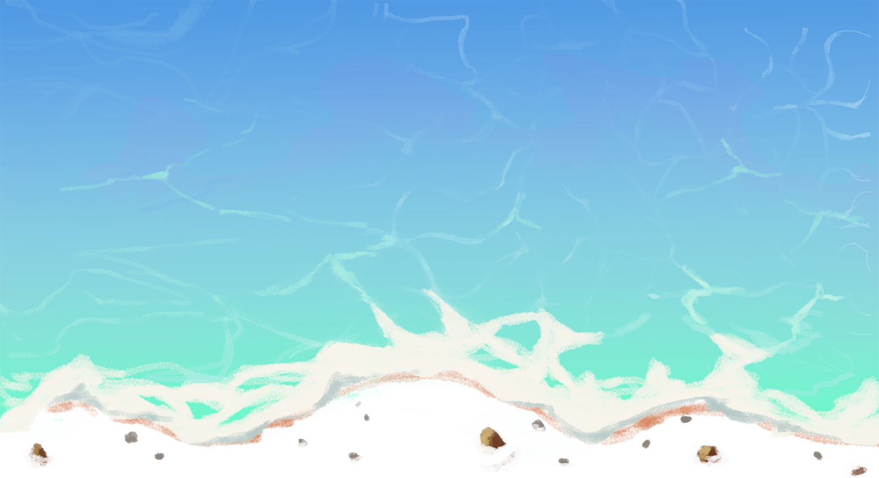
You are walking along a beach. The weather is just the way you like it. As you walk along, you see a carnival on the beach up ahead. There are many interesting things to see.

Slide 3

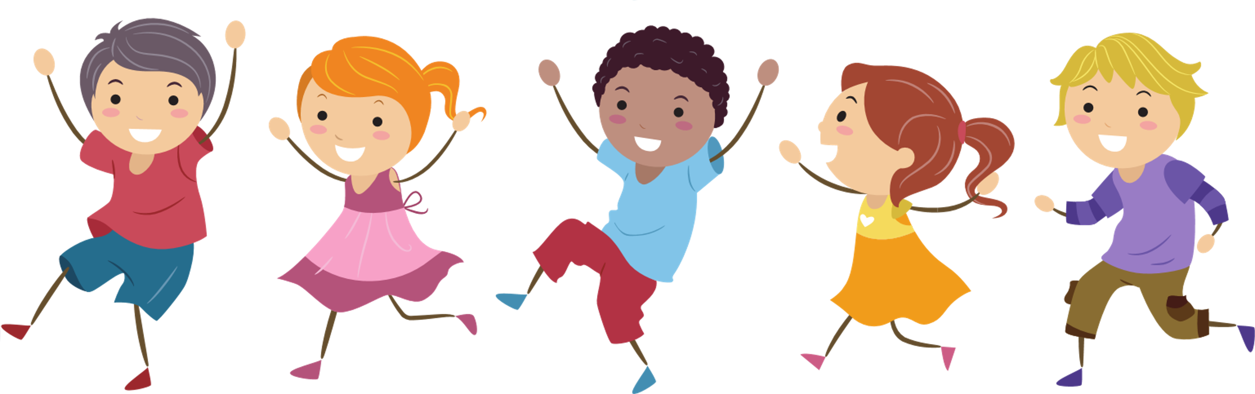
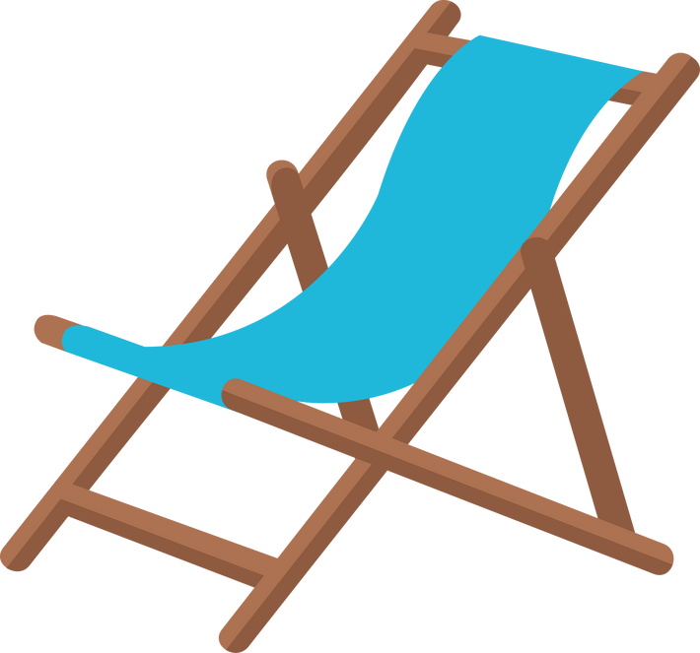

As you walk closer to the carnival, you notice there is a line to enter the carnival. There are rows of chairs on the beach for people to rest while waiting. You sit in a chair.
The sand feels warm on the bottom of your feet. You push your toes in the sand and squeeze sand between your toes. Try that now. Scrunch up your toes as you squeeze sand between them. And relax. Notice how good it feels to tense your toes and feet and then to relax. Try again to squeeze the warm sand between your toes. Hold it tight. Now relax.

Slide 4

As you sit waiting, you notice a big cool wave lapping onto the beach. Your chair is far back enough that you will not get wet if you pick up your feet. Lift up your legs to keep them dry. Stretch your legs out in front of you as tight as you can. Hold it, here comes the wave. The wave receded; you can now relax. You did a good job of keeping your legs dry.
Oh no, here comes another wave. Lift your legs high. Keep your legs out straight and stiff. Hold it a little longer. And relax. You put your feet back on the ground. Your legs feel nice and relaxed. The line to the carnival is shorter and it is your turn to go in.

Slide 5

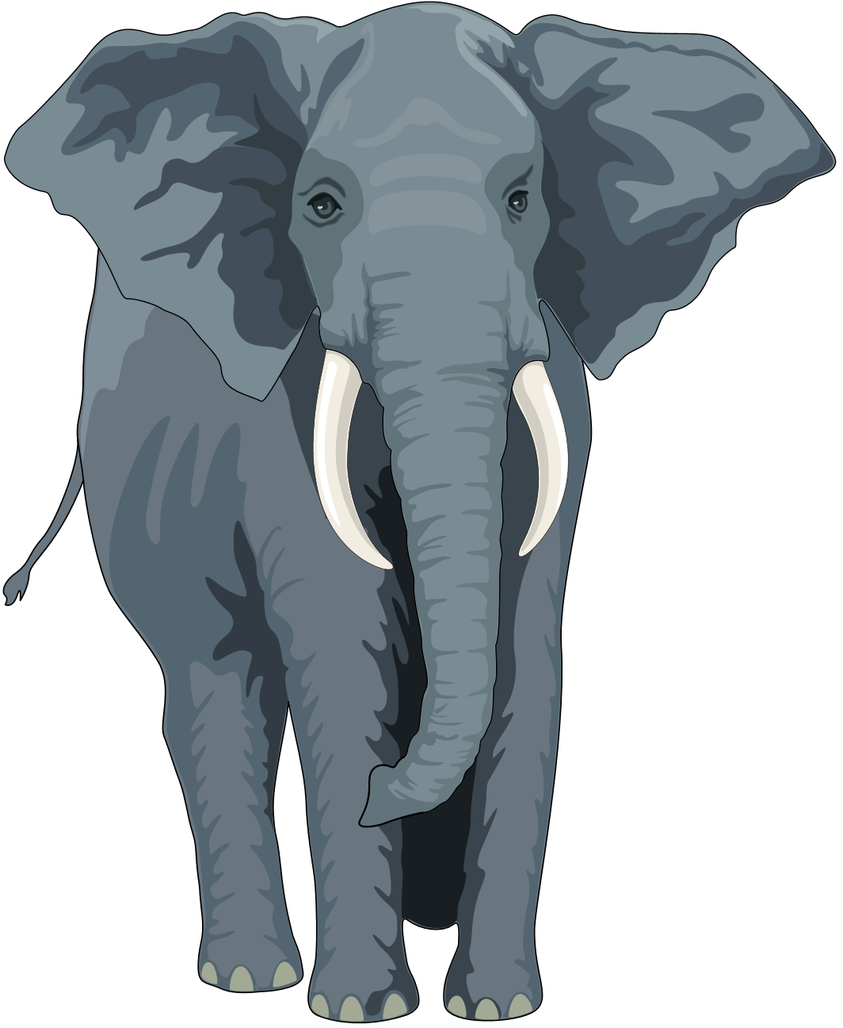
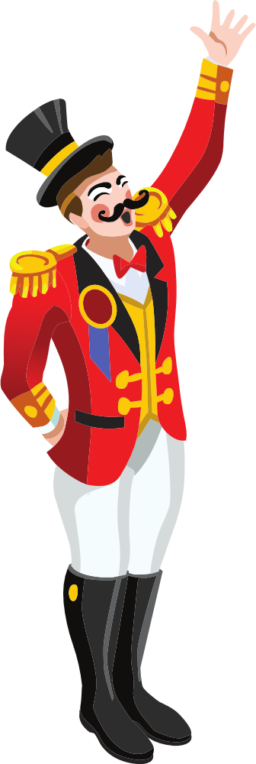
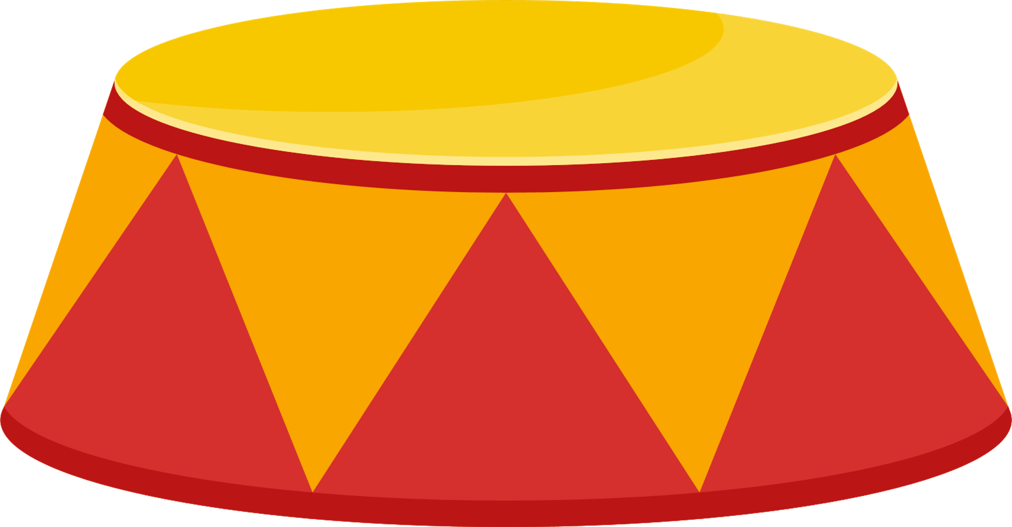
You join a carnival show under a big top tent. The main attraction is a baby elephant bigger than the tallest person. The ring master invites you to be part of the act. The crowd claps and claps for you as you walk to the center ring. The ring master has you lie down on a soft blank on the ground. The ring master tells the audience you are the strongest person on the planet, and to prove the point, the baby elephant will step on your stomach without hurting you. The ring master whispers to you to make your stomach muscles hard and tight so it looks like the elephant is stepping on you. “One-two-three,” the ring master shouts and the baby elephant lifts the right front foot and puts it on your stomach. Make your stomach hard and tight. Hold it strong. The crowd applauds and the elephant takes the foot off your stomach. You can now relax your stomach.
People start shouting “Encore, encore” and the ring master again has the baby elephant put the right front foot on your stomach. Quick, make your stomach hard as a rock. Keep it tight. A little bit longer…and relax. It feels good to relax those tight muscles. The ring master shakes your hand and the baby elephant offers it’s trunk for you to shake, too.

Slide 6
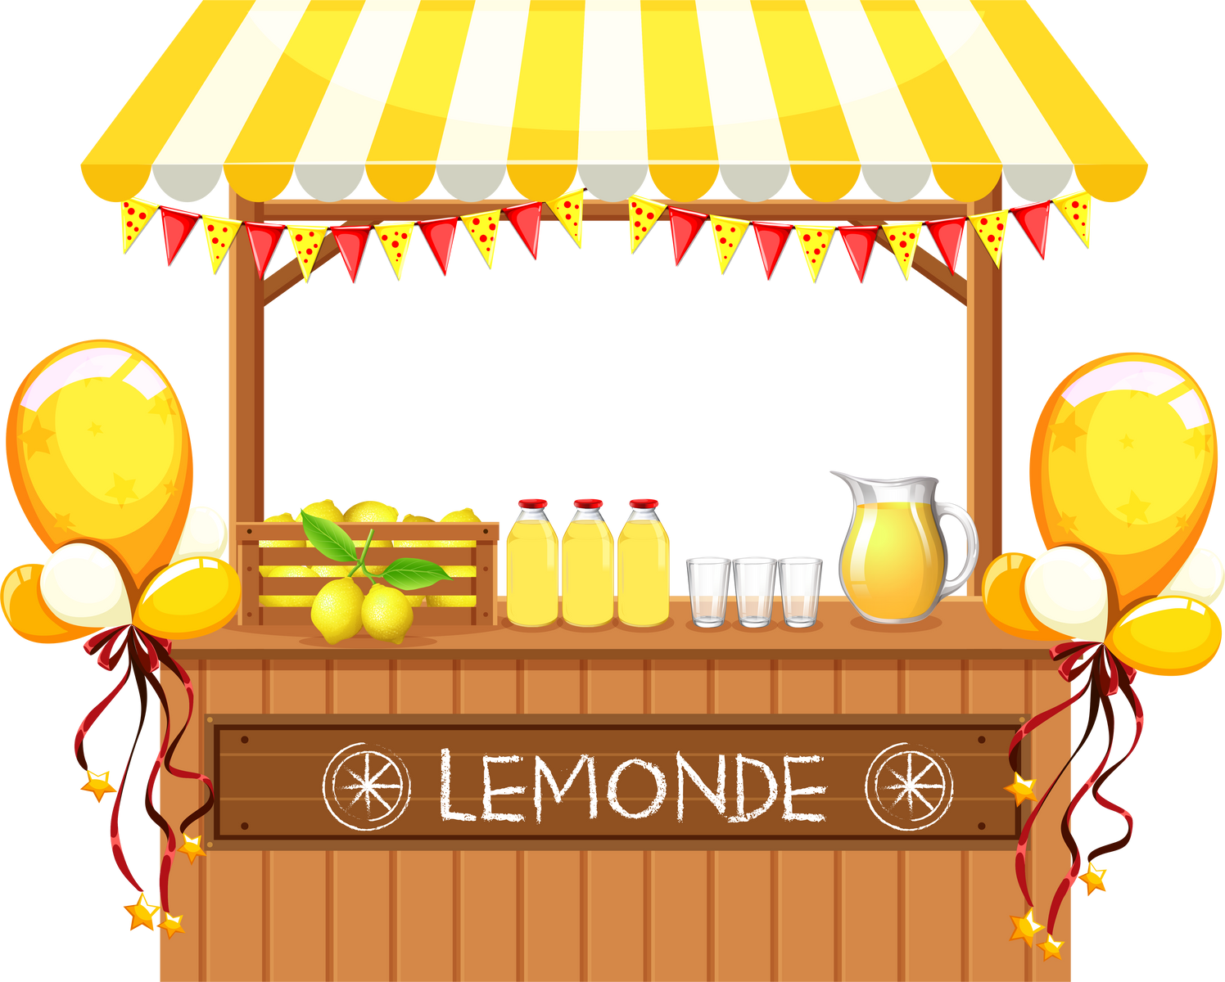
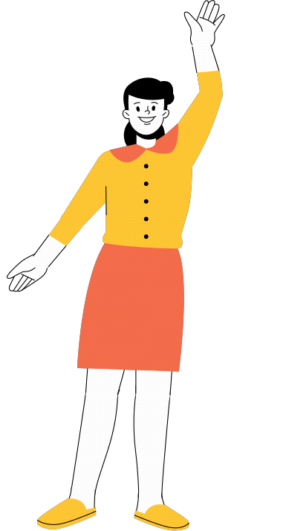
You leave the big top tent and see a woman at a lemonade stand giving away free lemonade to those willing to squeeze their own lemons. You walk over and get a glass ready for fresh lemon juice. The person hands you two bright yellow lemons, one in each hand. Squeeze the lemons as hard as you can to fill the glass. Squeeze all of the juice out. And relax. Your fingers and hands feel good, relaxed.
Too bad there is only half of a glass of juice. The person hands you two more lemons. Squeeze really hard to get all of the juice in the glass. Squeeze tight. Now relax. Your glass is full and your hands and fingers feel relaxed. The lemonade is delicious.

Slide 7
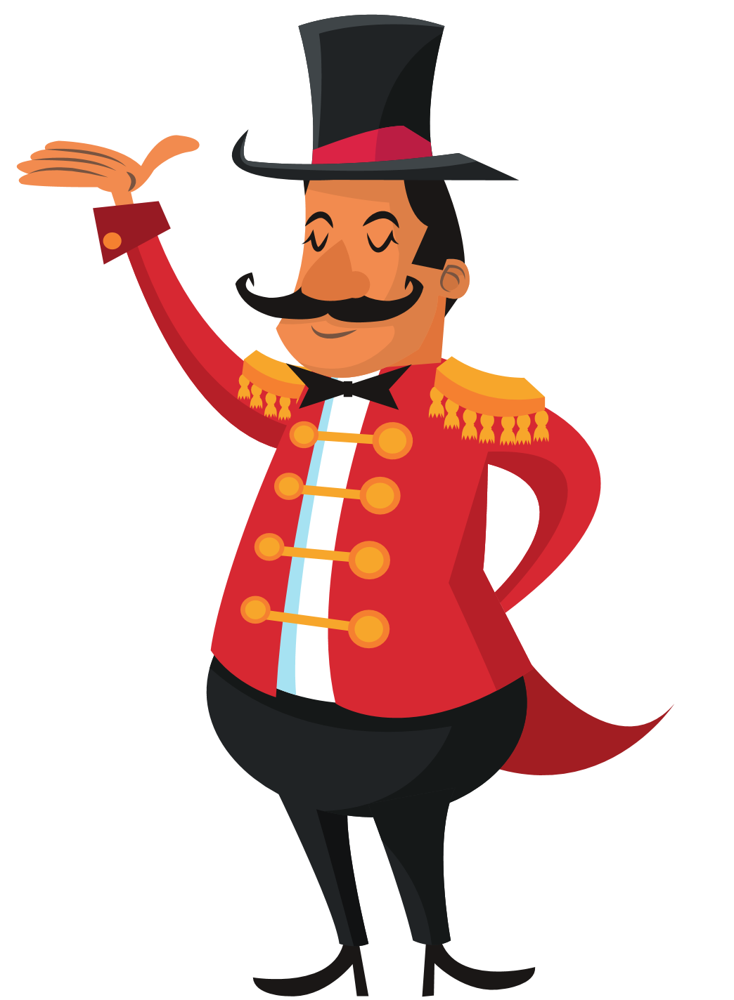
Nearby the lemonade stand is a stage with a sad looking man. You ask him why he is sad. He explains the strong man is late and the show cannot be advertised without someone showing off their strong muscles. The man asks if you could help and you say, “Yes.” You stand on the stage as he calls people to come look at the strongest person on Earth. Squeeze your arm muscles like a strongman! Make your arm muscles as big as you can. Hold it. Relax. Let your arms go loose to your side.
People are clapping and buying tickets for the show. The man is smiling and tells you to, again, show your strong muscles. Squeeze your arm muscles again, as big as you can. More people are applauding, which makes you squeeze those muscles even harder. And relax, letting your arms drop to your sides. The man is so happy.

Slide 8
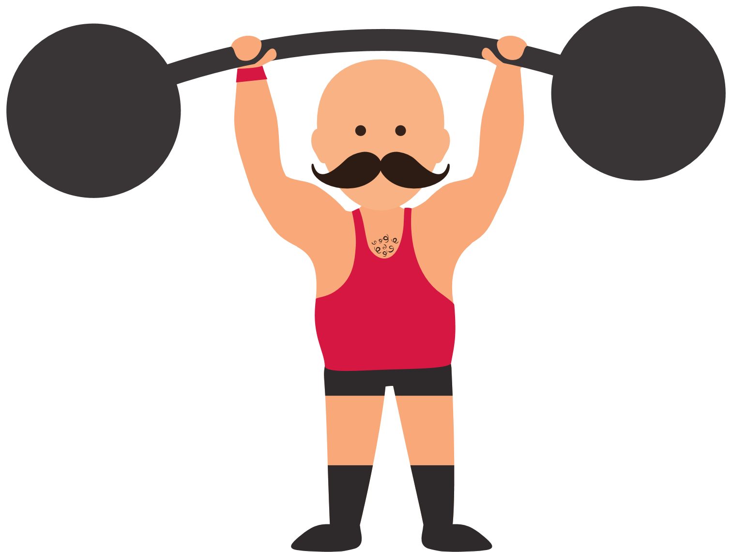
The strong man shows up just in time for his show to begin. He shakes your hand and thanks you for helping out. He picks up the man advertising the show and swings him around to enter the tent. You think quick to tuck your head like a turtle, tucking into it’s shell so you do not get hit! Try to touch your shoulders to your ears. Keep your head tucked in. Relax. That was a close call. Your shoulders feel so good after tucking your head.
Someone whistles behind you and the strong man turns quickly around, still with the man in his arms. Quick, tuck your head down again! Hold your head down like a turtle. Hold it, hold it. The strong man turns back around, swinging the man one last time over your head. You can relax now. Notice how good your shoulders feel after tensing and relaxing.

Slide 9

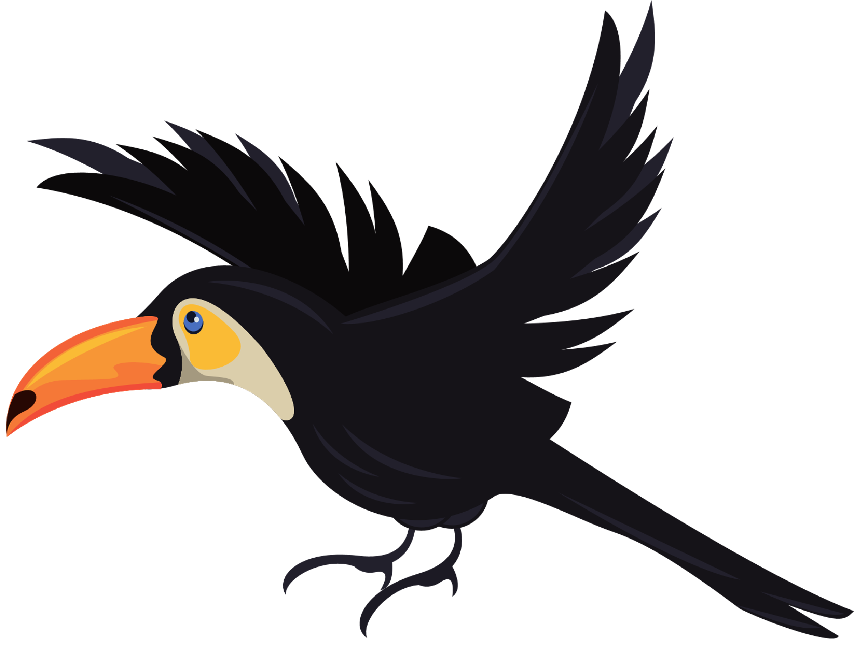
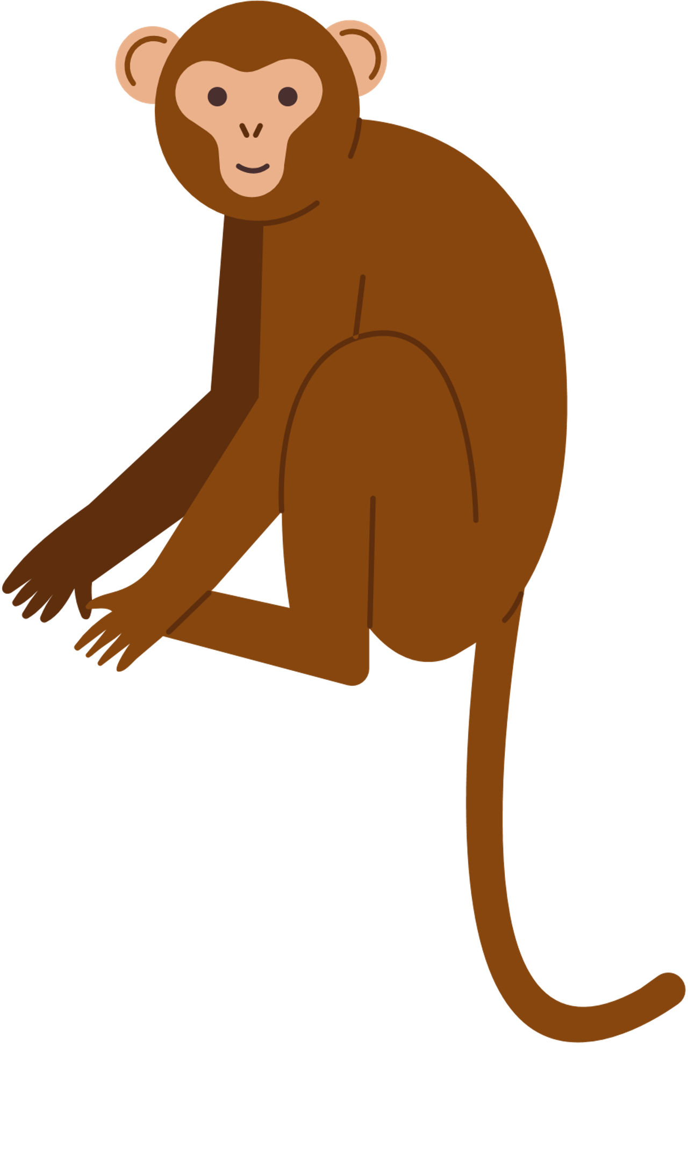
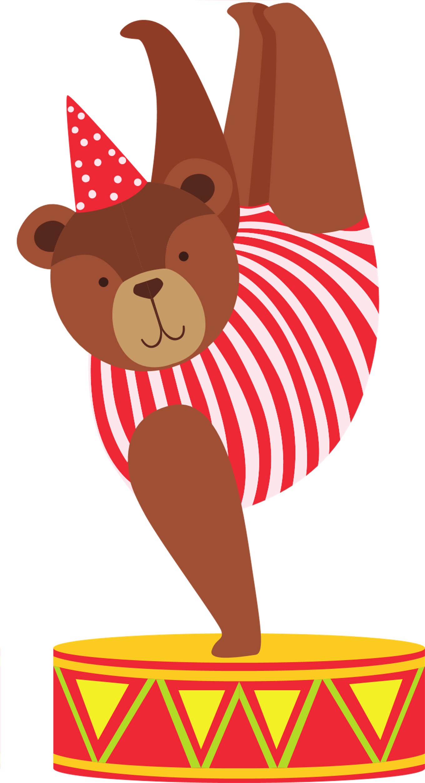

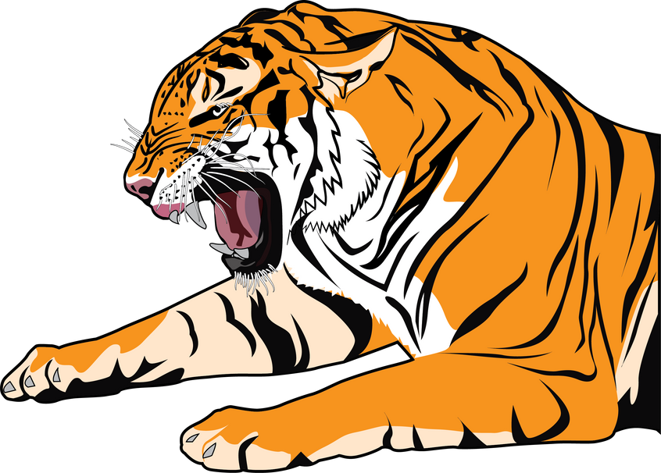
You walk away from the strong man show to look at all of the very interesting things at the carnival. Just ahead is a menagerie of animals. The biggest one of all is a big orange and black stripped tiger. The tiger looks at you and makes the biggest yawn you have ever seen. Wow, that’s a big yawn. Now all of the animals are yawning. Just when you think the yawning is done, you yawn really big. S-t-r-e-t-c-h your mouth with a BIG yawn like tiger. Hold it open as wide as you can. Relax and let your mouth come back together. That felt good.
The tiger yawns again and your join. Open your mouth big like the yawing tiger. Feel you lips and cheeks stretch wide. Now relax. You are feeling so calm and relaxed.

Slide 10
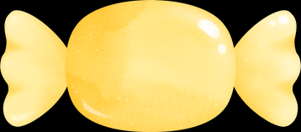
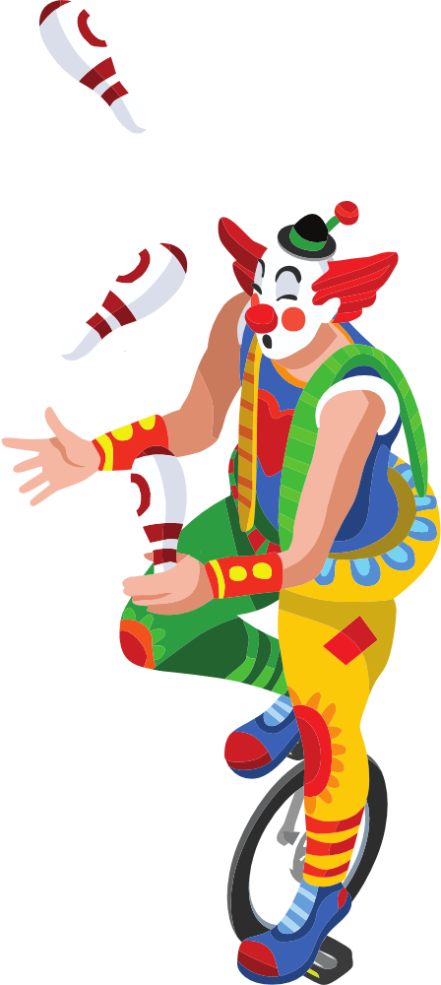
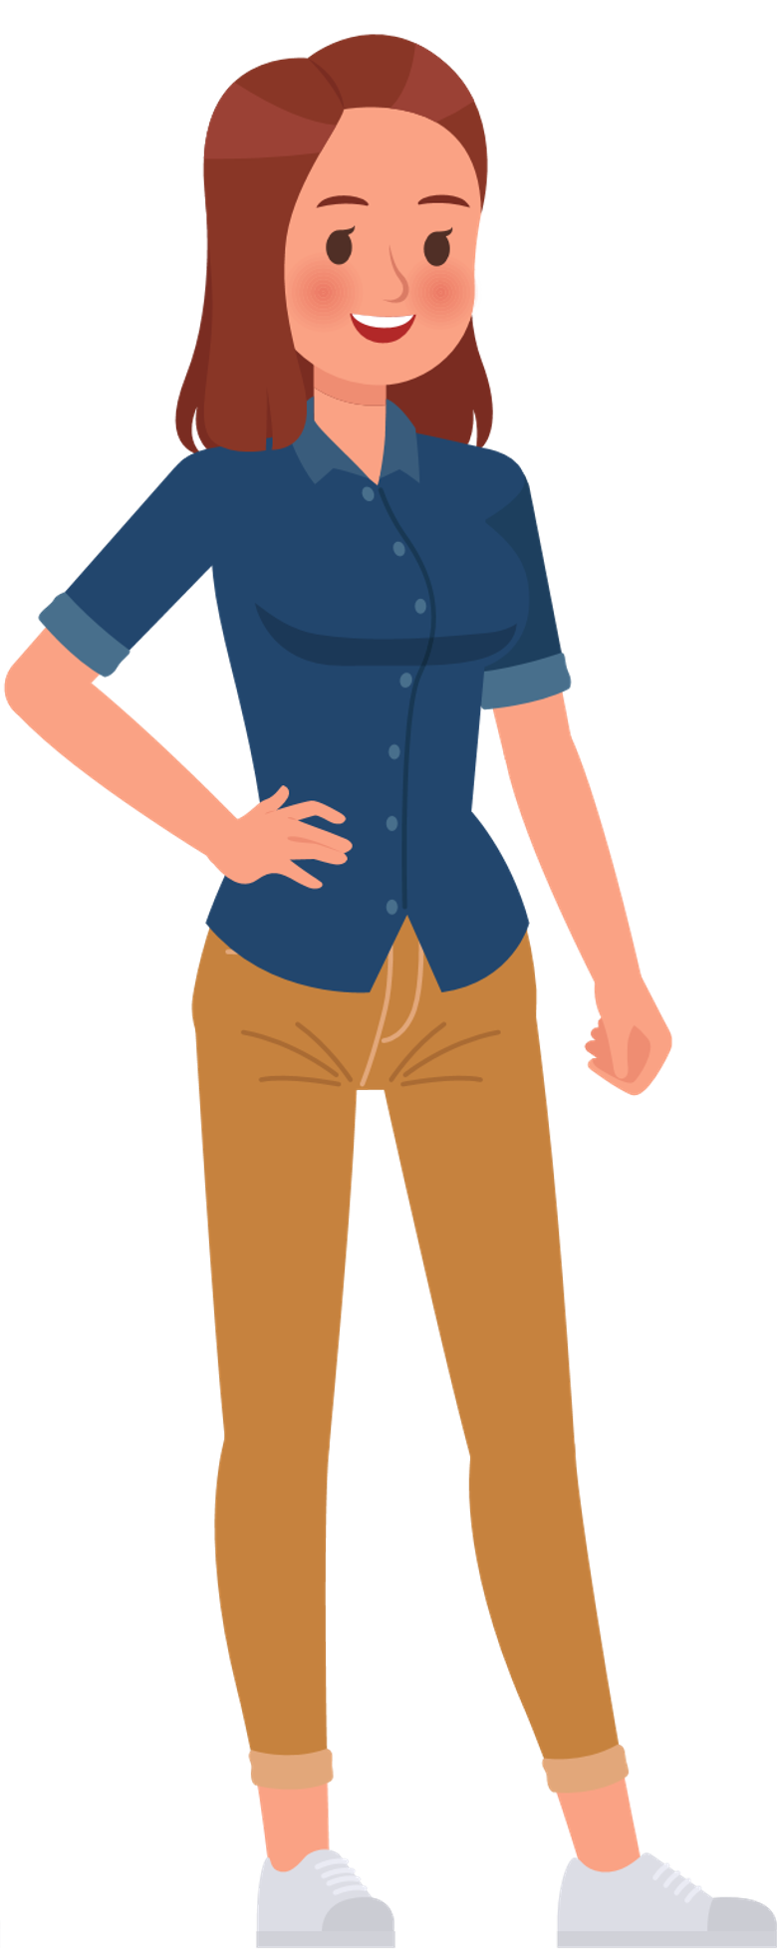
All of that yawning has made you a little hungry for something tasty. The lemonade stand is offering free candied lemons to carnival helpers and performers and you are offered one because you’ve helped so much. You put the lemon in your mouth and, wow, it is sour. Pucker your mouth like you just ate a VERY sour lemon. The more you pucker, the better it tastes. Now relax. Phew, that was a sour, but a tasty candied lemon.
It was so good you take a second one. Pucker up. Push your lips our and suck in your cheeks. Hold it for a few moments more. And relax. Your face is feeling more relaxed. You are feeling calmer.

Slide 11
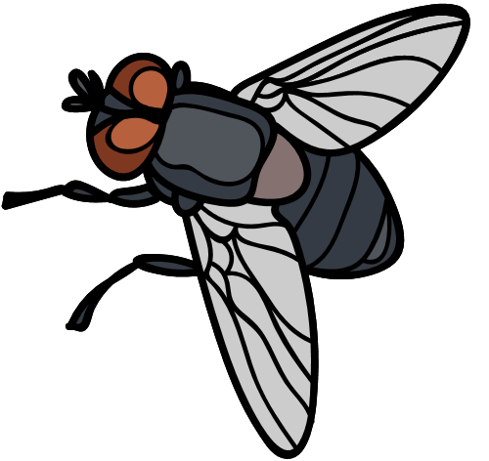
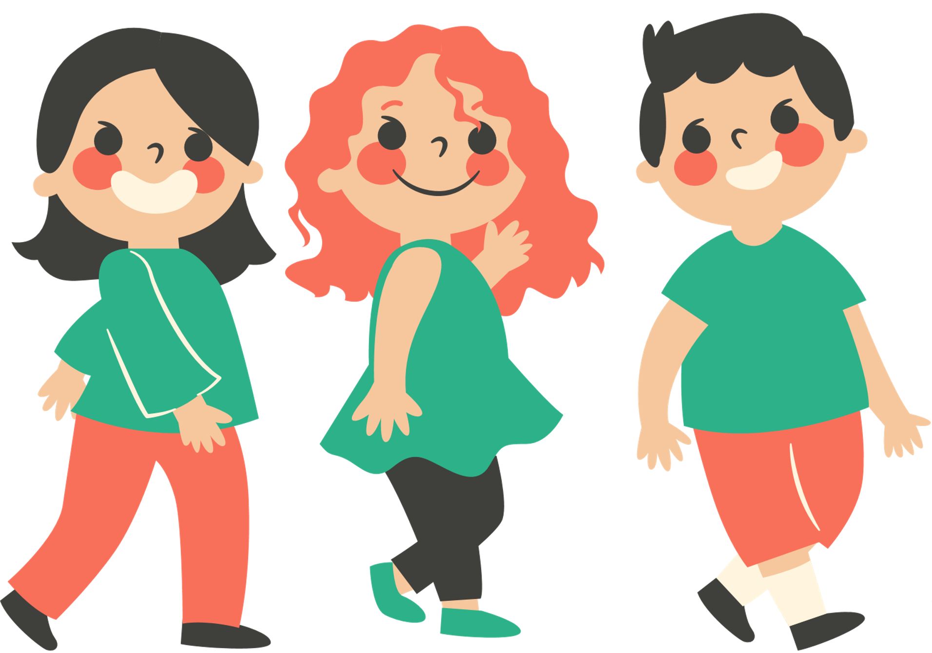
All of the candied lemons have attracted big flies that buzz around you. A fly lands on your nose and it tickles. Too bad your hands are covered with lemon juice and sugar, or else you could just swat the fly away. Oh well, you wrinkle your nose to make the fly go away! Wrinkle your nose as much as you can. Tight. The fly buzzes off and you can relax now. Your nose and face feel better relaxed.
Before you can find something to wipe your hands clean, the fly returns and lands on your nose, again. This time, wrinkle your nose and forehead as best you can. That should get the fly off your nose more quickly. Scrunch and wrinkle you nose and forehead. Do your best to get that fly off your nose. Hold it. Now relax. You did it! The fly takes off and you see a sink in which to wash your hands.

Slide 12

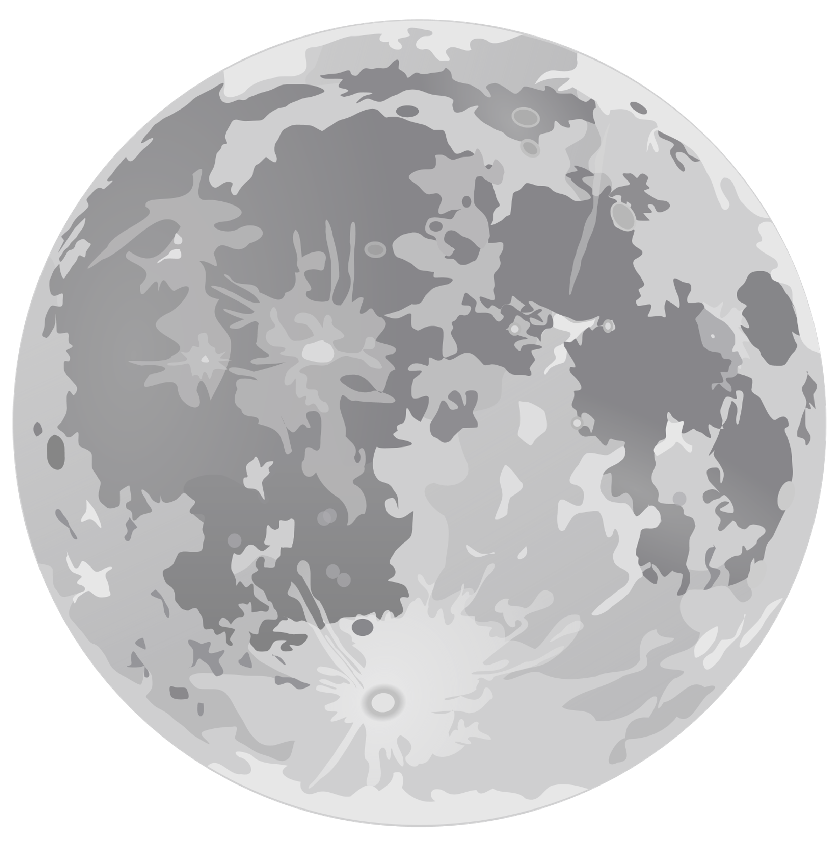
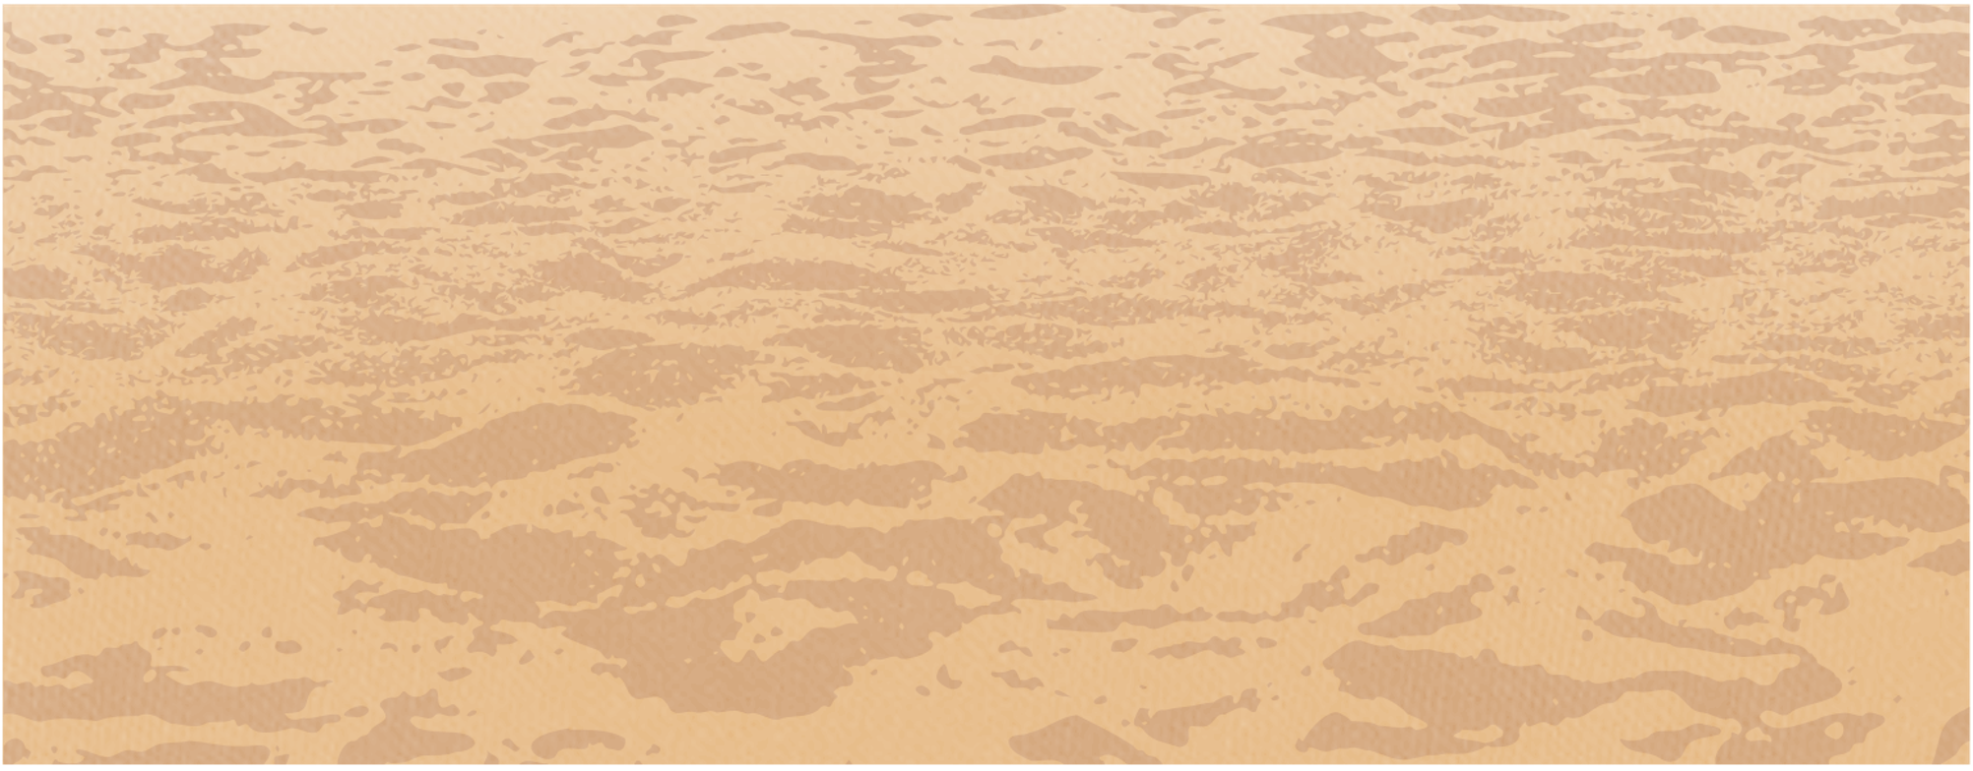
It’s been an interesting day for you at the carnival. You’ve done so much and feel so calm and relaxed that you decide to return where you started. Notice how your body feels relaxed, from the tips of your toes up your legs, across your stomach and up your arms and shoulders, and all the way up to the tip of your nose and top of your head. You feel good. You feel calm. It was a good time at the carnival. Stay seated and if your eyes are closed, slowly open them. Notice how your body feels. Are there muscles that feel more relaxed than others?
Remember which of the activities was most calming and relaxing to you. Maybe it was squeezing lemons to make lemonade, or maybe it was tucking your head down like a turtle. Using PMR will help you be calm when you have strong feelings, like mad, sad, scared, and even excited. Being calm will help you make helpful choices and stay out of trouble.

