Slide 1

My Story
Explanation of the Trauma Narrative

Slide 2
Instructions
Slides 2 – 6 review what defines a story, why kids write stories, and some quotes from kids that have finished their stories!
Slide 7 is clickable – have the client pick an emotion that they are feeling, and click on the icon. This will take you to a new slide where you can ask the client why they are feeling that way.
  Clients can pick more than one feeling! Click on the arrow on the bottom right hand corner to go back to the original screen.
Slides 15 – 19 will be completed by you and the client. Use in "Normal View" to add in text and draw.

Slide 3

What is a Story?
A story is something we make to talk about you and the bad or scary things that have happened in your life.
You can tell your story in different ways!
  Making a chapter book
  Coloring pictures
  Painting pictures

Slide 4

Why do I Write a Story?
Making a story will help you organize your memories and learn to take care of your big emotions.

Slide 5

Quotes from kids after completing their Trauma Narrative or Story:
  “I know what happened to me wasn’t my fault.”
  “I don’t think I’m a bad kid anymore.”
  “I feel happier now.”
  “It was hard at first, and then it got easier and easier.”
  “I’m excited about the future!”

Slide 6

What Questions do You Have?
These are common questions asked by kids just like you!
  Do I have to share my story with anyone?
  What happens with my story?
  What happens next in therapy after my story?

Slide 7
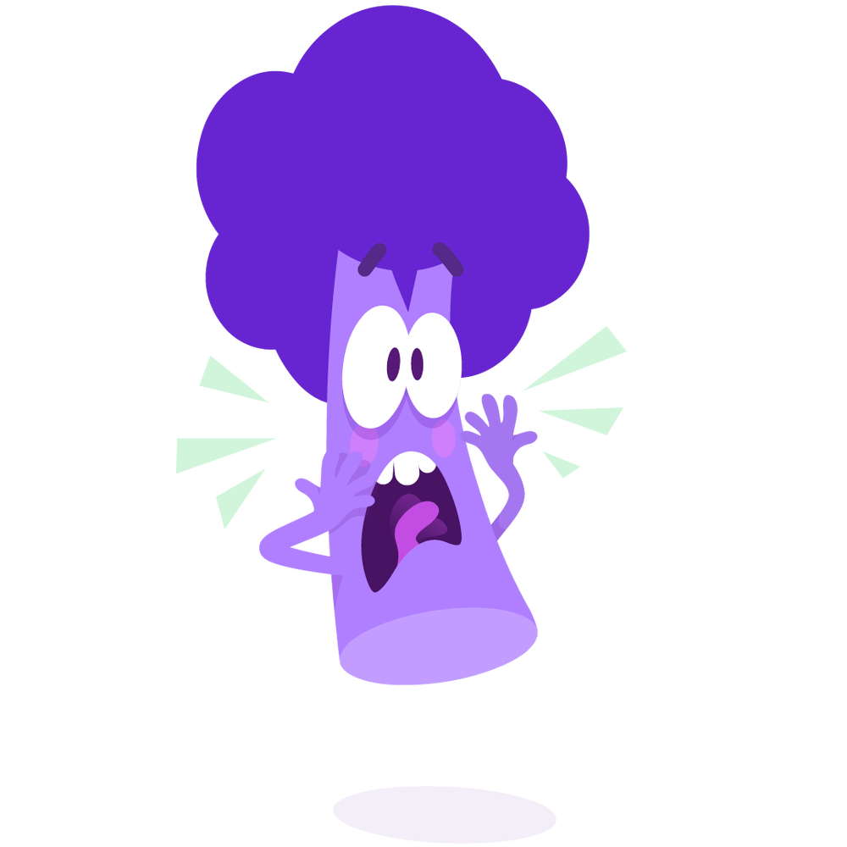
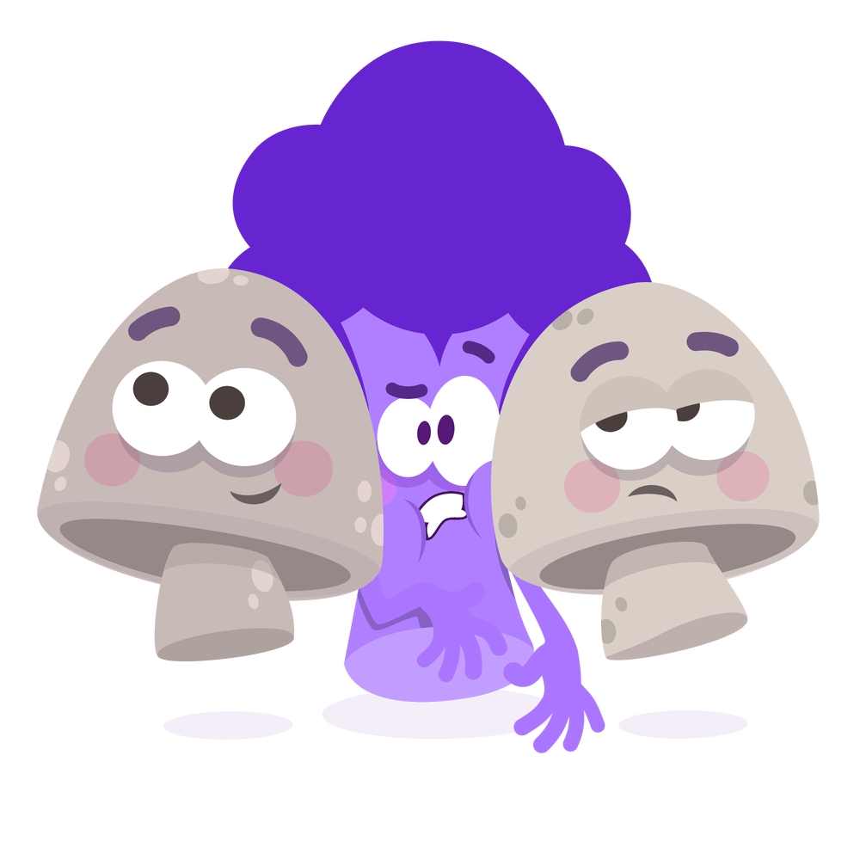

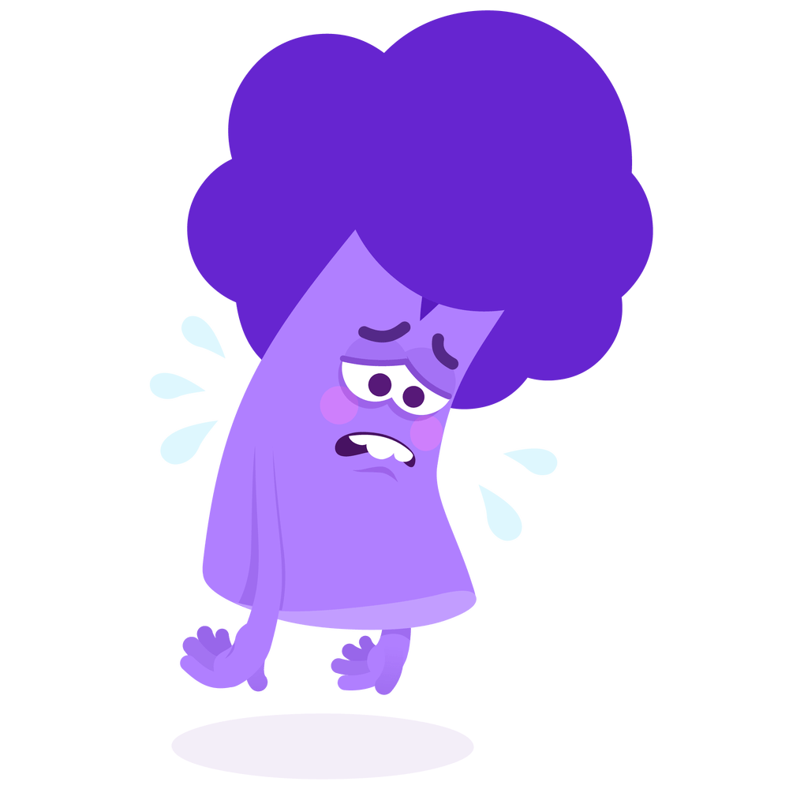

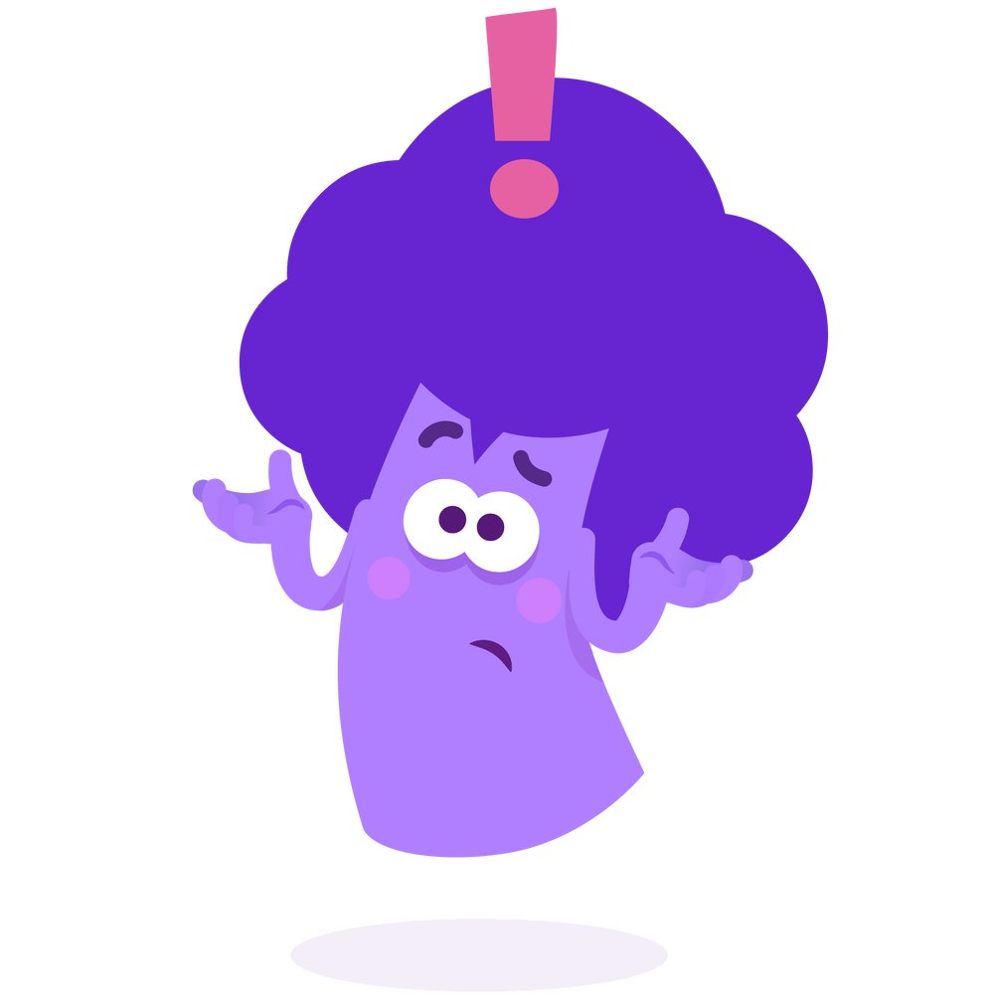
How do you feel about writing your Story?
Tip: Ask your therapist for a scale to RATE your feelings!
Calm
Scared
Nervous
Sad
?
Angry
Unsure
Other feeling

Slide 8
You are feeling CALM
Explain why you think you feel this way about writing your story:

Slide 9
You are feeling SCARED
Explain why you think you feel this way about writing your story:

Slide 10
You are feeling NERVOUS
Explain why you think you feel this way about writing your story:

Slide 11
You are feeling SAD
Explain why you think you feel this way about writing your story:

Slide 12
You are feeling ANGRY
Explain why you think you feel this way about writing your story:

Slide 13
You are feeling UNSURE
Explain why you think you feel this way about writing your story:

Slide 14
You are feeling ANOTHER FEELING
What do you think you are feeling?
Explain why you think you feel this way about writing your story:

Slide 15

Prepare to write your story.
Let’s pick relaxation skills that would be helpful for you when writing your story!

Slide 16


Who are your safe people?

Slide 17
Let’s pick some positive and helpful thoughts. Circle your favorites using the "Draw" tool.
I am brave
I am strong
I can do it
I can do hard things
I will feel better
I can heal from the trauma
I am not alone

Slide 18
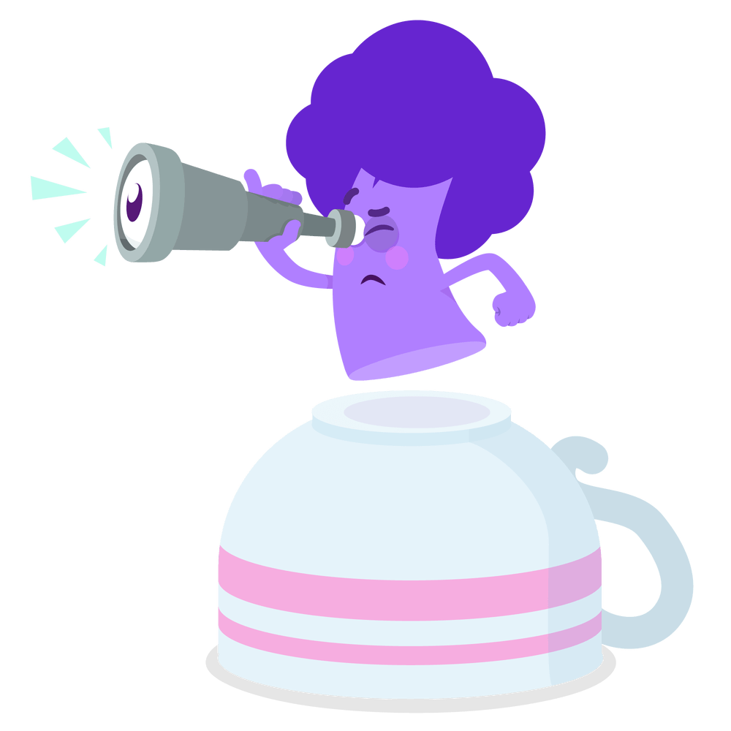
Any other questions?

Slide 19
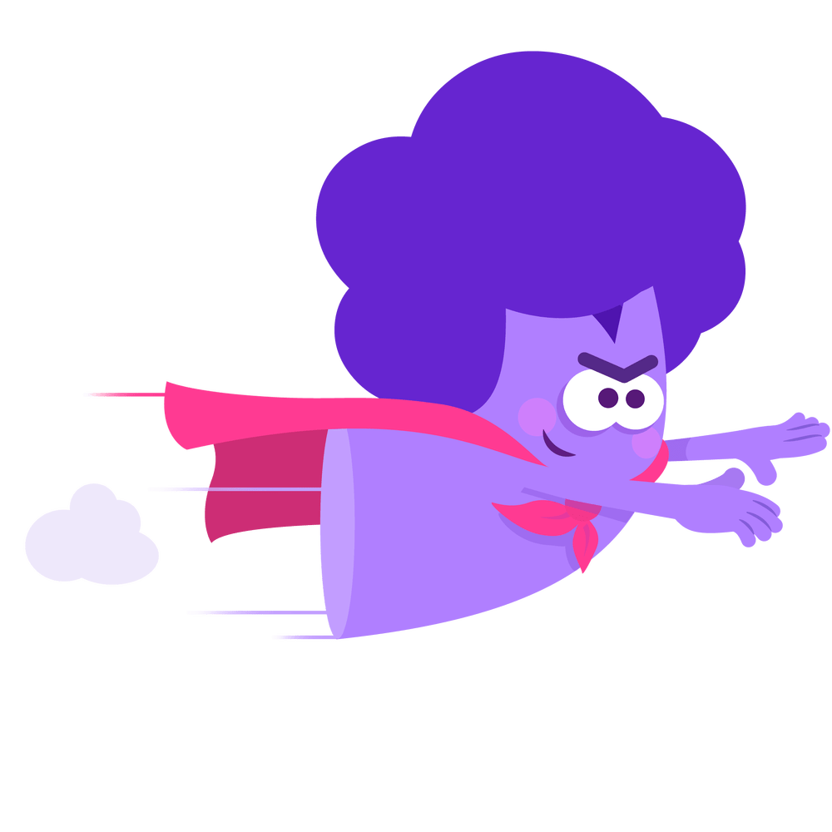
Would you want to start today or wait until next week?

