Slide 1
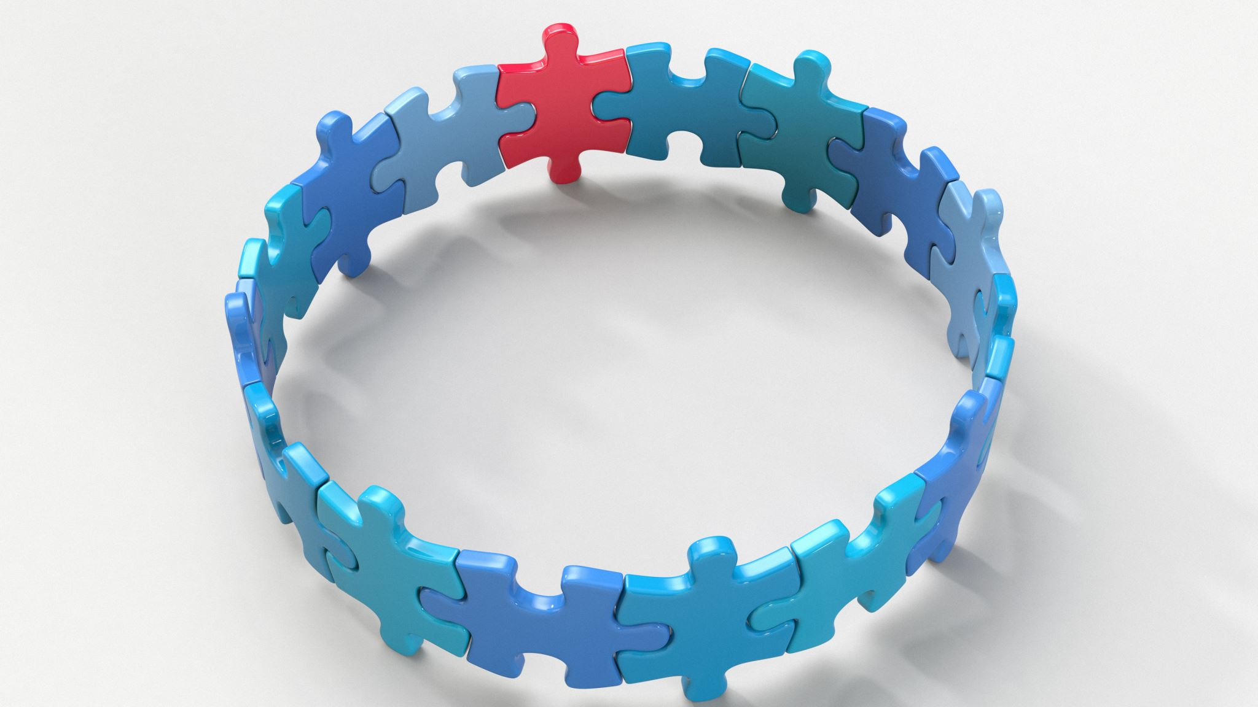
CIRCLE OF SUPPORT

Slide 2
Instructions
The purpose of this resource is to facilitate a conversation about various sources of social support the child has access to. You can help your client identify trusted adults and friends by asking questions like the following:
Who are some people in your life that will be there for you if you need help with something?
Who are some people in your life that you can talk to when you feel sad or upset?
Who are some people in your life that can almost always help you feel better if you are down?
Who are some people in your life you can trust to protect you?
Emphasize to the child that it is possible to have different levels of closeness / trust with different people. Utilize the inner circle for highly trusted adults or peers (e.g., family, best friends) and the outer circle for more distal supports (e.g., teachers).
Use the “text box” function to add the people your patient lists to their corresponding circles.

Slide 3
Coworker
Best friend
ME
Mom
Brother
Dad

Slide 4
ME

