Slide 1

Cognitive distortions
Trivia

Slide 2

This is a Jeopardy style game. If used in individual sessions, the client and therapist will take turns (a)picking a category, and(b) giving a personal example.
If used in group sessions, group members will take turns picking categories and giving examples.
After examples are shared, click the to return to the home screen to pick another category.
INSTRUCTIONS

Slide 3
Cognitive Distortion Trivia
Mind reading | Predicting the future | Catastrophizing
Negative filter | Overgeneralizing | Labeling
Discounting the positive | All-or-nothing thinking | Shoulds
Personalizing | Feelings Are facts | Unfair comparisons

Slide 4

Mind Reading:
Believing you know what others are thinking about you – without any proof
“He thinks I’m an idiot.”
“I’m not going to make the team.”

Slide 5

An example from your life:

Slide 6

Predicting the future:
Thinking that you already know that bad things are going to happen in the future
“If I try, I will Fail. Then, people will make fun of me.”
“If I say how I feel, no one will care or do anything anyway.”

Slide 7

An example from your life:
This Photo by Unknown Author is licensed under CC BY-SA-NC

Slide 8

Catastrophizing: believing what might happen will be so awful that you won’t be able to stand it
“If I make a bad grade, then I will never get into a good college or have a successful life.”

Slide 9

An example from your life:

Slide 10

Negative filter:
Focusing almost exclusively on all the negatives and seldom noticing the positives
“Look at all the terrible things on the news.”
“Girls never have anything nice to say.”

Slide 11

An example from your life:

Slide 12

Overgeneralizing:
Thinking that just because something happened once, it will always continue to happen; Using words like “never” or “always”
“I fail all the time.”
“Nothing ever works out for me.”
This Photo by Unknown Author is licensed under CC BY

Slide 13

An example from your life:
Bad

Slide 14

Labeling: assigning general negative traits to yourself and others
“I’m a burden.”
“He’s horrible.”
"she's a loser."
I’m disgusting.

Slide 15
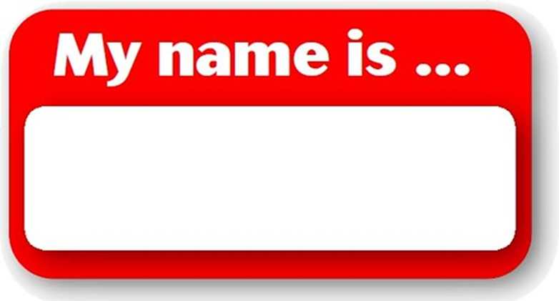
An Example from your life:
Stupid

Slide 16

Discounting the positive:
Claiming that the positives that you or others have don’t matter
“That’s what she was supposed to do, so it doesn’t count.”
“Those successes were easy. Who even cares?”

Slide 17

An example from your life:
NEGATIVE

Slide 18

All-or-nothing thinking: viewing events or people in all-or-nothing/black-or-white terms
“It was a complete waste of time.”
“I get rejected by everyone.”
“Nothing ever goes my way.”
"If I'm not Perfect, I've Failed."

Slide 19
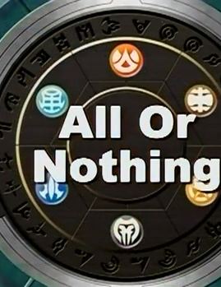
An example from Your life:

Slide 20

Shoulds:
Telling yourself things should be a certain way-- and if they’re not, Feeling Sad, guilty, annoyed, or angry
“my life shouldn't be like this."
"They should have known how I would feel."

Slide 21
An example from your life:

Slide 22
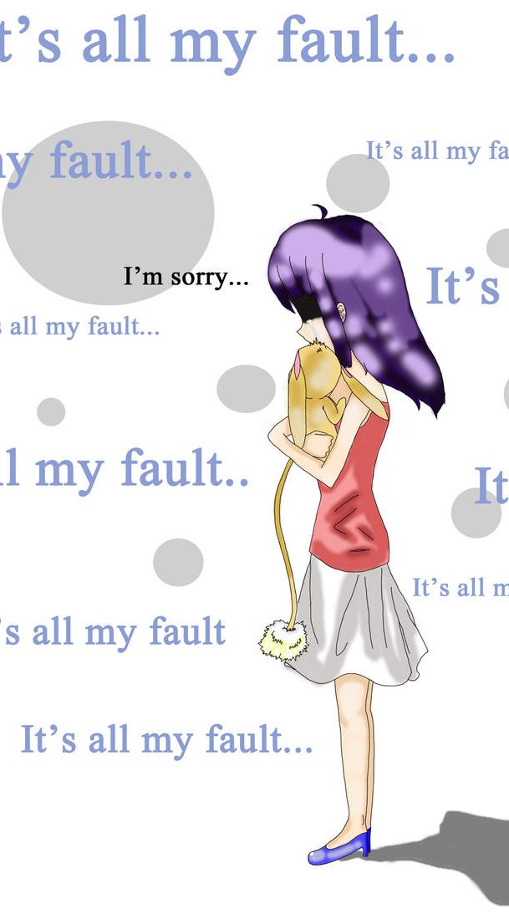
Personalizing:
Believing that things are your fault, even if they had nothing to do with you
“My relationship ended because I wasn’t fun enough.”
“It was my fault my group got a bad grade.”
"My friend seems upset. I must have done something. I need to make them feel better."
This Photo by Unknown Author is licensed under CC BY-SA-NC

Slide 23
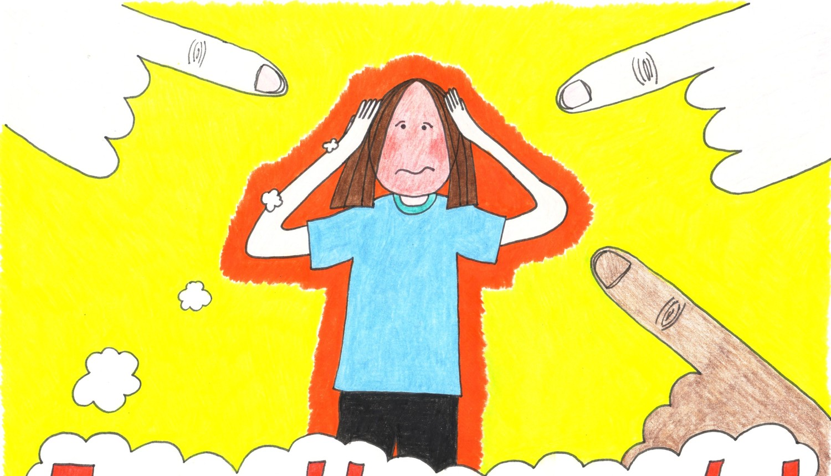
An example from your life:

Slide 24

Feelings Are Facts:
Thinking that the way you feel means that what you are thinking has to be true
“I feel embarrassed. people at school are all talking about me.”
“I feel anxious about this. I'm in danger.”
"I Feel mad. everyone treated me unfairly."

Slide 25
An example from your life:

Slide 26

Unfair comparisons: interpreting events in terms of standards that are unrealistic
“I Don't look like them.”
“Other people my age are more successful than I am.”

Slide 27
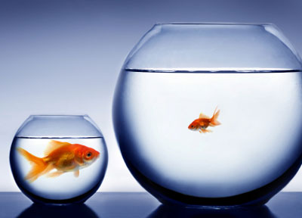
An example from your life:

