Slide 1
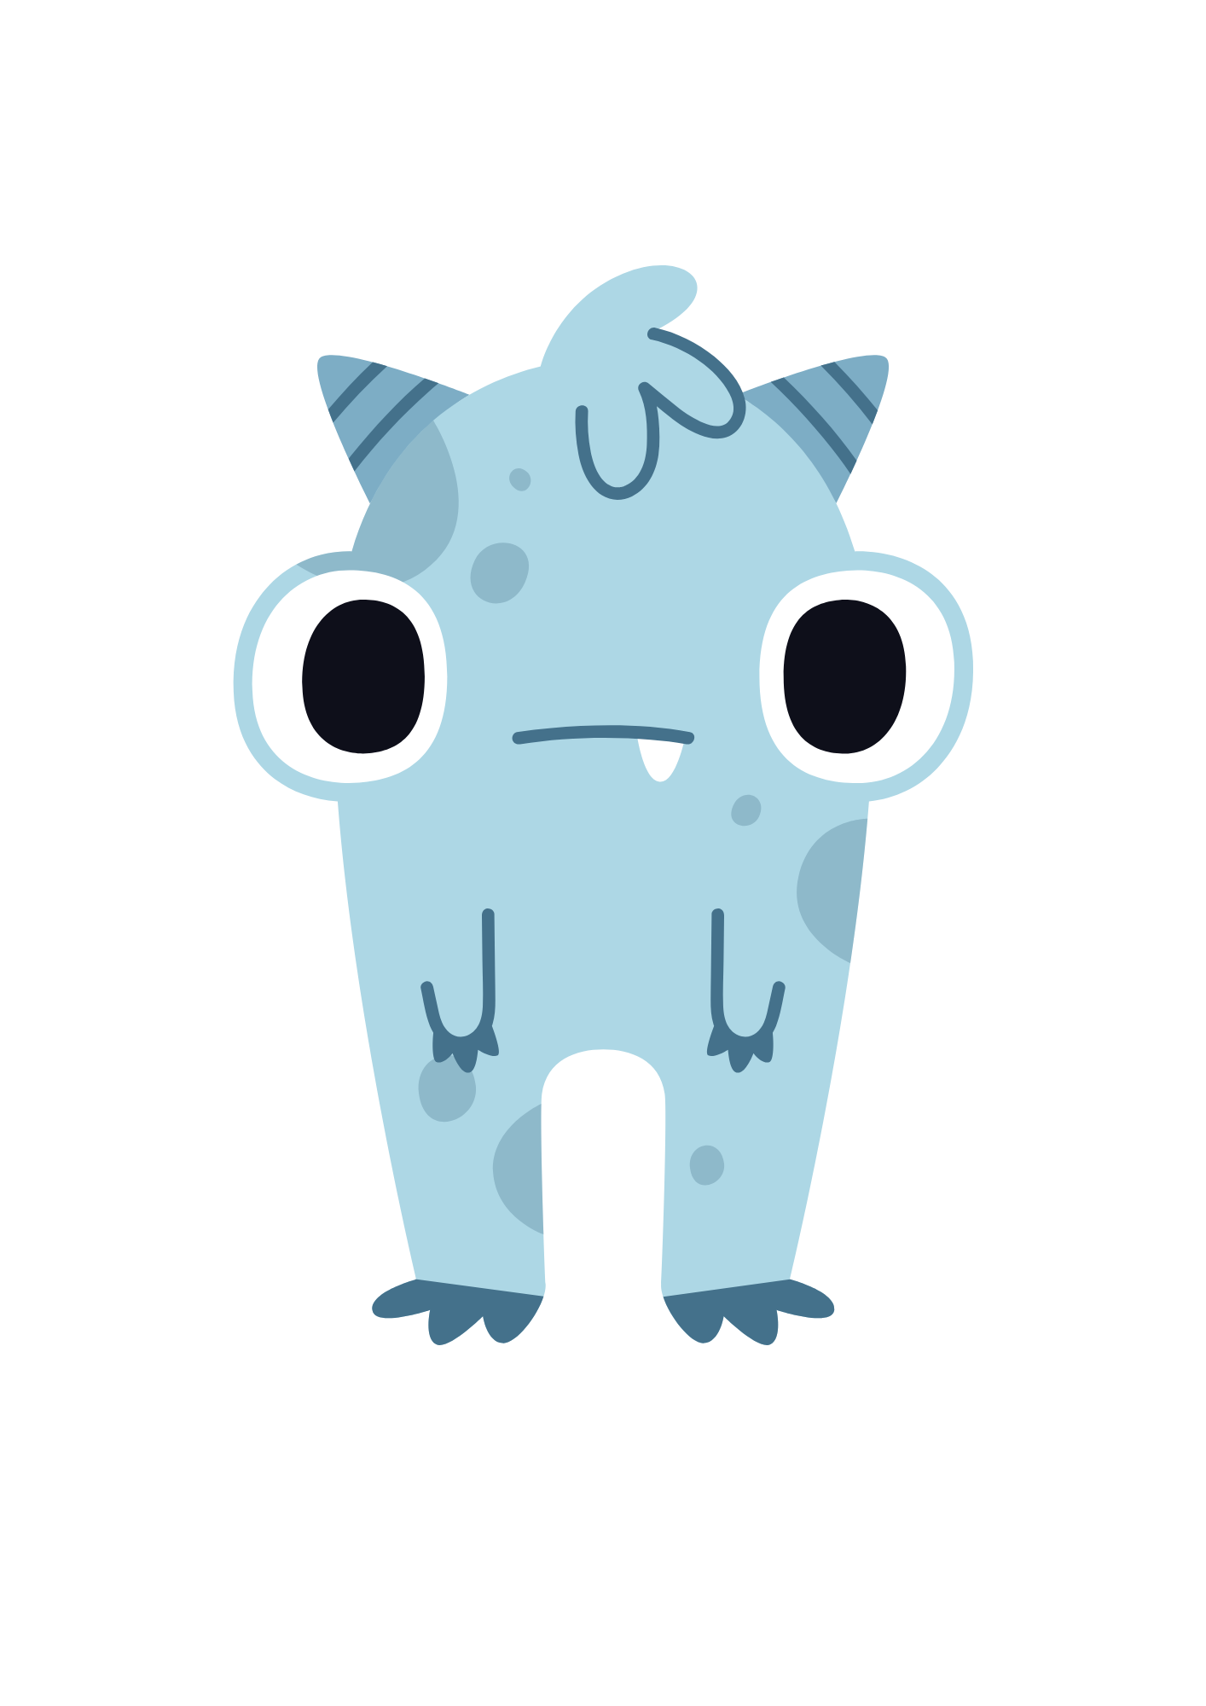
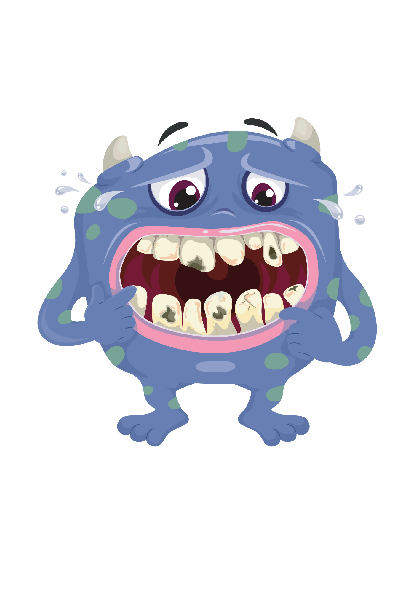
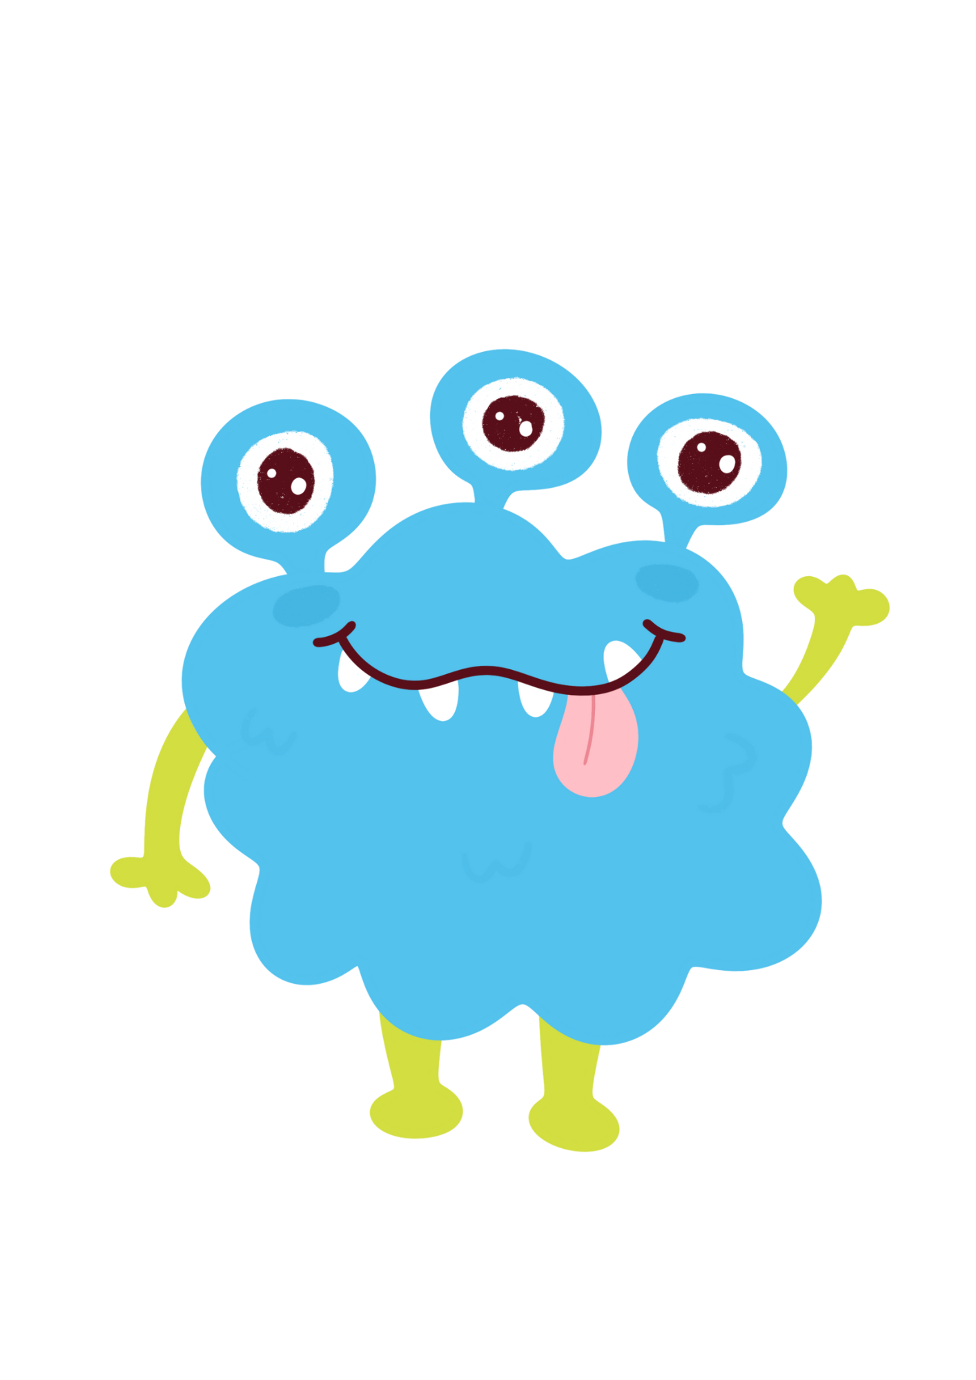

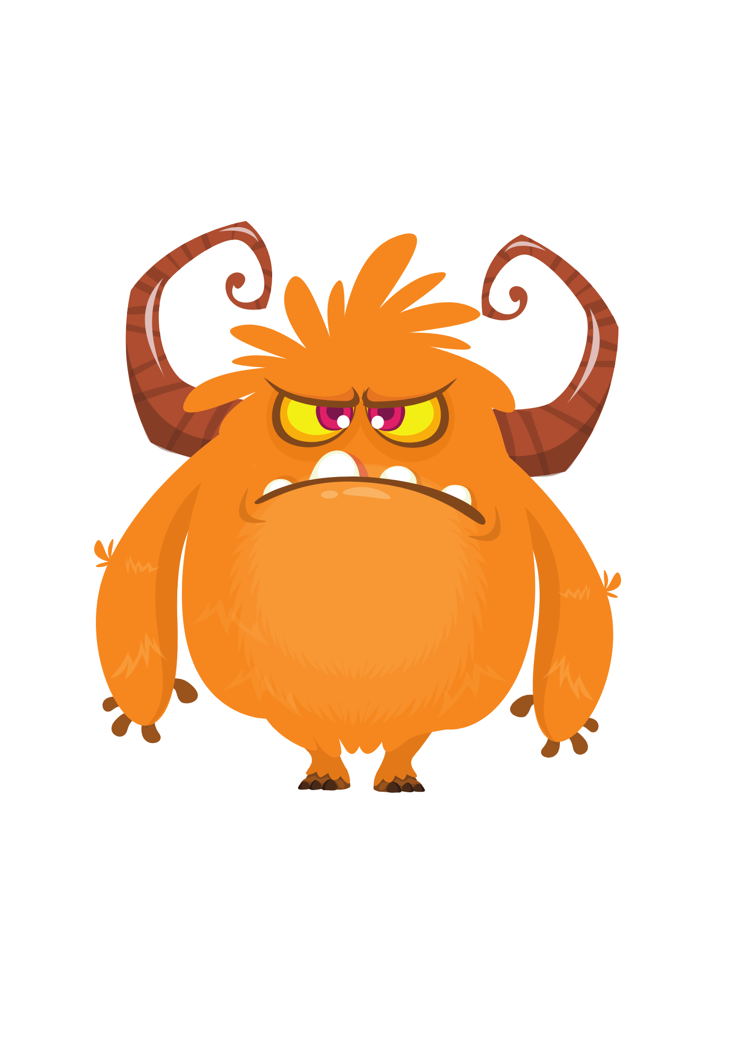
FEELINGS

Slide 2
Instructions
This ppt can be used in normal mode (not slide show mode) which will enable the user to type in the text, move the arrows, etc.
Or
It can be used in Slide show mode with the annotate features in your video platform

Slide 3
Make a List of all the feeling words you can think of in 30 seconds.

Slide 4
Match the color with the feeling
(Grab the arrows and match the feeling words to the color that represents them)
Angry
Calm
Happy
Bored
Frustrated
Scared
Silly
Sad

Slide 5

WHAT COLOR ARE YOU FEELING TODAY?
Use the Annotate feature to add the color you are feeling.
Colors can sometimes feel like emotions. Think of how you are feeling right now and what color it feels like.

Slide 6

















Let’s Match
Emotions can also be like the weather; they change over time, and they can change quickly. Look at the weather outside. Do your emotions match?
OUTSIDE WEATHER
Sunny | Stormy | Windy | Frosty | Calm
HOW I’M FEELING
Happy | Sad | Scared | Angry | Silly
Place a * on the image that represents the weather outside.
Place a ~ on the images that represent what you are feeling.

Slide 7
Mixed Emotions
It is very common to have more than one emotion at a time, and sometimes those emotions may even feel opposite of each other. For instance, a kid can be happy that their parent got a new job, but sad that it means they need to move away from friends to a new city. On the next page, circle all the emotions you feel when you think of the bad thing that happened.

Slide 8




Pleased
Glad
Relieved
Happy
Discouraged
Disappointed
Blue
Heavy-Hearted
Inadequate
Sad
Loved
Encouraged
Loving
Delighted
Defeated
Ashamed
Sorrowful
Down-in-the-Dumps
Fortunate
Affectionate
Content
Peaceful
Caring
Understood
Thankful
Friendly
Guilty
Sorry
Remorseful
Regretful
Sympathetic
Confident
Relaxed
Left-Out
Hurt
Lonely
Rejected
Sure
Hopeful
Interested
Optimistic
Pessimistic
Abandoned
Miserable
Depressed
Excited
Amazed
Gloomy
Appreciated
Proud
Hopeless
Anguished
Embarrassed
Self-Conscious
Uneasy
Aggravated
Dissatisfied
Frustrated
Pressured
Stressed
Surprised
Defiant
Determined
Fed-up
Shocked
Concerned
Suspicious
Wary
Resentful
Bitter
Stubborn
Mad
Anxious
Afraid
Nervous
Worried
Envious
Jealous
Defensive
Offended
Indignant
Outraged
Irritated
Exasperated
Apprehensive
Scared
Insecure
Annoyed
Disgusted
Furious
Angry
Mixed-Up
Confused
Uncertain
Enraged
Hostile
Displeased
Disapproving
Timid
Shy

Slide 9
Color your heart
Next, fill in the heart with how much you
feel those feelings. If you are mad
a lot, then use a lot of that color to
fill in the heart. Do the same for all feelings.
Pick your 5 most common feelings.
Use the annotate feature to type in
Your feelings, then add a color in the circle
to represent them.
New employees & anniversaries

Slide 10
Color your heart
Does your heart look different when you think of the bad thing that happened? Color your heart to represent how you feel when you think about what happened.
Add your 5 most common feelings.
Use the annotate feature to type in your
feelings, then add a color in the circle
to represent them.
New employees & anniversaries

Slide 11

WHERE IN YOUR BODY DO YOU FEEL FEELINGS?
Pick your 5 most common feelings.
Use the annotate feature to type in your
feelings. Then, add a color in the circle
to represent them.

Slide 12
How Big are your feelings?
Ask your therapist to pull the color up to the number you feel today.
How do you feel when you think about the bad thing that happened?
10
9
8
7
6
5
4
3
2
1
10
9
8
7
6
5
4
3
2
1
10
9
8
7
6
5
4
3
2
1
10
9
8
7
6
5
4
3
2
1
10
9
8
7
6
5
4
3
2
1

Slide 13
Sad
What are my thoughts?
What are my actions?

Slide 14
Silly
What are my thoughts?
What are my actions?

Slide 15
Angry
What are my thoughts?
What are my actions?

Slide 16
Happy
What are my thoughts?
What are my actions?

Slide 17
Scared
What are my thoughts?
What are my actions?

Slide 18
What is the Difference between a 1 vs a 10?
1
10
Feelings
Happy
Thoughts
Actions
Feelings
Angry
Thoughts
Actions
Feelings
Sad
Thoughts
Actions

Slide 19
Do you need different things to help you at 1 vs a 10?
What I need at a 1 | What I need at a 10

Slide 20
Make a list of coping skills you could use when you have big feelings
1.
2.
3.
4.
5.
20

