Slide 1
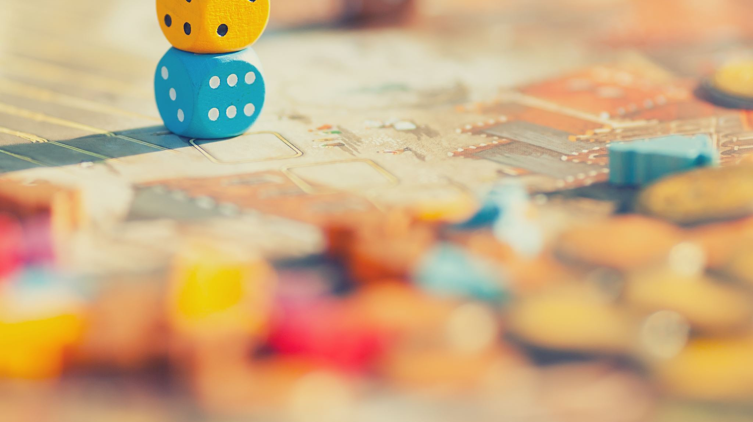
Getting To Know You Game

Slide 2
Instructions for this Resource
This PowerPoint contains a game that can be used to get to know your clients.
To play, put your PowerPoint in “presentation mode," share your screen with your client, and go to slide 2- which contains a table with the numbers 1 to 12.
Explain to your client that the purpose of the game is to get to know more about them and for them to also get to know you better.
Take turns with your client selecting numbers and responding to questions.
When selecting a number, it is important to click on the numbers themselves, rather than simply clicking in the cell where they are.
Feel free to adapt this resource to include your own questions!

Slide 3
Getting to Know You Game
1 | 2 | 3
4 | 5 | 6
7 | 8 | 9
10 | 11 | 12

Slide 4
Tell me a food you like to eat
BACK

Slide 5
Tell me something you like to watch or listen to
BACK

Slide 6
Tell me your favorite game
BACK
Resource created by the Telehealth Outreach Program

Slide 7
Tell me something that happened yesterday
BACK

Slide 8
Tell me something you learned recently
BACK

Slide 9
Tell me something you do well
BACK

Slide 10
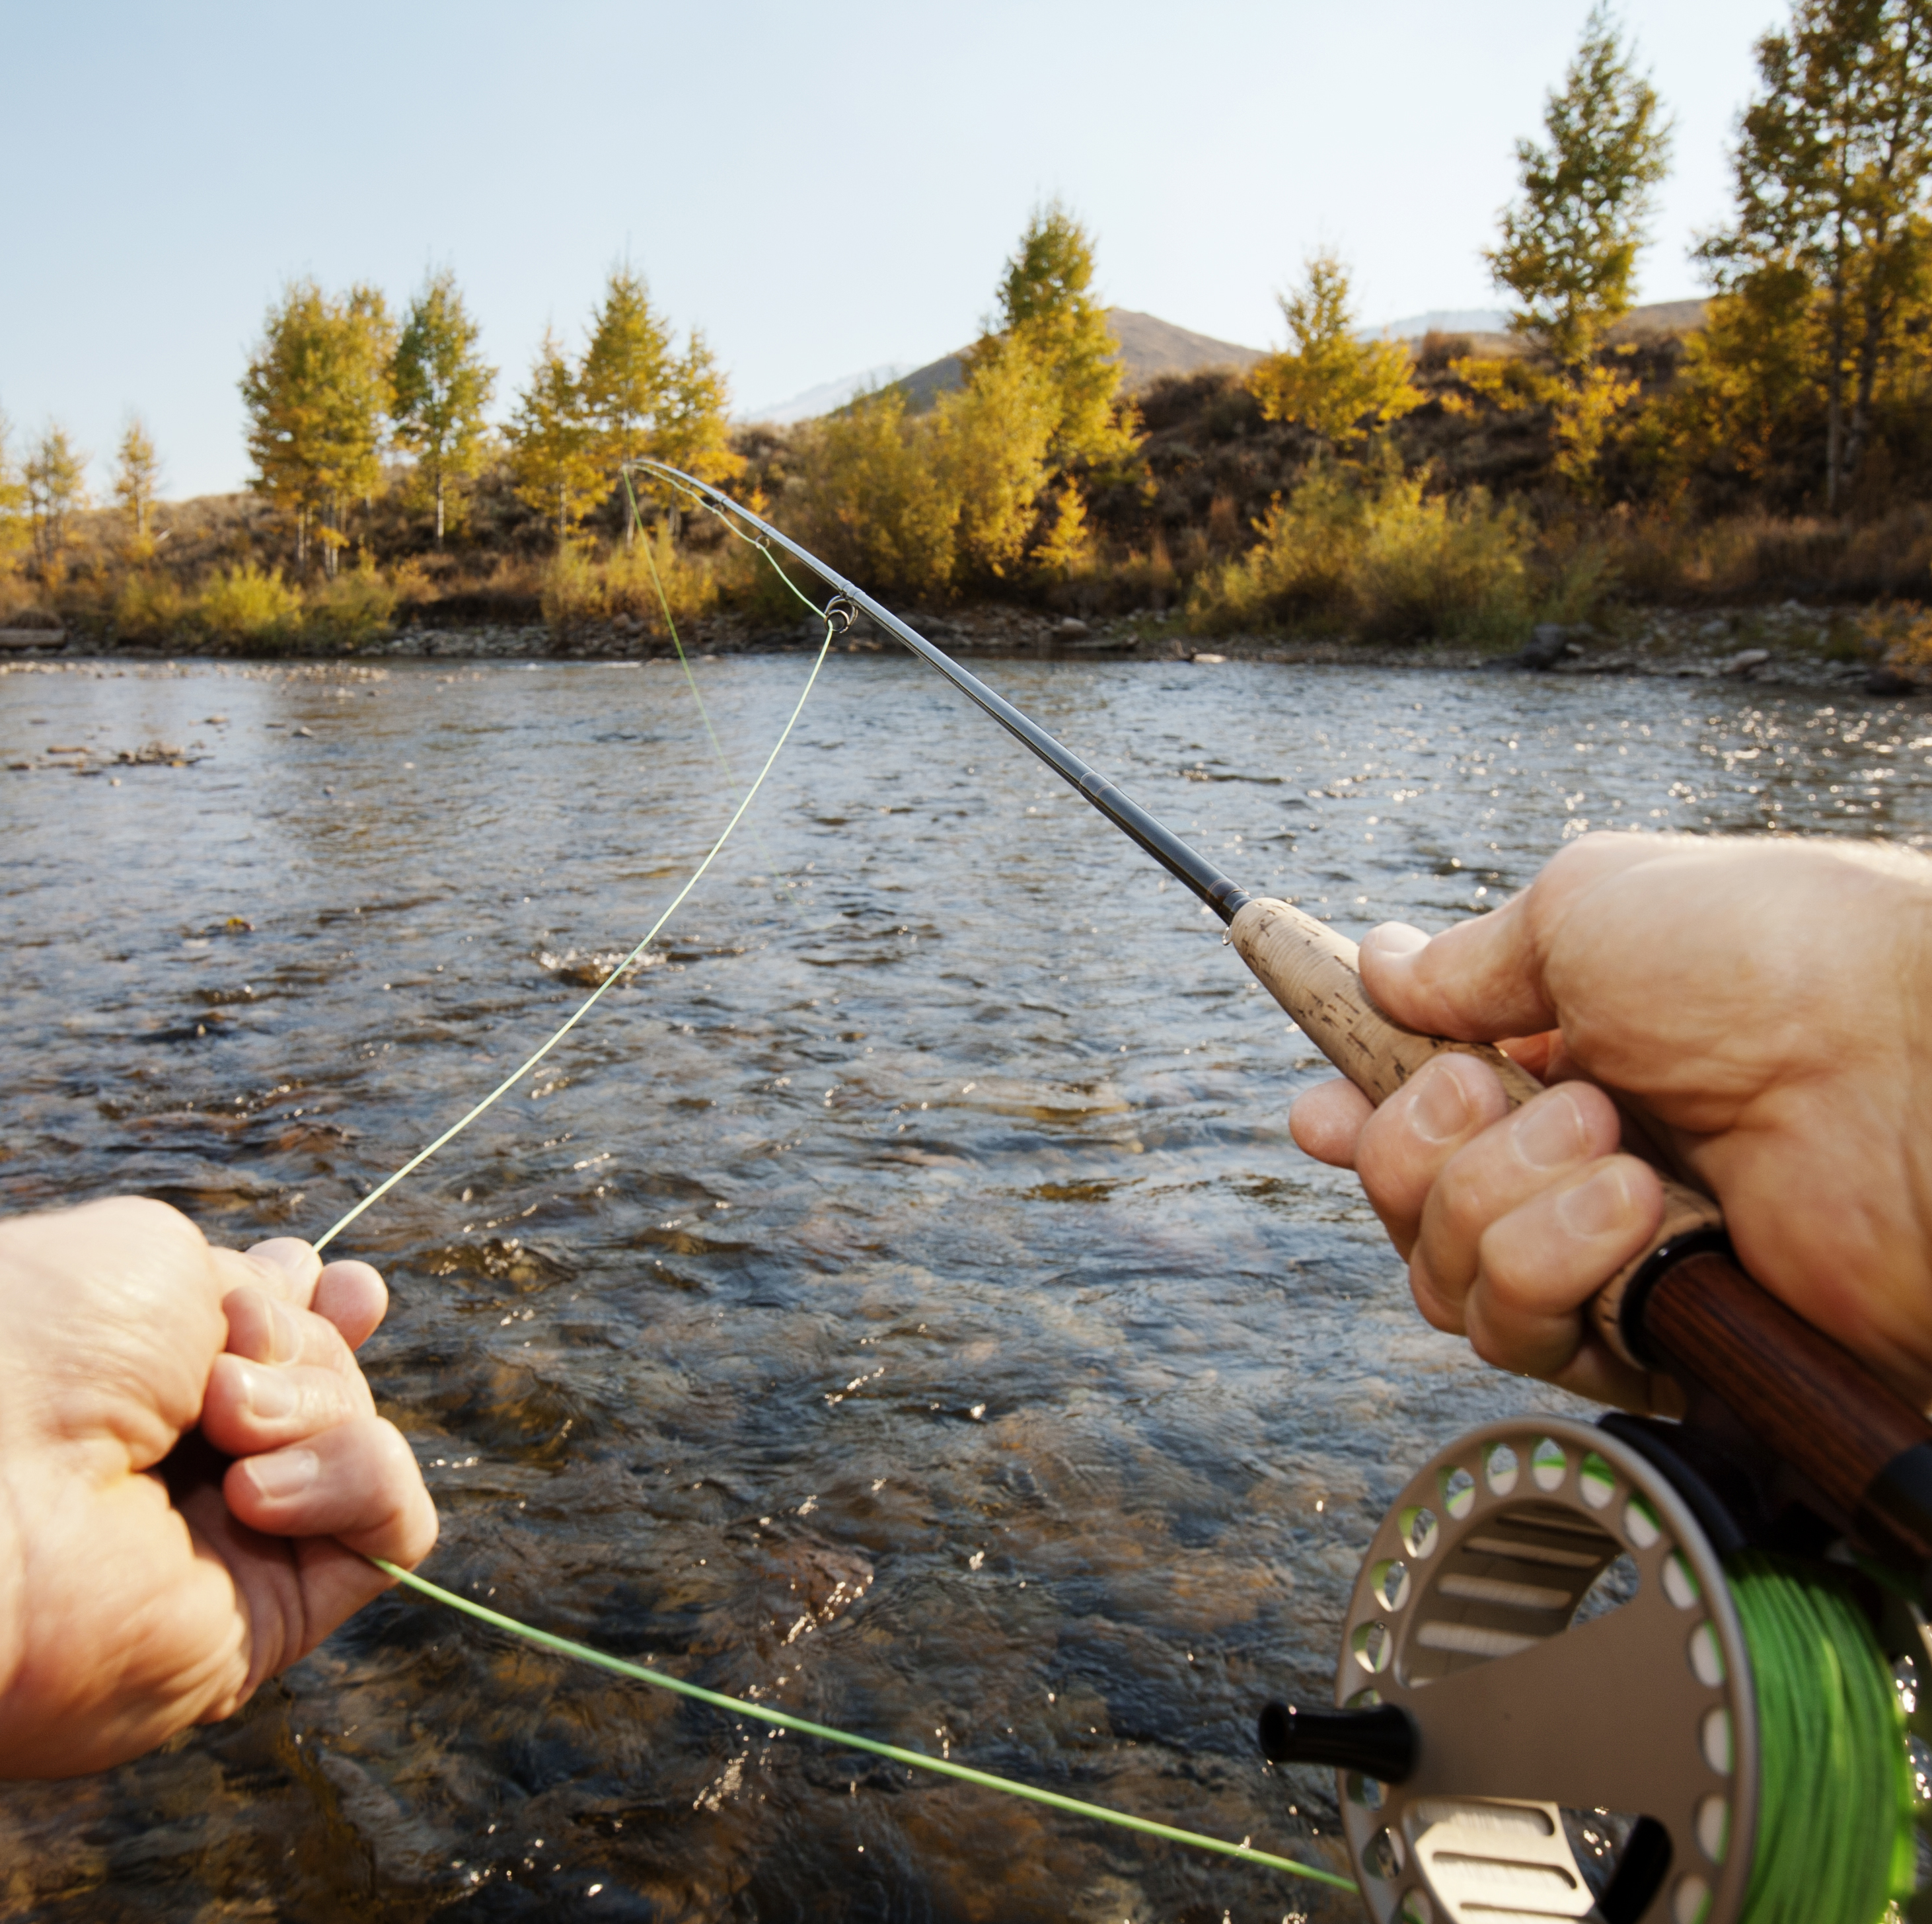
Tell me something you like to do for fun
BACK

Slide 11
Tell me something you can’t live without
BACK

Slide 12
Tell me how you celebrated your last birthday
BACK

Slide 13
Tell me your favorite color
BACK

Slide 14
Tell me your favorite movie
BACK

Slide 15
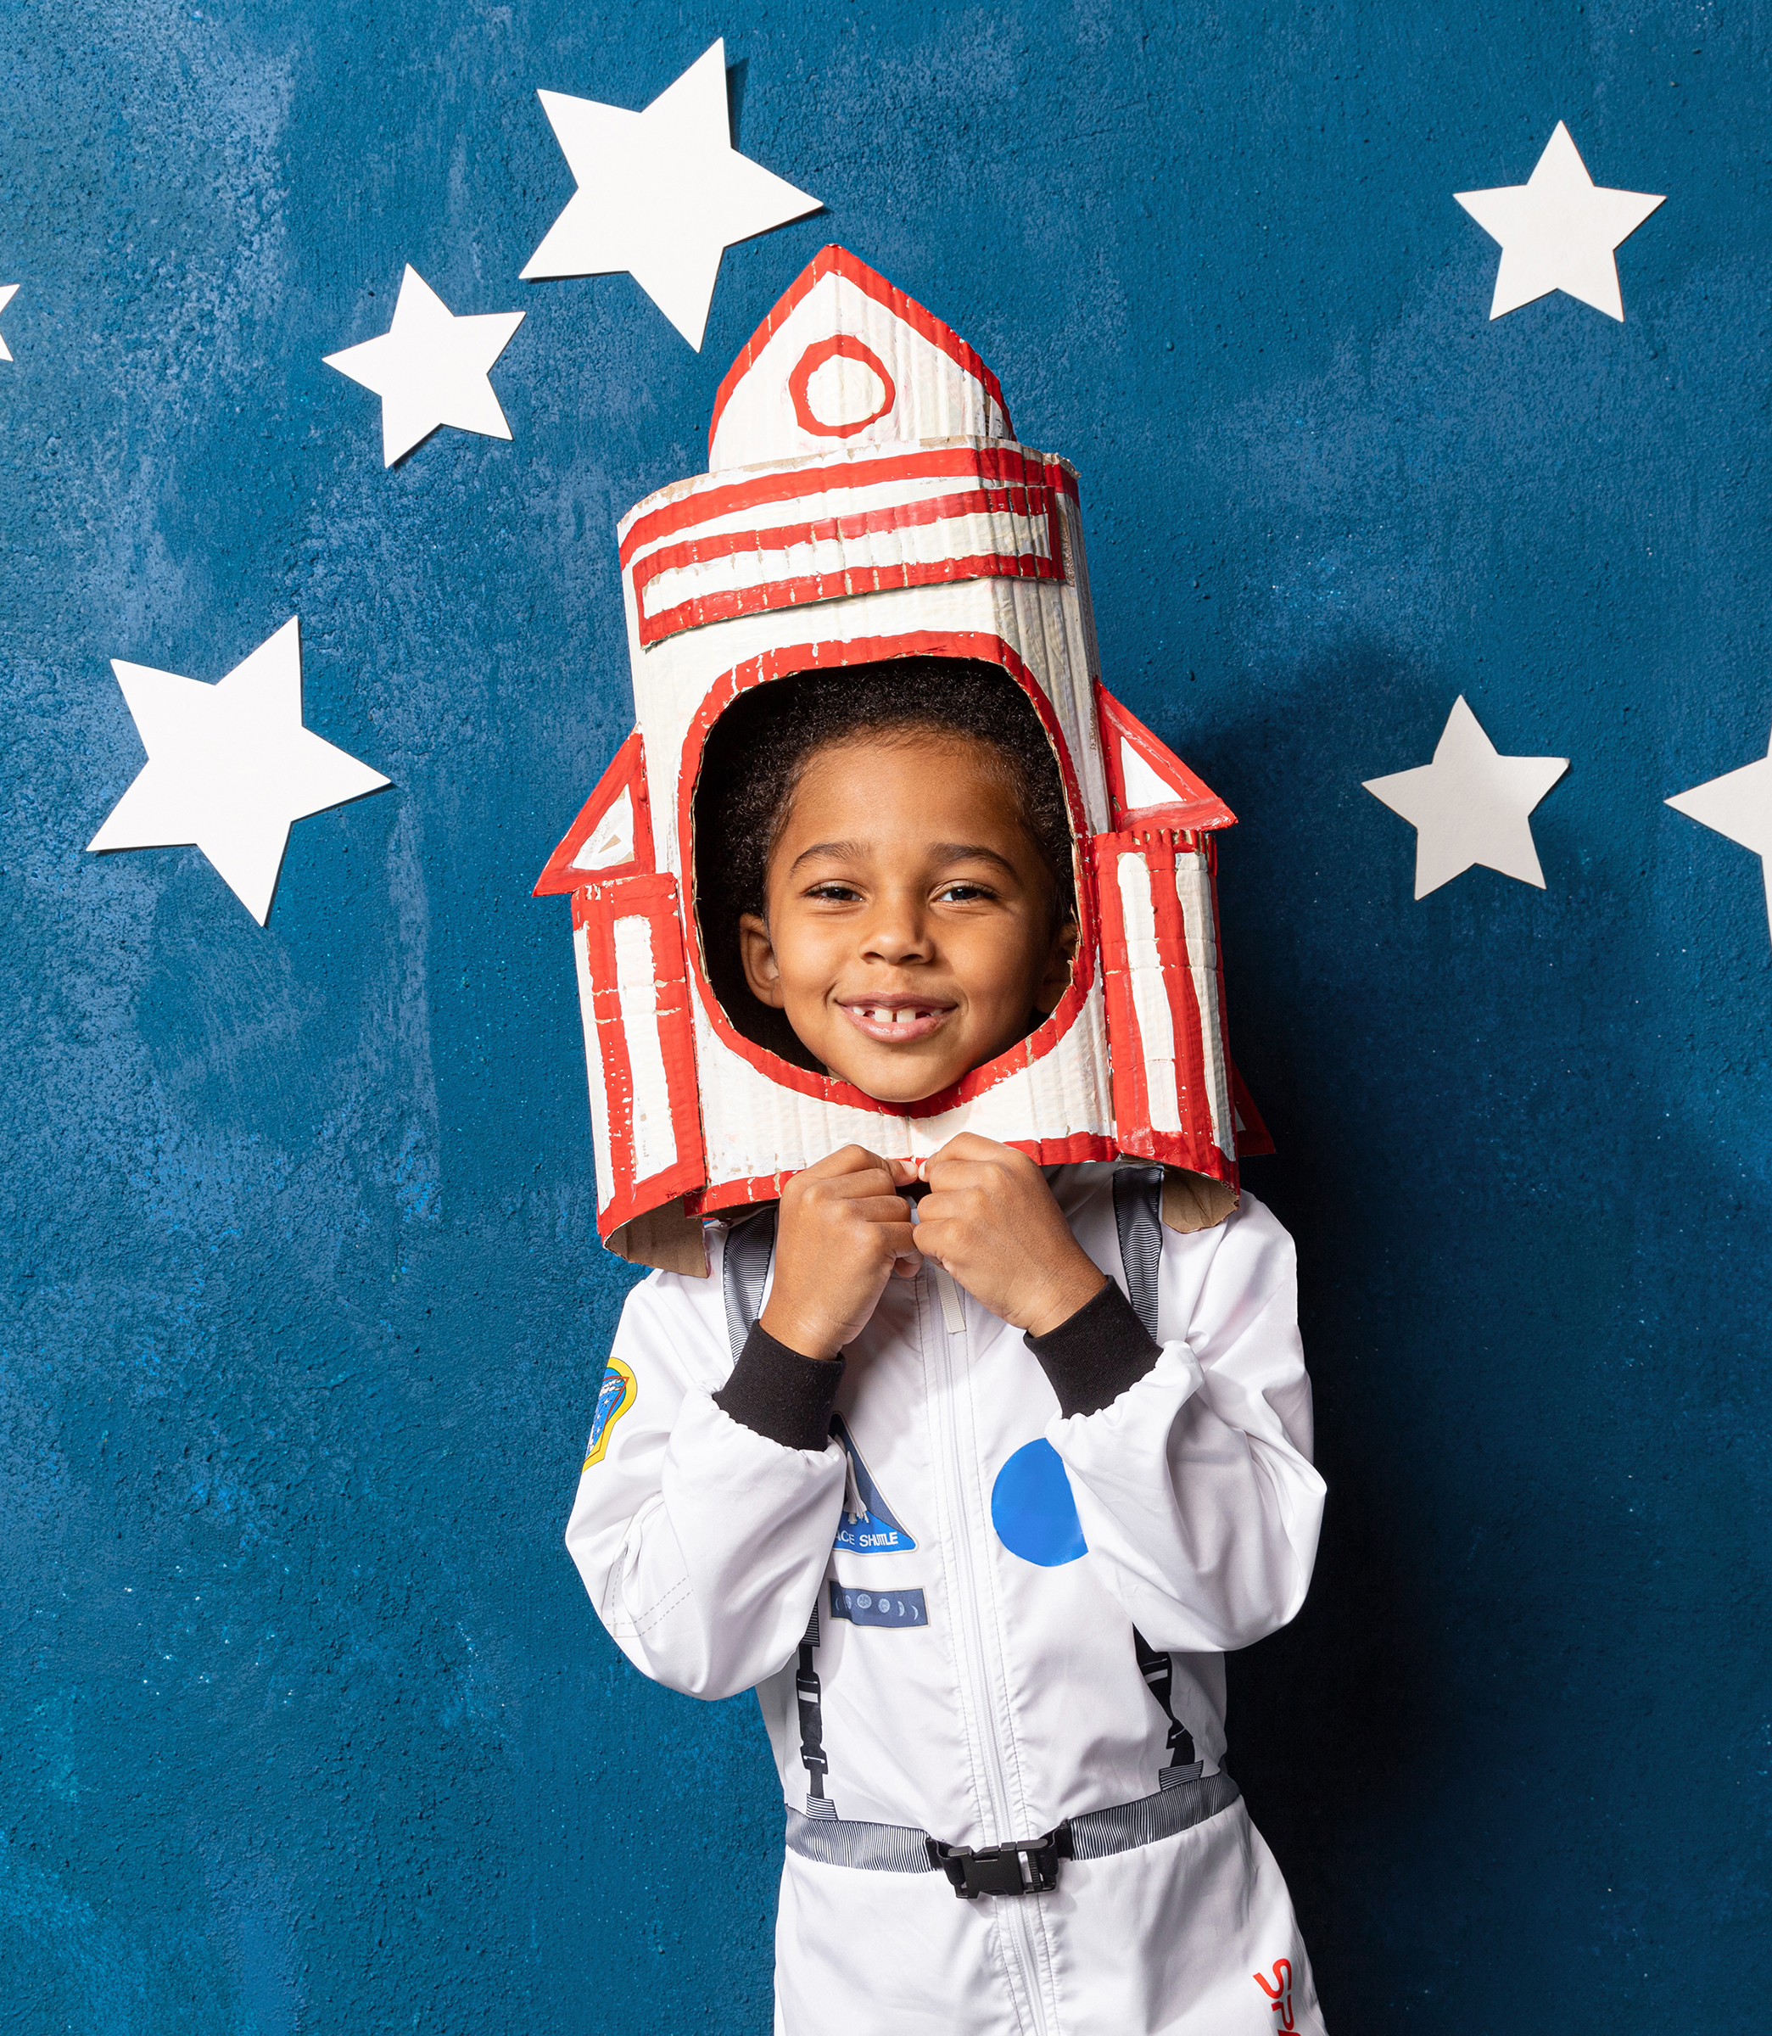
Tell me what you want to be when you grow up
BACK

