Slide 1
How do you feel today?
SUD SCALES

Slide 2

Direction for this resource:
This PPT can be used to teach the SUDS (subjective units of distress scale) that helps clients identify and rate their emotions.
There are several different options to use when teaching a SUDS scale. Try them out, and use the SUDS scale that works best for each client.

Slide 3

How are You Feeling?
Use this in Slide Show Mode
Have the client rate how they are feeling for each of the emotions by clicking the number on the corresponding emotion.
Use the “Questions to Ask” when first teaching this skill.
Teach the clients that using a SUDS Scale is helpful to move someone from their emotional brain to their thinking brain and can assist in better decision making.
Make sure to clear the emotions before you save and close.

Slide 4










0 | 1 | 2 | 3 | 4 | 5
0 | 1 | 2 | 3 | 4 | 5
0 | 1 | 2 | 3 | 4 | 5
0 | 1 | 2 | 3 | 4 | 5
0 | 1 | 2 | 3 | 4 | 5
Happy
Scared
How Are You Feeling?
Angry
Sad
Silly
Clear

Slide 5
Questions to Ask:
How does your body feel different when a feeling is a zero vs a five?
Make a list of coping skills you need when you are a zero, three , and five.
What do you need from others when you are feeling each emotion? Does it change as the rating increases or decreases?
For each emotion ask these questions

Slide 6
Size of Feelings
Using Annotate, Rate Your Feelings on How Big They Feel

Slide 7





Size of Feelings
5
4
3
2
1
5
4
3
2
1
5
4
3
2
1
5
4
3
2
1
5
4
3
2
1

Slide 8
Rate Your Feelings
Complete a list of however many feelings the client can come up with to assess feeling vocabulary.
Use each slide on core feelings to talk about examples of when they have felt that feeling.
Circle SUDS using annotation feature.
Complete slides with client in regards to what each character is feeling in that situation.
Clinician should type on slide for client.

Slide 9
Feelings

Slide 10



10
9
8
7
6
5
4
3
2
1
0
“Angry” Scale

Slide 11



10
9
8
7
6
5
4
3
2
1
0
“Sad” Scale

Slide 12



10
9
8
7
6
5
4
3
2
1
0
“Happy” Scale

Slide 13



10
9
8
7
6
5
4
3
2
1
0
“Scared” Scale

Slide 14
Feelings Thermometer:
Ask the client about a time in their life they felt the core feeling.
Clinician should type example on the slide.
Have the client use the annotation feature to circle the intensity on the SUD scale they felt that feeling.
Repeat for each slide.

Slide 15
10
9
8
7
6
5
4
3
2
1
0
“Angry” Scale

Slide 16
10
9
8
7
6
5
4
3
2
1
0
“Sad” Scale

Slide 17
10
9
8
7
6
5
4
3
2
1
0
“Happy” Scale

Slide 18
10
9
8
7
6
5
4
3
2
1
0
“Scared” Scale

Slide 19
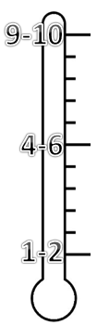
_______’s EMOTION THERMOMETERS
I’m about to explode with happiness!
I’m totally terrified!
Ok, I’m going to do something!
I’m boiling over!
I’m pretty satisfied
I’m thinking about taking action
I feel trouble bubbling up
My stomach is in knots
I feel normal
I feel a little uncomfortable
I’m a little worried but I won’t do anything yet
How annoying
Happy
Scared
Protective
Angry

Slide 20
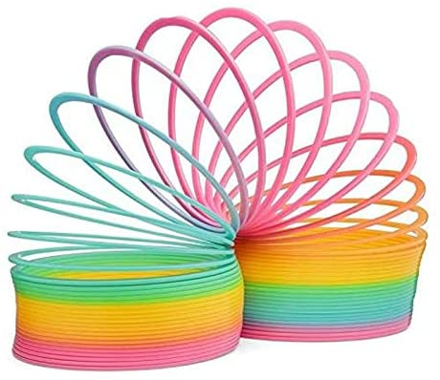

Alternative to Thermometer SUDs

