Slide 1
My Story
Explanation of the Trauma Narrative

Slide 2
Instructions
Slides 2 – 6 review what defines a story, why kids and teens write stories, and some quotes from kids and teens that have completed their stories!
Slide 7 is clickable – have the client pick an emotion that they are feeling, and click on the icon. This will take you to a new slide where you can ask the client why they are feeling that way.
Clients can pick more than one feeling! Click on the arrow on the bottom right hand corner to go back to the original screen.
Slides 15 – 19 will be completed by you and the client. Use in "Normal View" to add in text and draw.

Slide 3
What is a Trauma Narrative?
The story of the trauma(s) told through verbal, written, and/or artistic means, including:
Chapter Books
(Examples of Chapters: About Me, Title for a Neutral Story Chapter, My Family, Title for a Pleasant Memory with People Involved in the Traumatic Event Chapter, Title for the Actual Traumatic Event Chapter, What I Learned in Therapy, My Hopes and Dreams for the Future)
Comic Strips
Poetry
Drawings
Paintings
Collages etc.

Slide 4
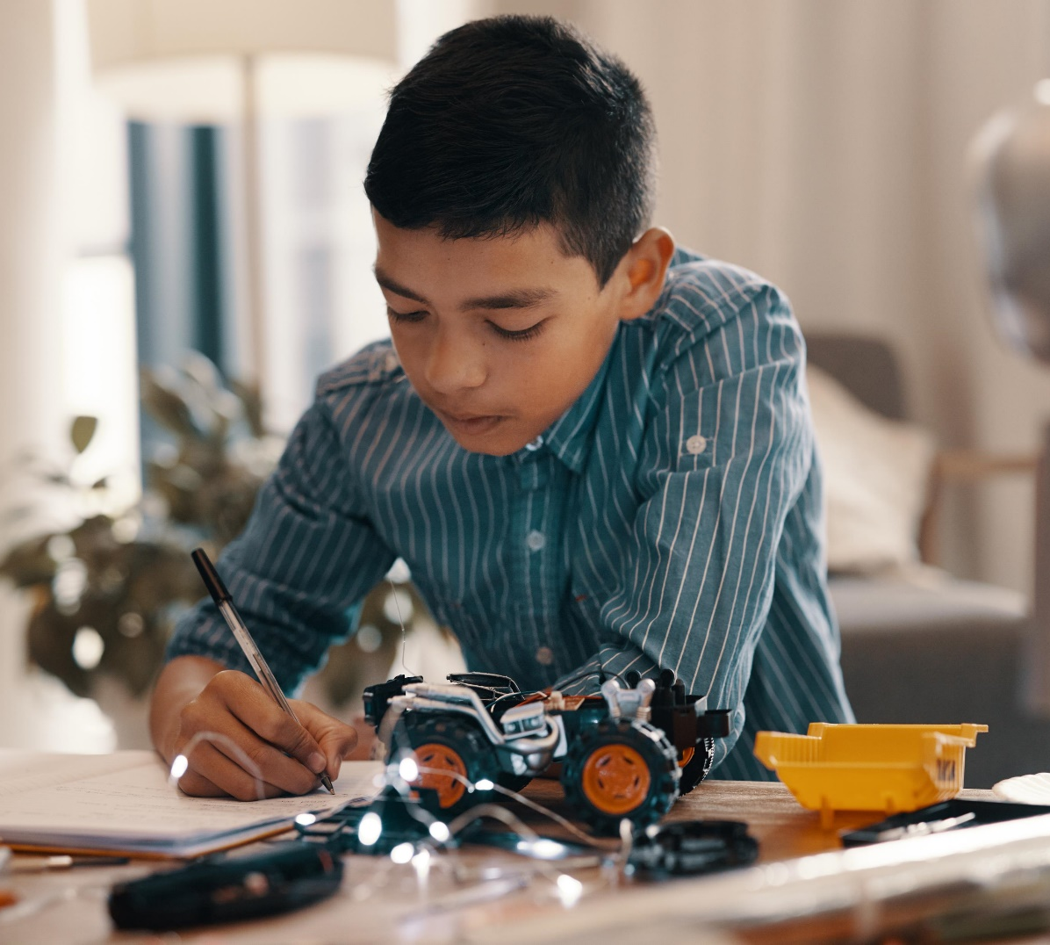
Why Do I Write the Trauma Narrative?
The memories of a trauma can feel like a jumbled mess. The trauma narrative is a way for survivors of trauma to make sense of their experiences.
Completing the trauma narrative will allow you to organize your memories and practice coping with the painful emotions they carry.

Slide 5
Quotes from Kids and Teens after Completing their Trauma Narrative or Story:
“I know what happened to me wasn’t my fault.”
“I don’t think I’m a bad kid anymore.”
“I feel happier now.”
“It was hard at first, and then it got easier and easier.”
“I’m excited about the future!”

Slide 6
What Questions or Concerns do You Have?
These are frequently asked questions by kids and teens just like you!
Do I have to share my story with anyone?
What happens with my story?
What happens next in therapy after my story?

Slide 7
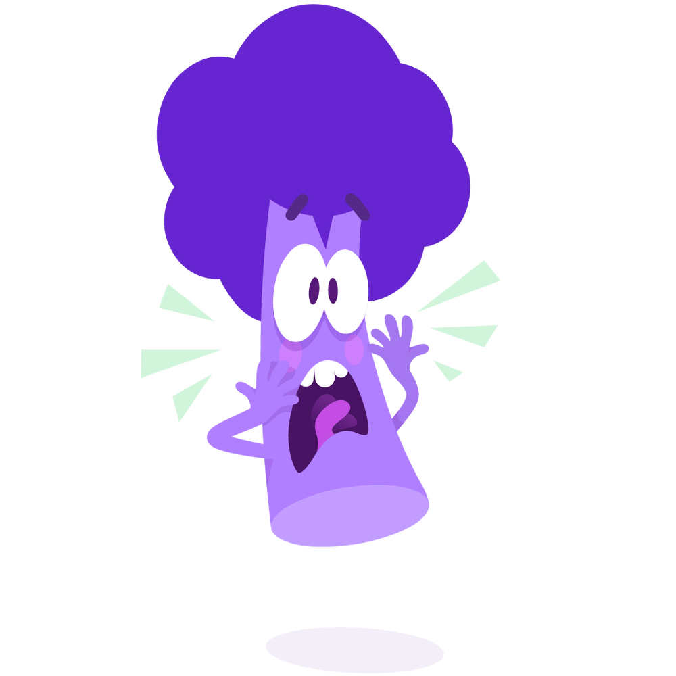
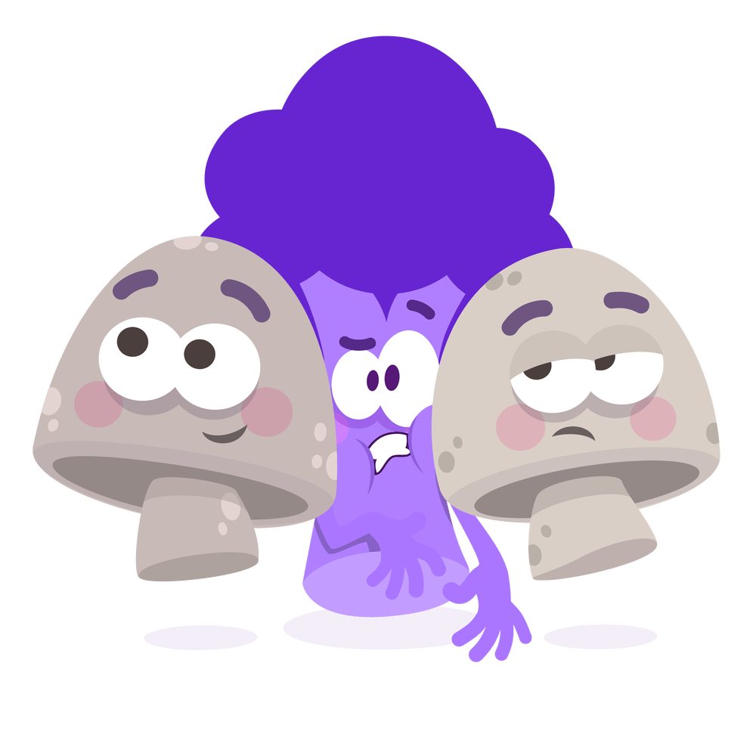
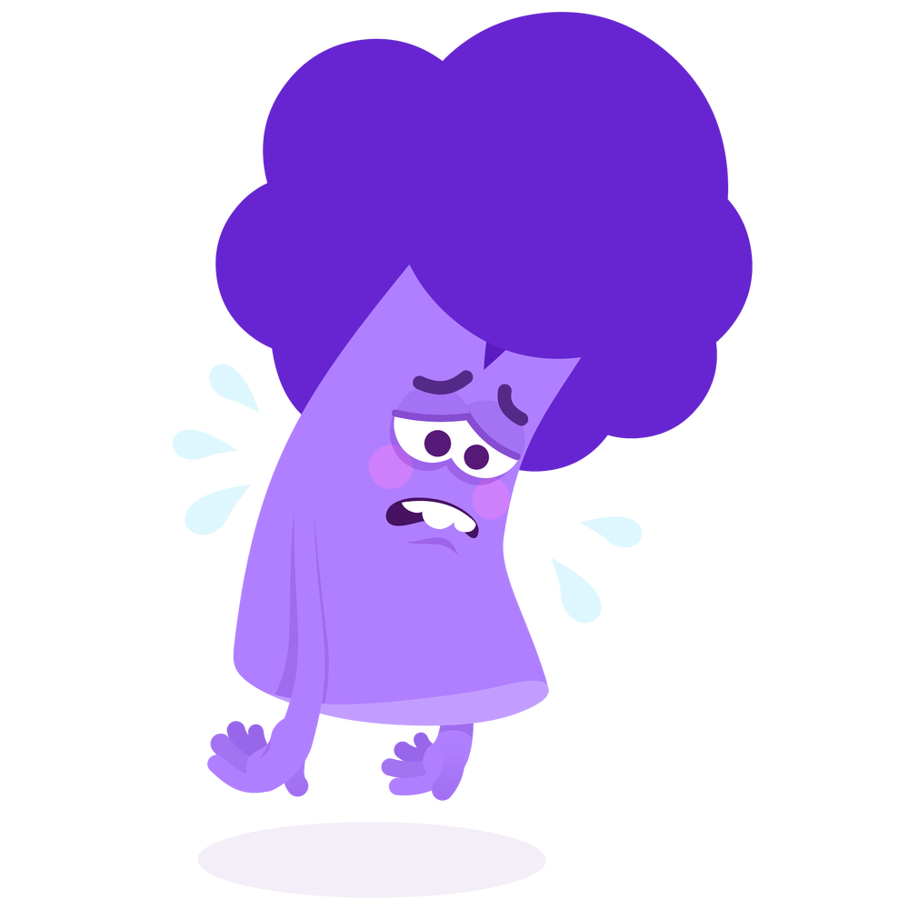
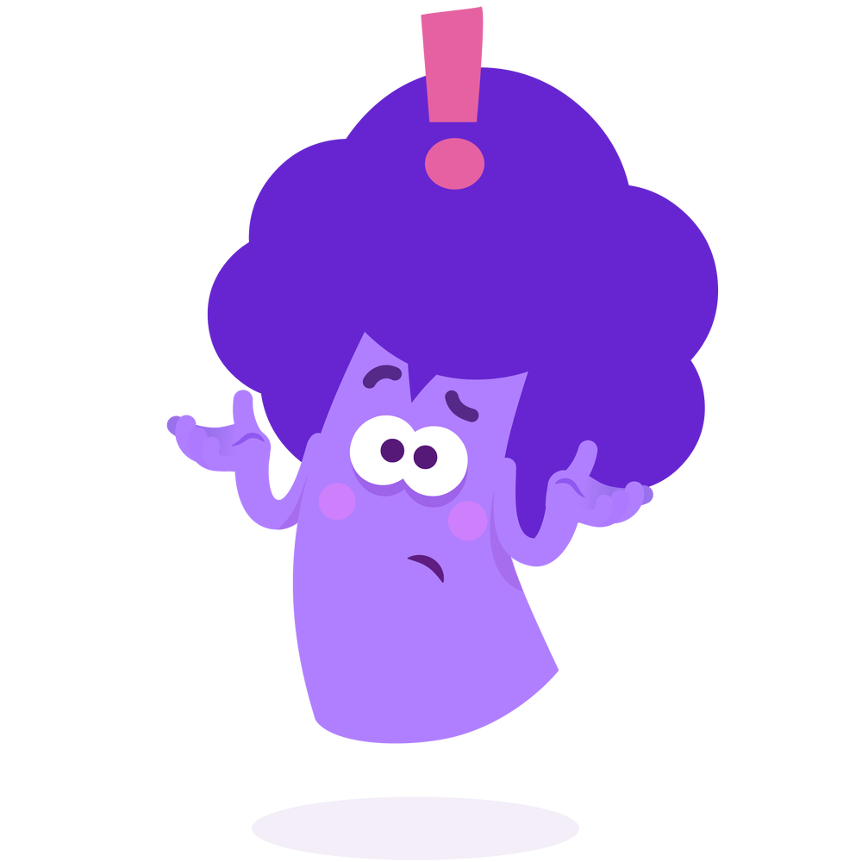
How do you feel about writing your Story? Tip: Ask your therapist for a scale to rate your feelings!
Calm
Scared
Nervous
Sad
?
Angry
Unsure
Other feeling

Slide 8
You are feeling CALM
Explain why you think you feel this way about writing your story:

Slide 9
You are feeling SCARED
Explain why you think you feel this way about writing your story:

Slide 10
You are feeling SAD
Explain why you think you feel this way about writing your story:

Slide 11
You are feeling NERVOUS
Explain why you think you feel this way about writing your story:

Slide 12
You are feeling ANGRY
Explain why you think you feel this way about writing your story:

Slide 13
You are feeling UNSURE
Explain why you think you feel this way about writing your story:

Slide 14
You are feeling ANOTHER FEELING
What do you think you are feeling?
Explain why you think you feel this way about writing your story:

Slide 15
Prepare to write your story.
Let’s pick relaxation skills that would be helpful for you when writing your story!

Slide 16
Who are your safe people?

Slide 17
Let’s pick some positive and helpful thoughts. Circle your favorites using the "Draw" tool.
I am brave
I am strong
I can do it
I can do hard things
I will feel better
I can heal from the trauma
I am not alone

Slide 18
Any other questions?

Slide 19
Would you want to start today or wait until next week?

