Slide 1
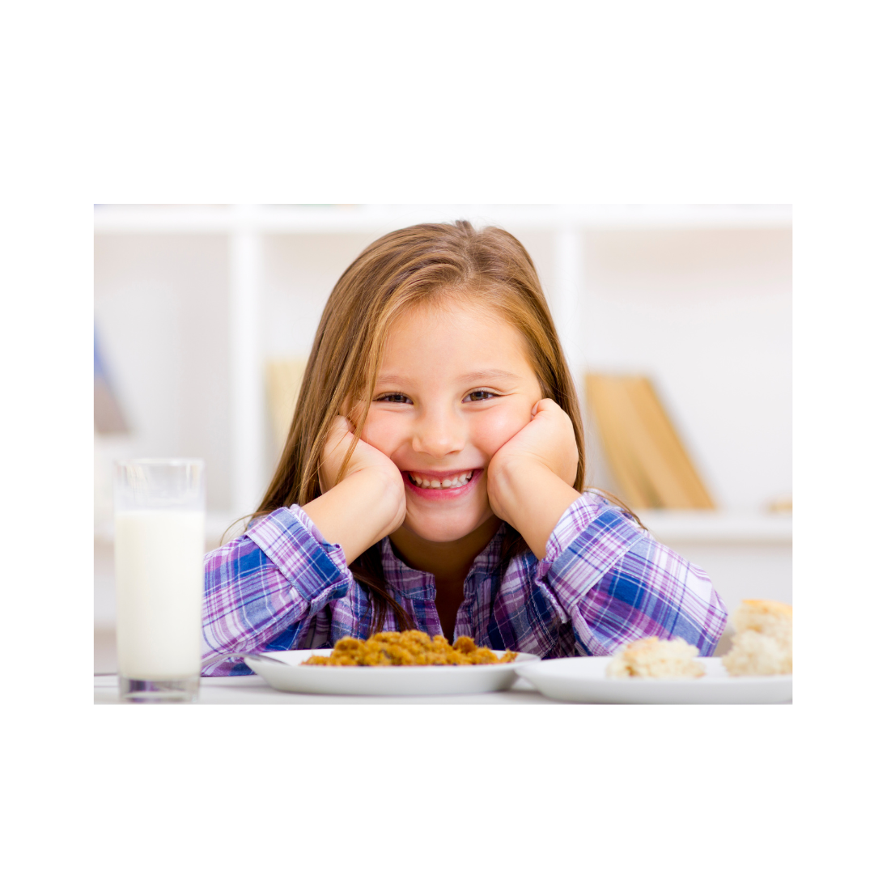

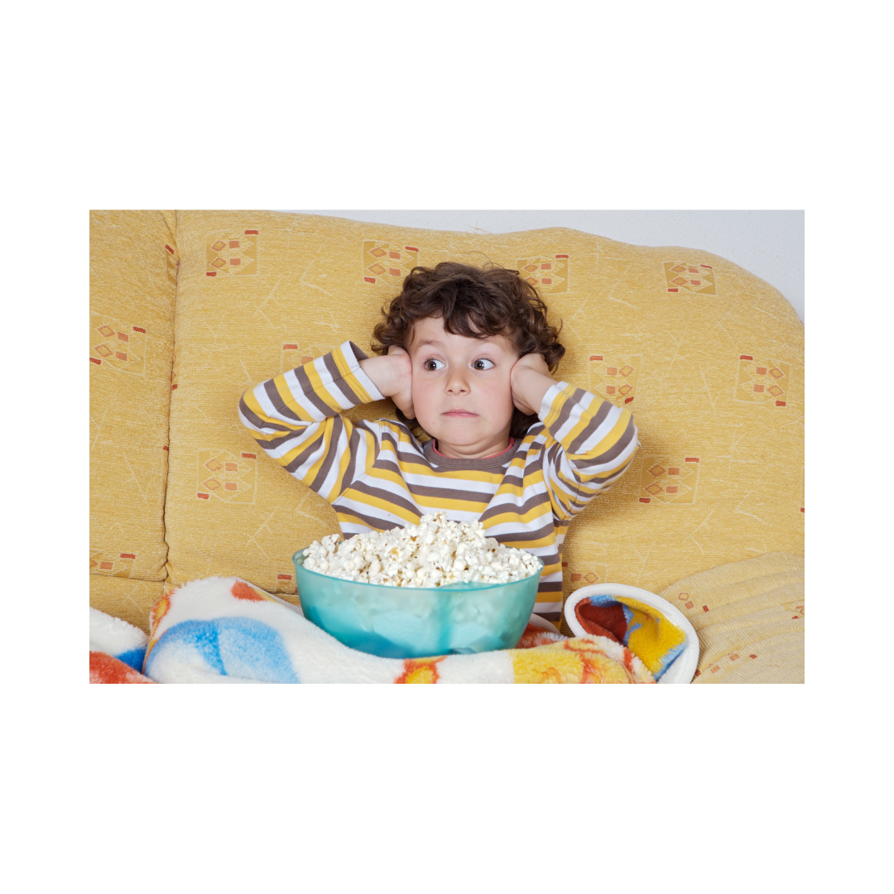
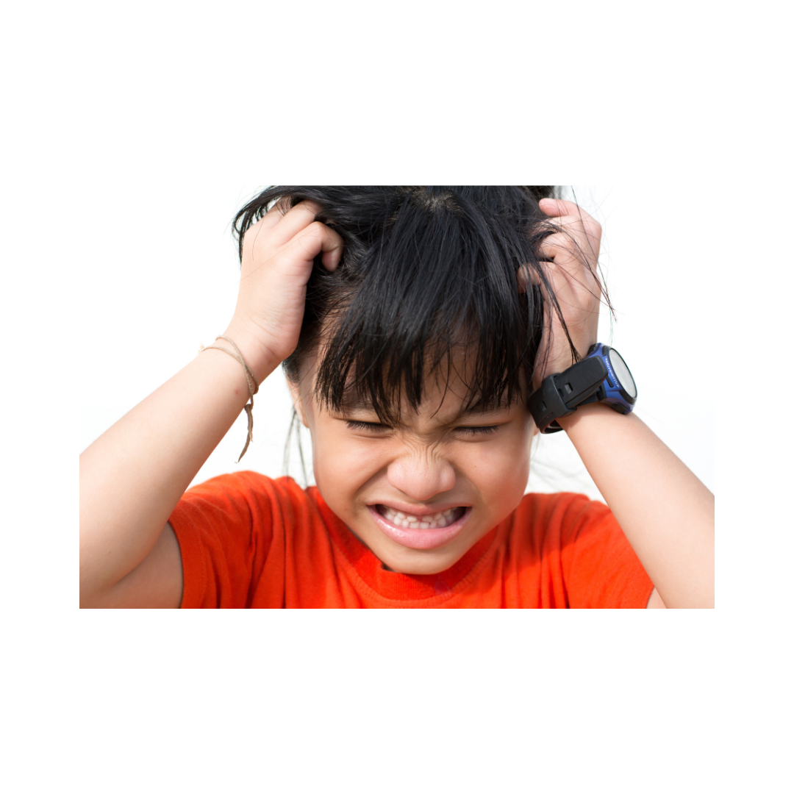
Feelings Identification
& Matching

Slide 2


How would you know?

Slide 3
Directions:
Fill in the blank with the appropriate feeling on the slide.
Use the space below the text to type the answers provided by the client.
Continue for the remainder of the feelings.

Slide 4
Happy
How would you know that you are feeling_____________?

Slide 5
Happy
How would you I know that you are feeling_______________?

Slide 6
Happy
How would you know that another kid is feeling____________?

Slide 7
Happy
When I feel_______ I___________________(action).

Slide 8
Happy
When I’ve seen other kids who are ____________(feeling), they sometimes__________(action).

Slide 9
Sad
How would you know that you are feeling_____________?

Slide 10
Sad
How would you I know that you are feeling_______________?

Slide 11
Sad
How would you know that another kid is feeling____________?

Slide 12
Sad
When I feel_______ I___________________(action).

Slide 13
Sad
When I’ve seen other kids who are ____________(feeling), they sometimes__________(action).

Slide 14
Scared
How would you know that you are feeling_____________?

Slide 15
Scared
How would you I know that you are feeling_______________?

Slide 16
Scared
How would you know that another kid is feeling____________?

Slide 17
Scared
When I feel_______ I___________________(action).

Slide 18
Scared
When I’ve seen other kids who are ____________(feeling), they sometimes__________(action).

Slide 19
Mad
How would you know that you are feeling_____________?

Slide 20
Mad
How would you I know that you are feeling_______________?

Slide 21
Mad
How would you know that another kid is feeling____________?

Slide 22
Mad
When I feel_______ I___________________(action).

Slide 23
Mad
When I’ve seen other kids who are ____________(feeling), they sometimes__________(action).

Slide 24

Match the thoughts & feelings

Slide 25
Directions:
Using the annotation feature on Zoom and have your client circle the emotion that fits the thought best.
Take turns back and forth and encourage a conversation about a time the client might have had a thought like that and how it made them feel.

Slide 26

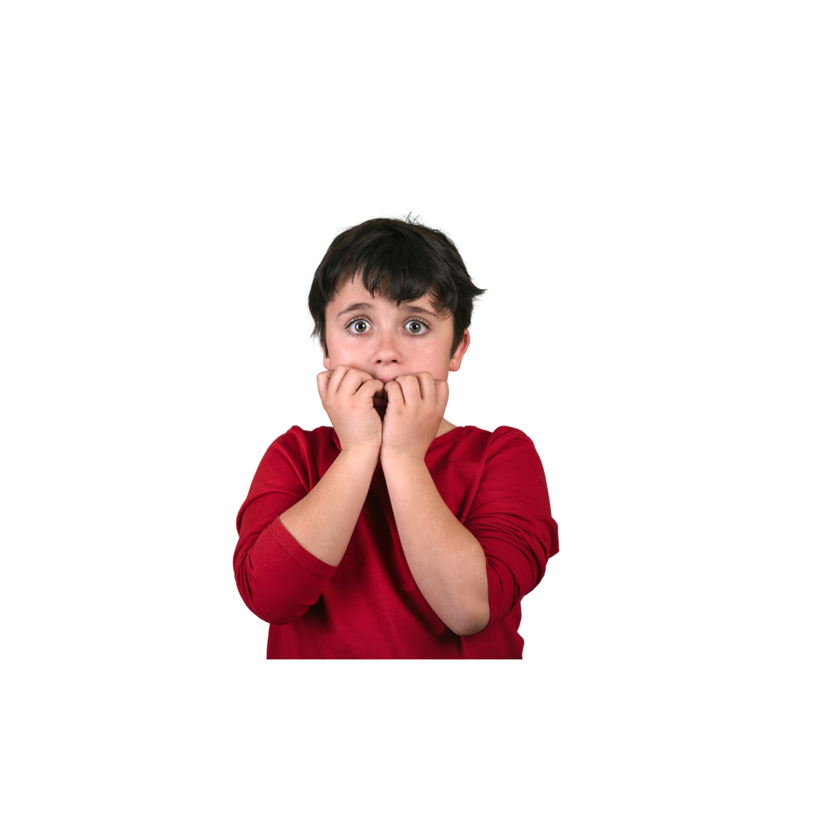
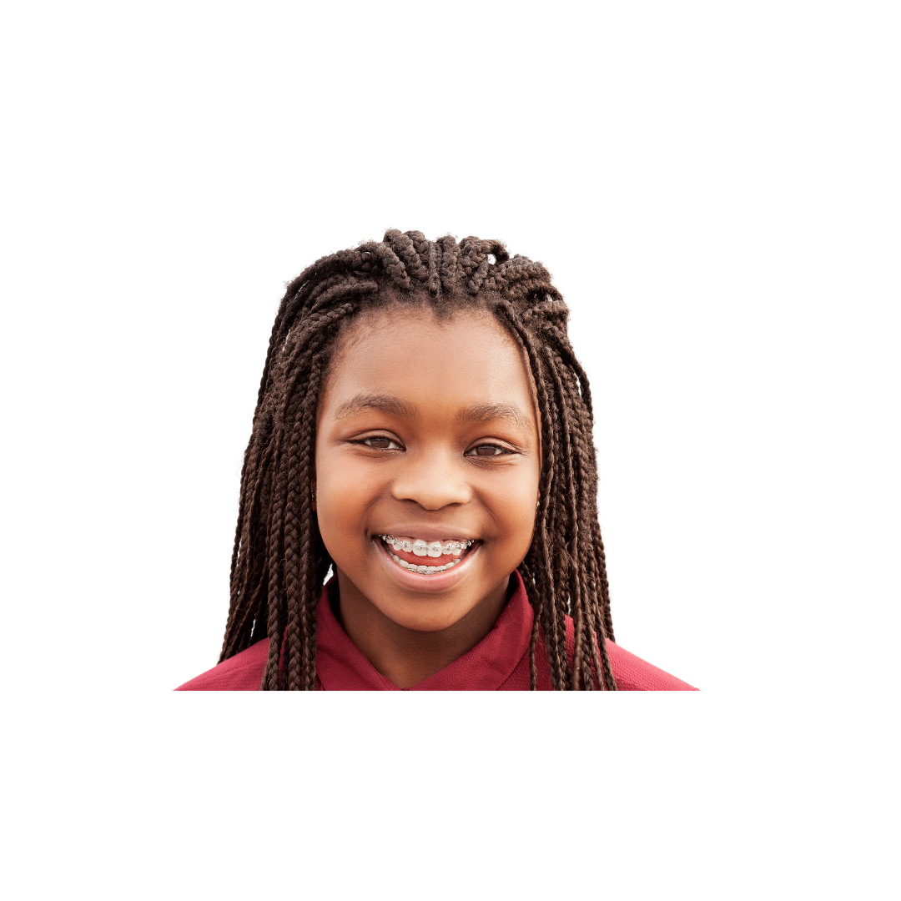
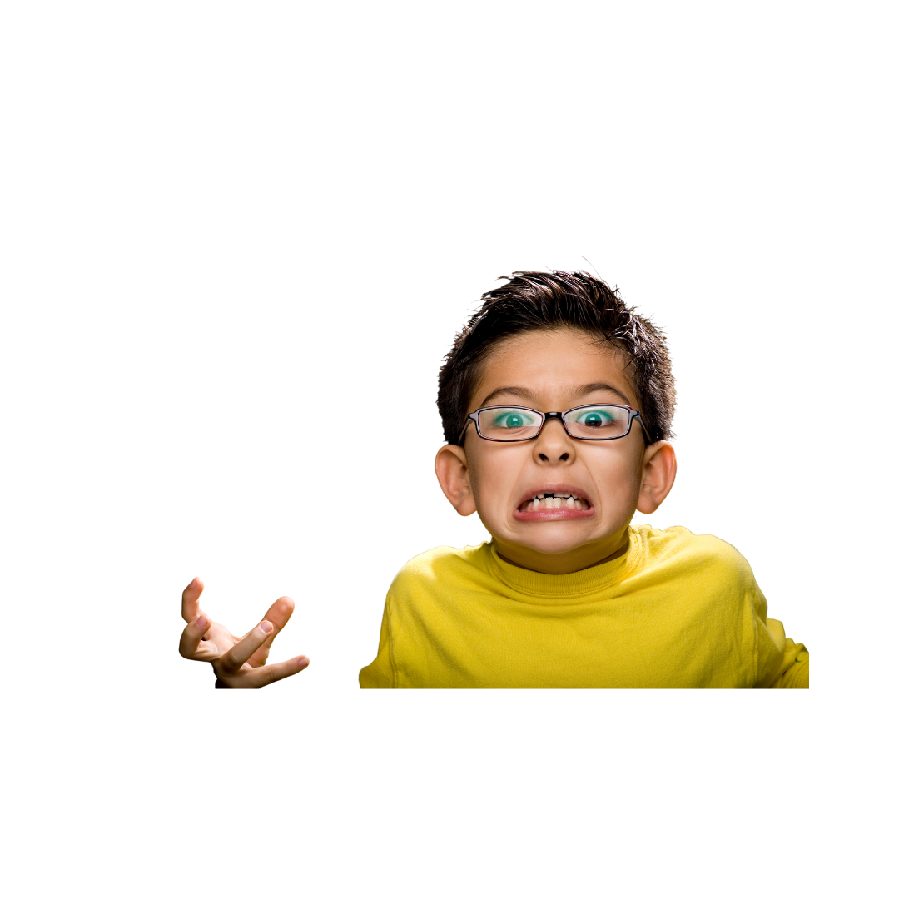
Match the feeling to the thought!
Nobody likes me….
Angry

Slide 27
Match the feeling to the thought!
I’m a good dancer!

Slide 28
Match the feeling to the thought!
I know I flunked my test!

Slide 29
Match the feeling to the thought!
I never get my way!

