Slide 1
Creating a Visual Schedule
For Kids

Slide 2
Instructions
This PowerPoint needs to be used in normal mode (not in slide show mode).
Several blank templates are provided to customize a visual schedule for a child. There are blank templates for 3, 4 or 6 activities per template.
Choose the template that fits the child best or let them pick.
An example Visual Schedule is available on slide 5.
The templates are made so you can add a picture by clicking insert in your PPT task bar or we have pulled several premade pictures in slides 15 through 17 that you can copy and paste into the template.
When a schedule is completed save that slide as a picture or PDF and email/send to the family to use.

Slide 3
Why do a visual schedule?
Visual Schedules help kids follow a routine, transition between activities, develop new skills and reduce dependence on caregivers when completing daily activities such as getting ready for school, chores or winding down for the day.
Notes:
NOTE: To change images on this slide, select a picture and delete it. Then click the Insert Picture icon in the placeholder to insert your own image.

Slide 4
How To Create a Visual Schedule
Think of a skill your child is having difficulty with. Is it morning routine? Doing homework? Doing Chores?
List all the steps that skill entails
Add pictures clearly depicting each step
For older kids you can also add words
Print out the schedule and hang it somewhere the child will see it regularly
Provide praise and small rewards such as stickers for completing tasks

Slide 5
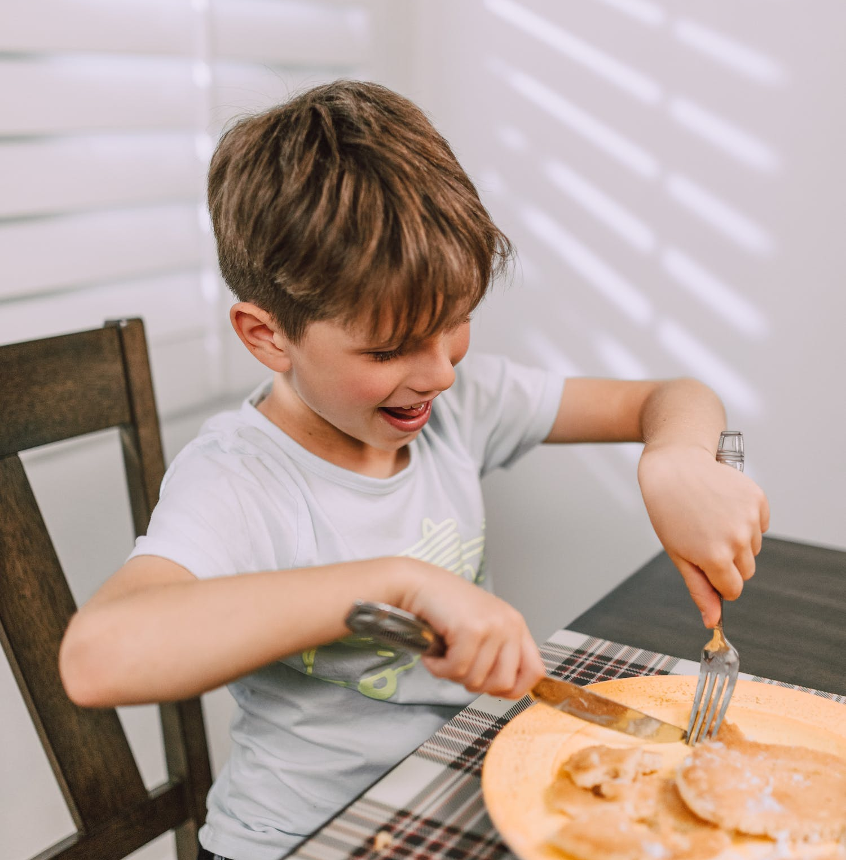
Example – Morning Routine
Brush Teeth
Get Dressed
Eat Breakfast
Notes:
NOTE: To change images on this slide, select a picture and delete it. Then click the Insert Picture icon in the placeholder to insert your own image.

Slide 14
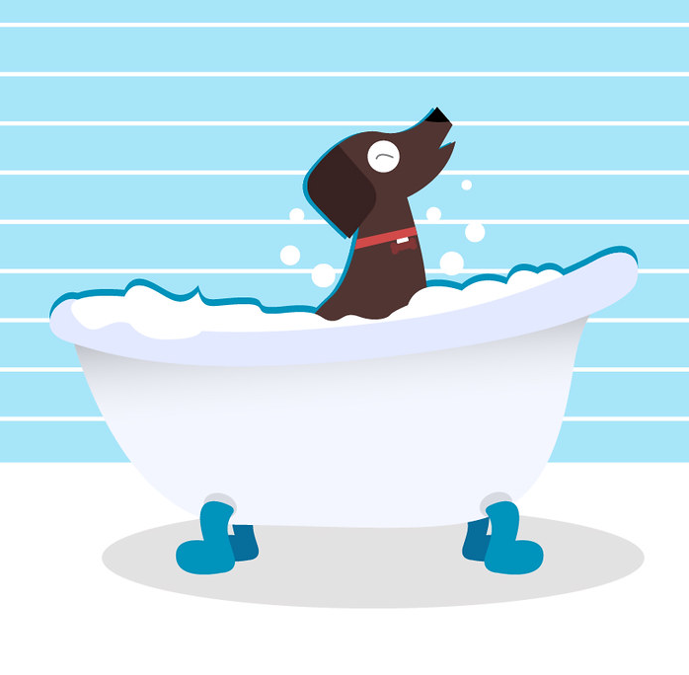
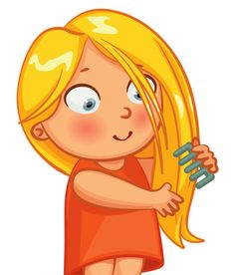
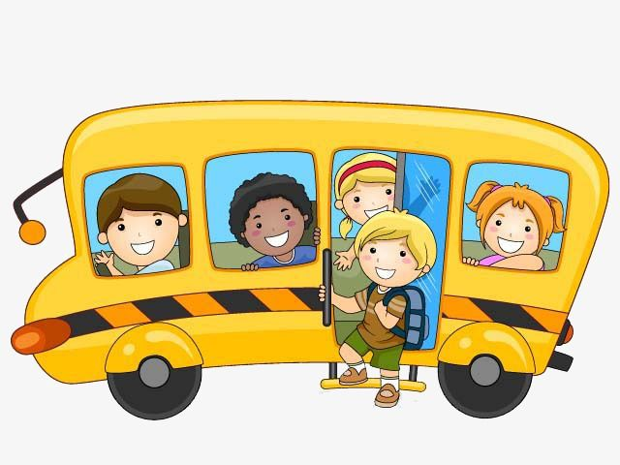
Sample Pictures

Slide 15
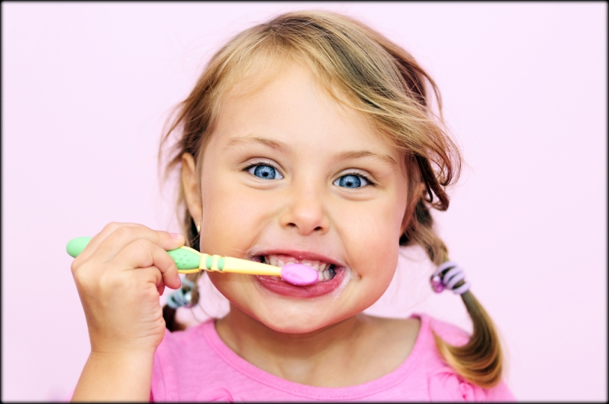
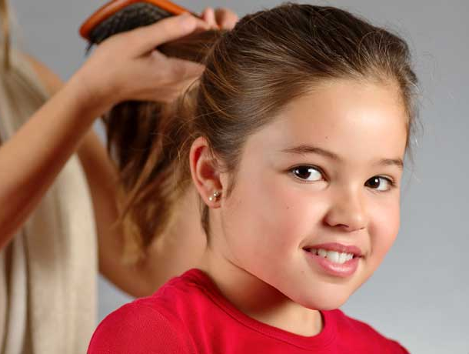
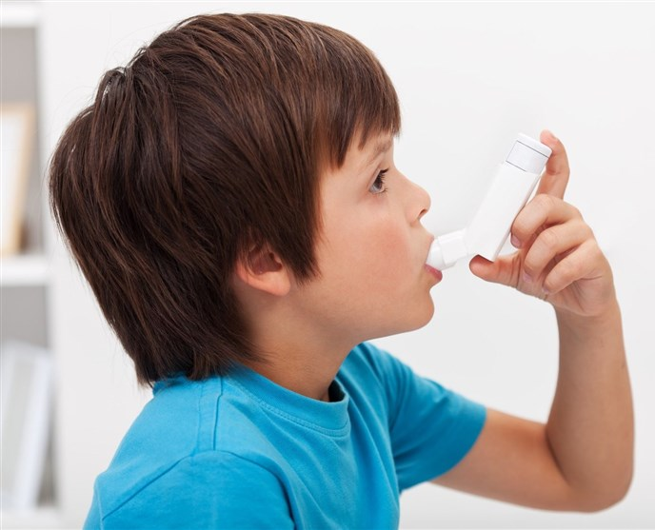
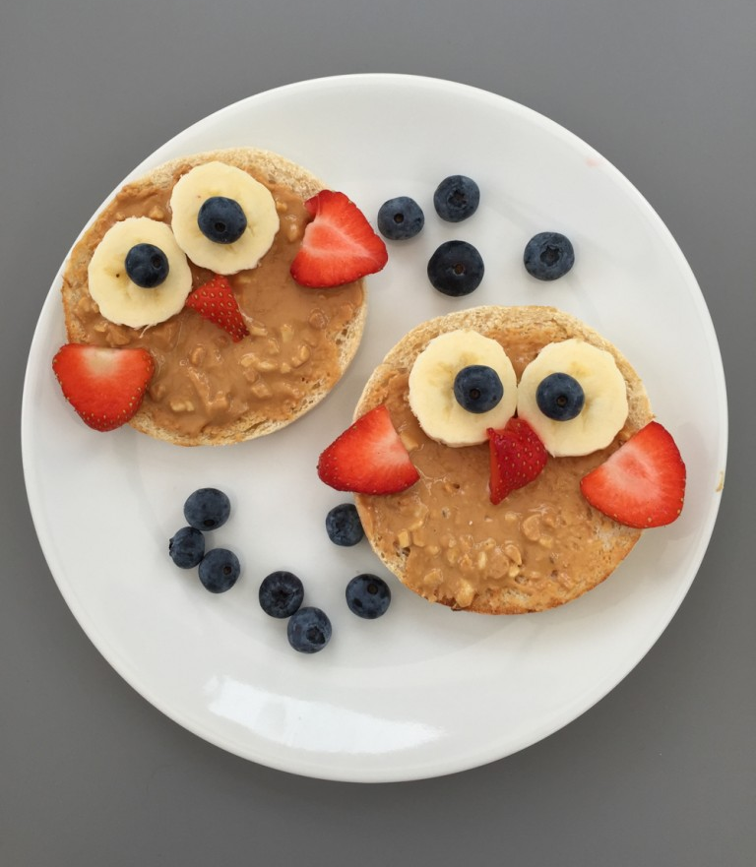
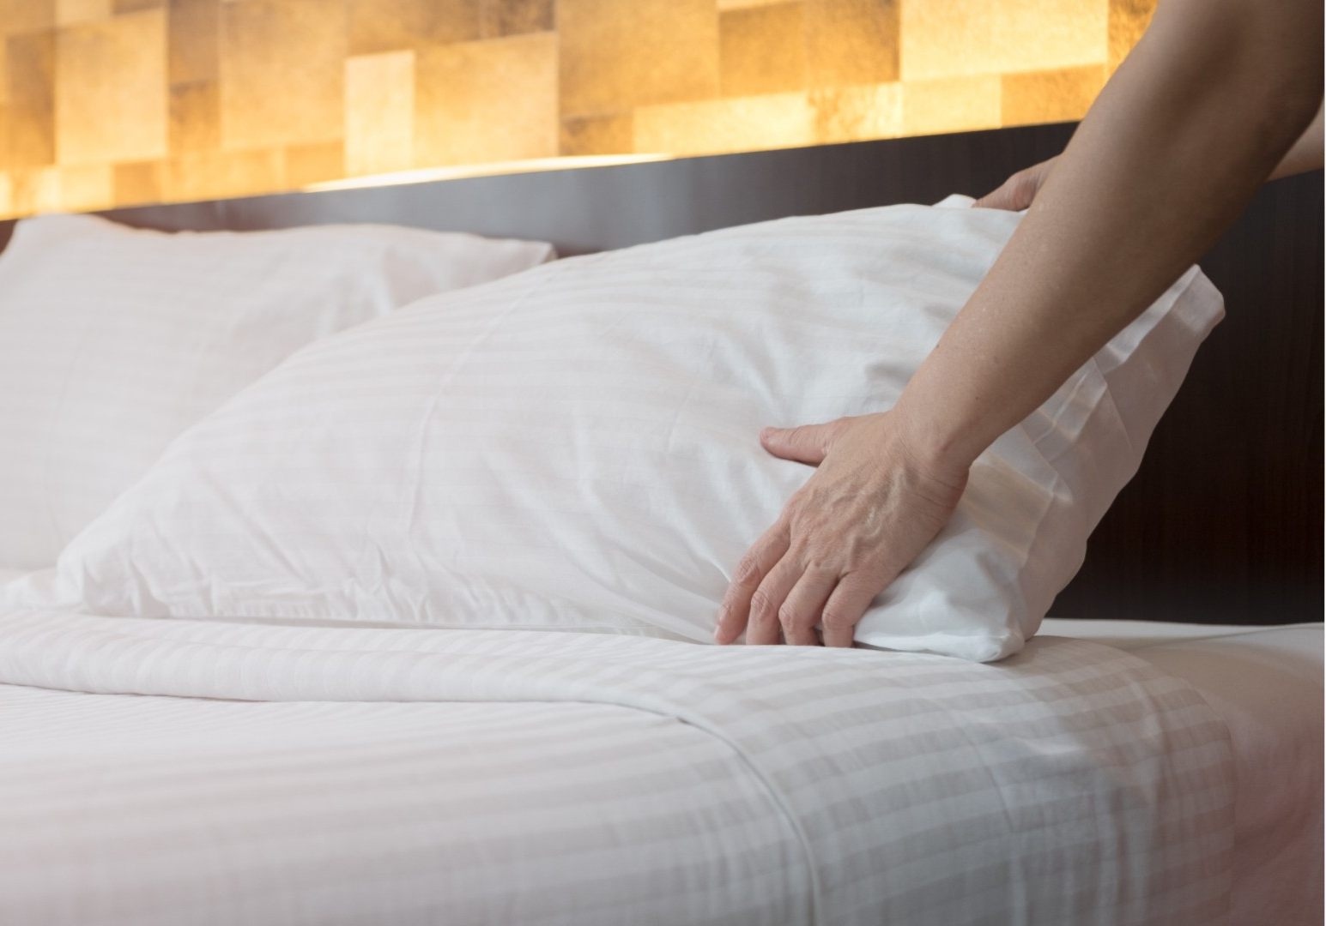
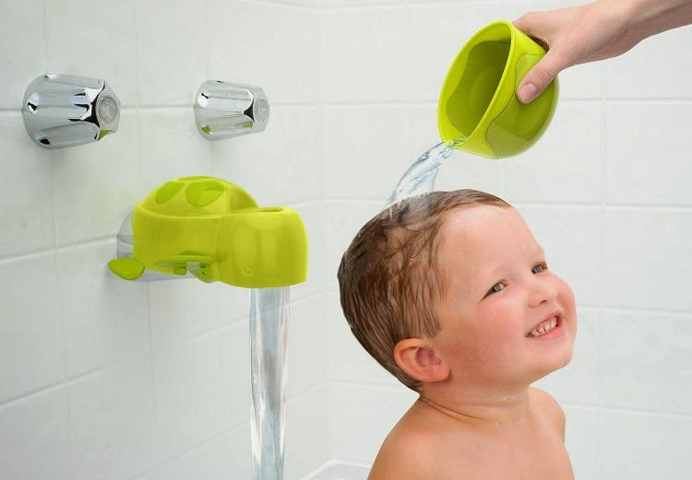
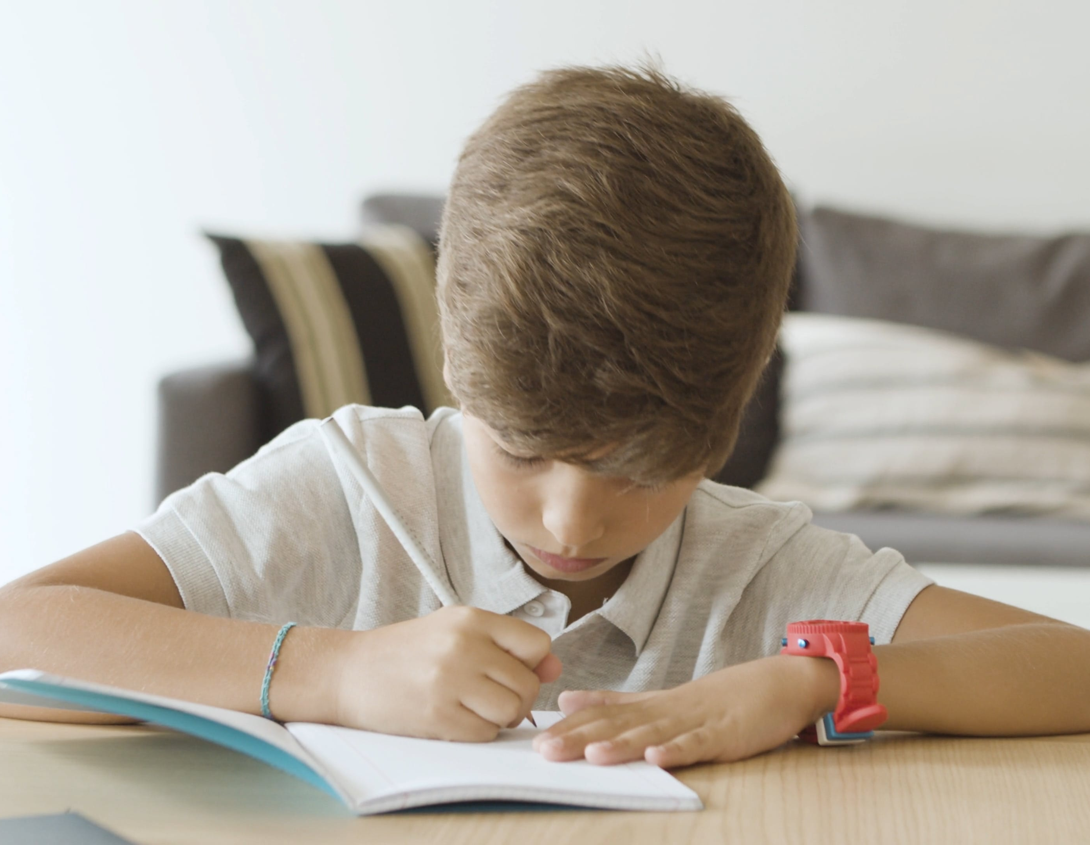
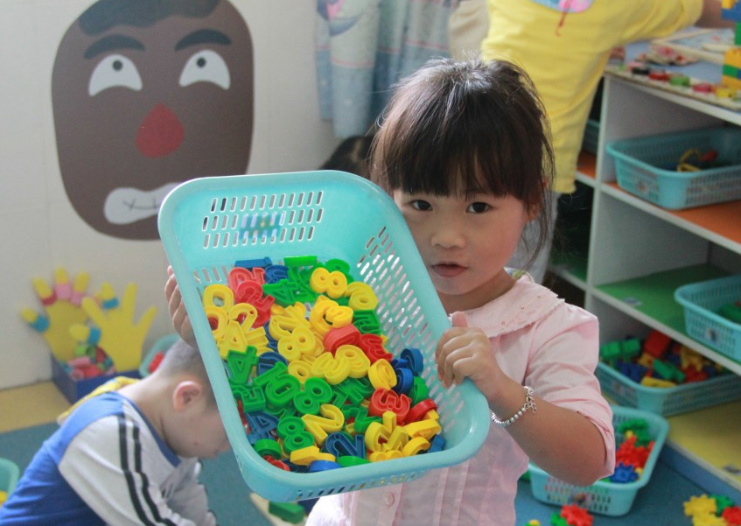
1.
2.
3.
4.
5.
6.
Brush Teeth
Brush Hair
Take Medicine
Eat Breakfast
Make Bed
Take a Bath
Do Homework
Go To Sleep
Clean Up Toys
Talk About Feelings
Go To School
Sample Pictures

Slide 16
1.
2.
3.
4.
5.
6.
Brush Teeth
Comb Hair
Take Medicine
Eat Breakfast
Make Bed
Take a Shower
Do Homework
Go To Sleep
Clean Up Toys
Talk About Feelings
Go To School
Sample Pictures

