Slide 1
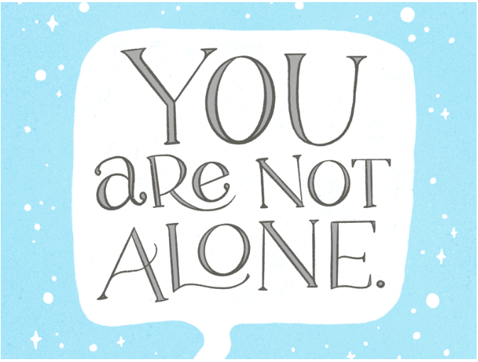
Created by: Emily Tilstra-Ferrell

Slide 2
Safety Plan
Hello! We are so glad you are taking this first step to making a safety plan for suicidal thoughts. First of all, we want you to know that you are NOT alone. Having suicidal thoughts is common after traumatic events.
Luckily, there are lots of things we can do to help cope with thoughts of suicide. Today we will work together to create a plan to help you cope and stay safe when thoughts of suicide come up. Then, you can take this plan home with you!
Before we start, do you have any questions?
https://redcap.musc.edu/surveys/?s=DLW9KAJEXAW3J7AL

