Slide 1

BRAIN BREAK

Slide 2
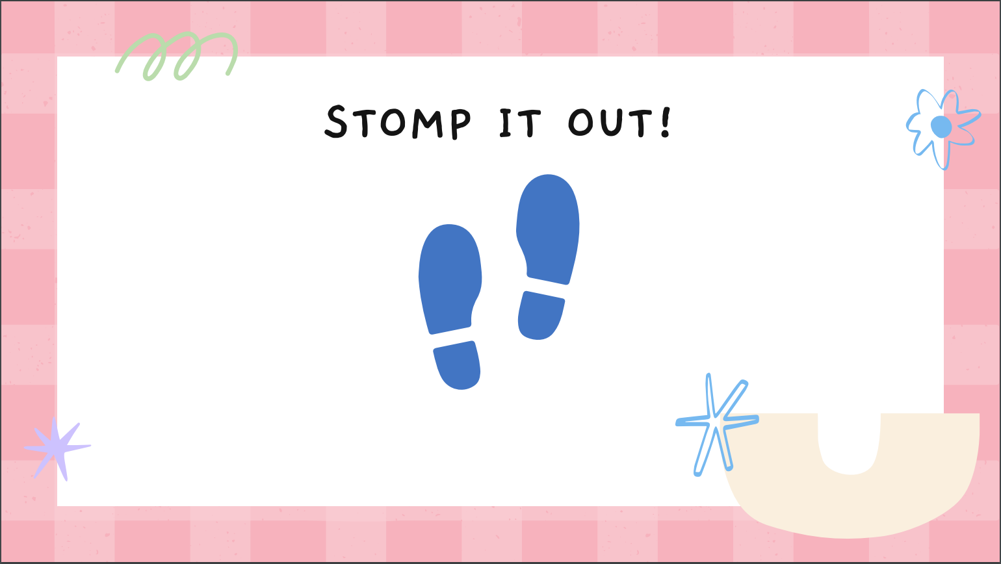

Slide 3









C O U N T I T O U T !

Slide 4

TRACE THE RAINBOW!

Slide 5
FLEX YOUR MUSCLES!

Slide 6

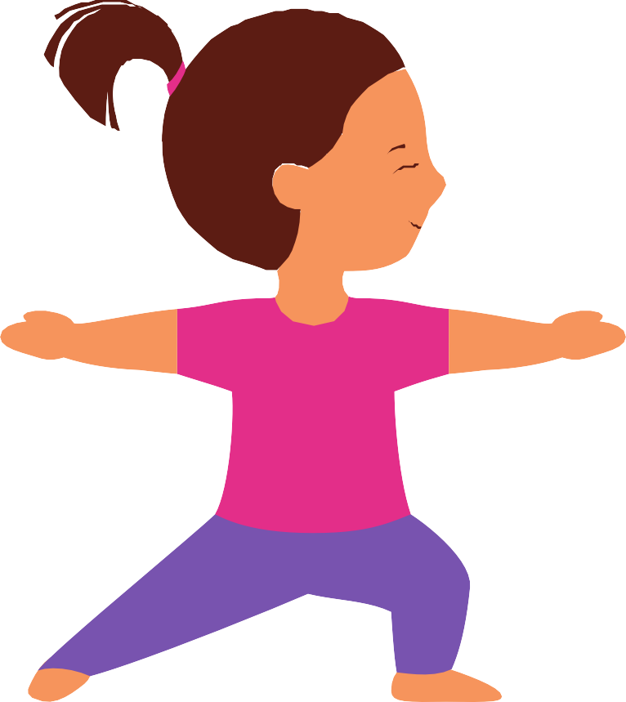


Choose a Pose!

Slide 7

TAKE A DEEP BREATH!
Breathe in...
Breathe out...

Slide 8
Y O U D ID IT!

Slide 9
MOVEMENT BREAK

Slide 10
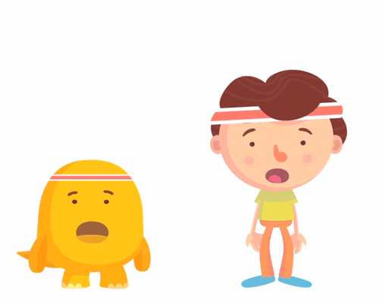
Jumping Jacks

Slide 11
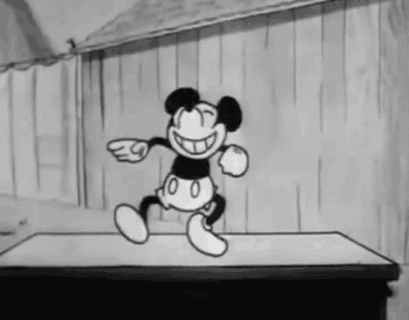
Dance

Slide 12
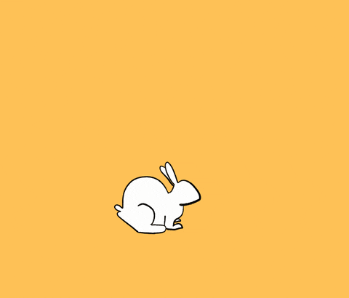
Hop like a bunny

Slide 13
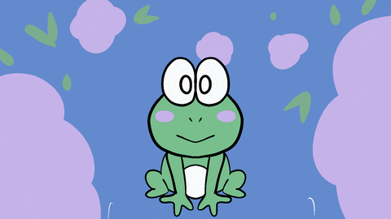
Jump like a Frog

Slide 14
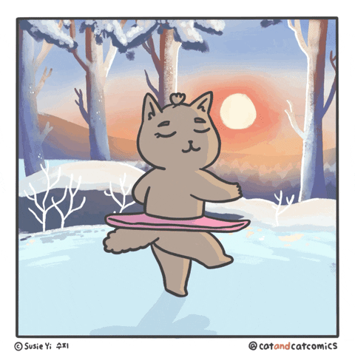
Twirl like a ballerina

Slide 15

Wiggle

Slide 16

Stand tall like a Giraffe

Slide 17
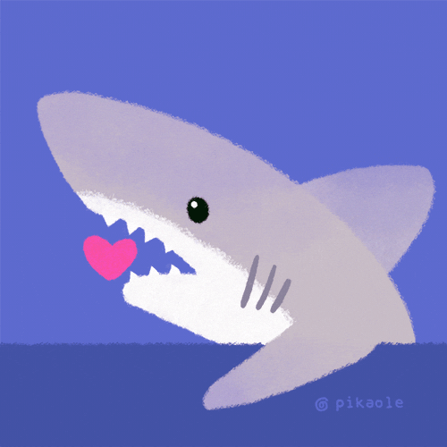
Chomp like a Shark

Slide 18

Crawl like a Crab

Slide 19
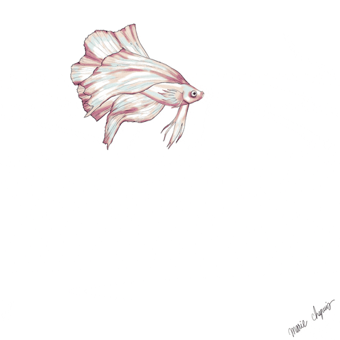
Swim like a Fish

Slide 20

Fly like a Bird

Slide 21
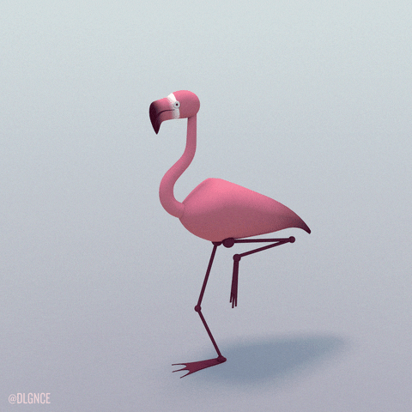
Stand like a Flamingo

Slide 22
Y O U D ID IT!

