Slide 1
Relaxation: How It Affects the Brain and the Body

Slide 2
The Science of Breathing
What controls our breathing?
Our brain controls our breathing. There is a place at the base of our brain that helps regulate breathing, heart rate, and other “automatic” responses.
This structure is called the brain stem. The brain stem sends signals down your spine and into the muscles that are involved in breathing.
These signals tell the muscles involved in breathing to tighten (contract) and loosen (relax). This is why your breathing is automatic (you don’t even know it is happening).

Slide 3
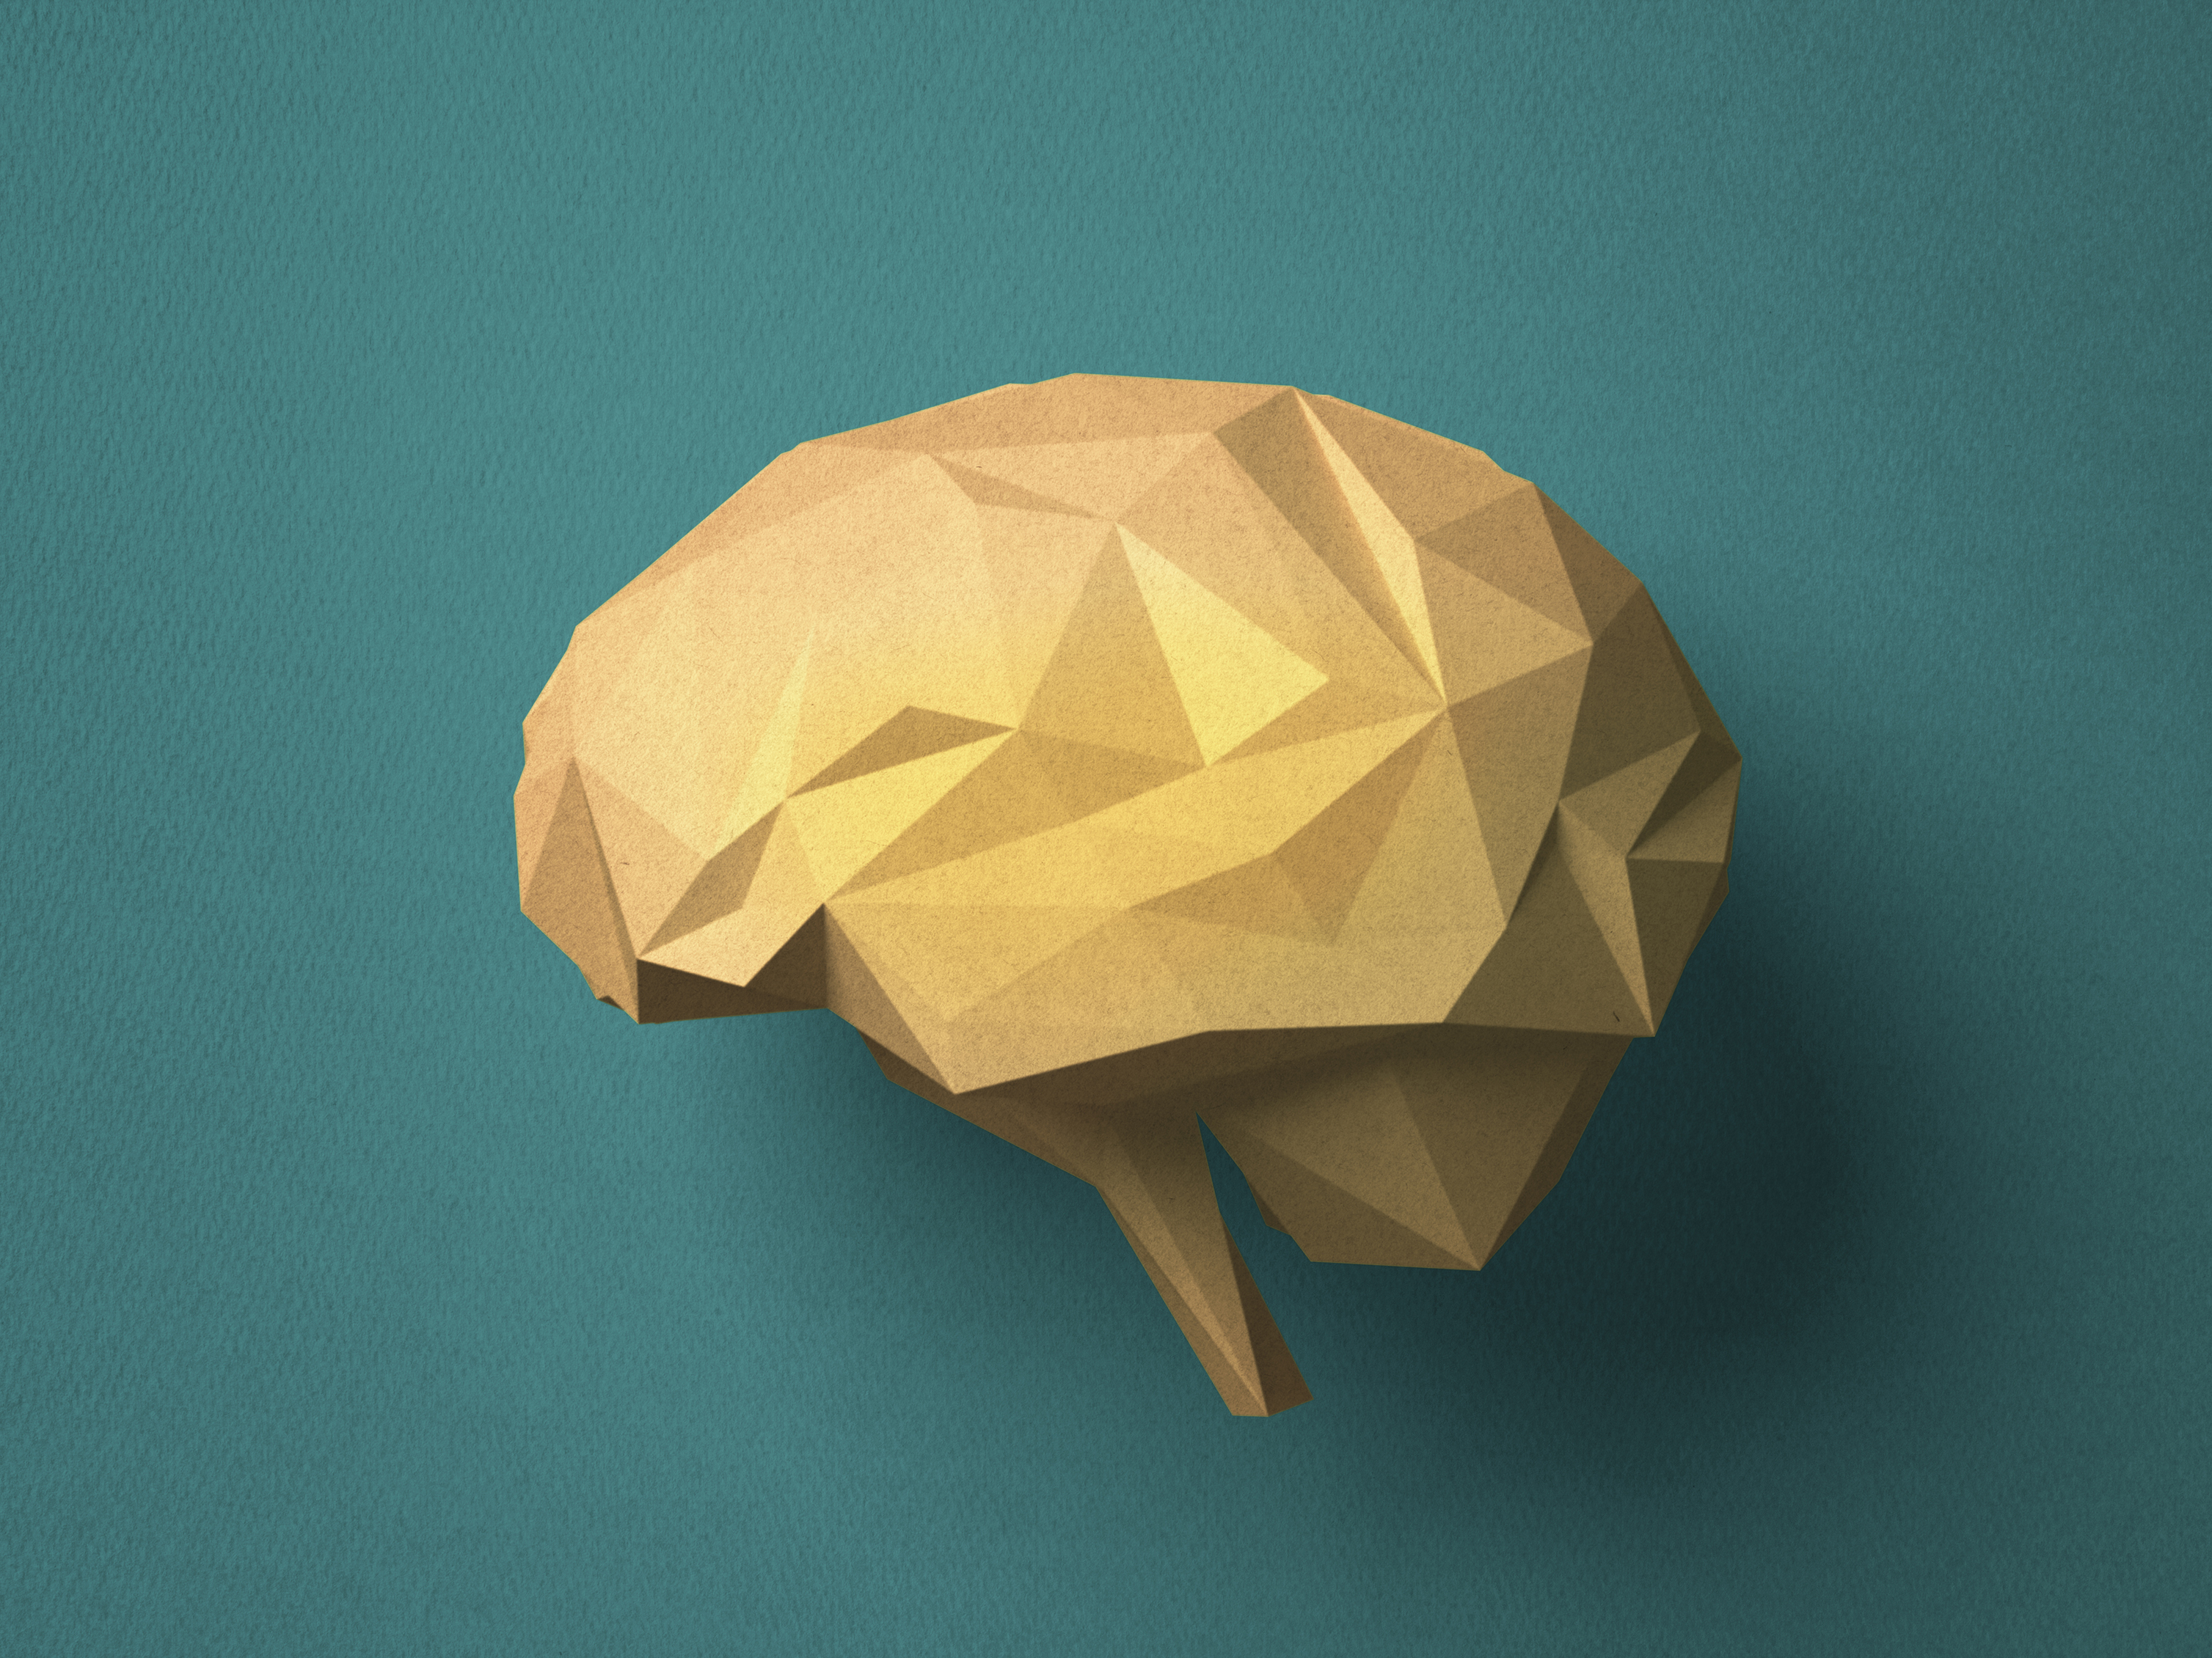
The Science of Breathing
Breathing allows oxygen to flow to our breath through the blood stream. This helps with our ability to think clearly and reason regarding situations that are occurring.

Slide 4
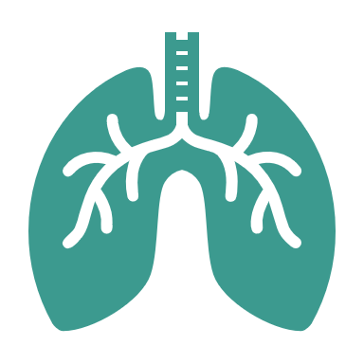
Why Deep Breathing?
Deep breathing, sometimes called “Diaphragmatic Breathing,” is a technique that can be used to help slow down your breathing when you are stressed, anxious, scared , or even angry.

Slide 5
How do we breathe when we are feeling upset?
Our breathing changes when we are feelings anxious or scared or angry. We tend to take short, quick, shallow breaths, or, in some cases, we might “hyperventilate,” meaning we over breathe.
When you over-breathe, you can actually feel worse. It can make you feel more anxious because your heart continues to race, you might feel dizzy, or even develop headaches.

Slide 6
What is Deep Breathing?
Deep Breathing is a slower, controlled form of breathing. This isn’t meant to stop you from feeling anxious, but rather, teach you how to manage the anxiety.

Slide 7
Deep Breathing Practice
Take
Take a deep, slow breath in through the nose, breathing into your lower belly (about 4-5 seconds).
Hold
Hold your breath for 1 – 2 seconds.
Exhale
Exhale slowly through your mouth (about 4-6 seconds).
Wait
Wait a few seconds before taking another deep, slow breath.

Slide 8
Let’s try that now

Slide 9
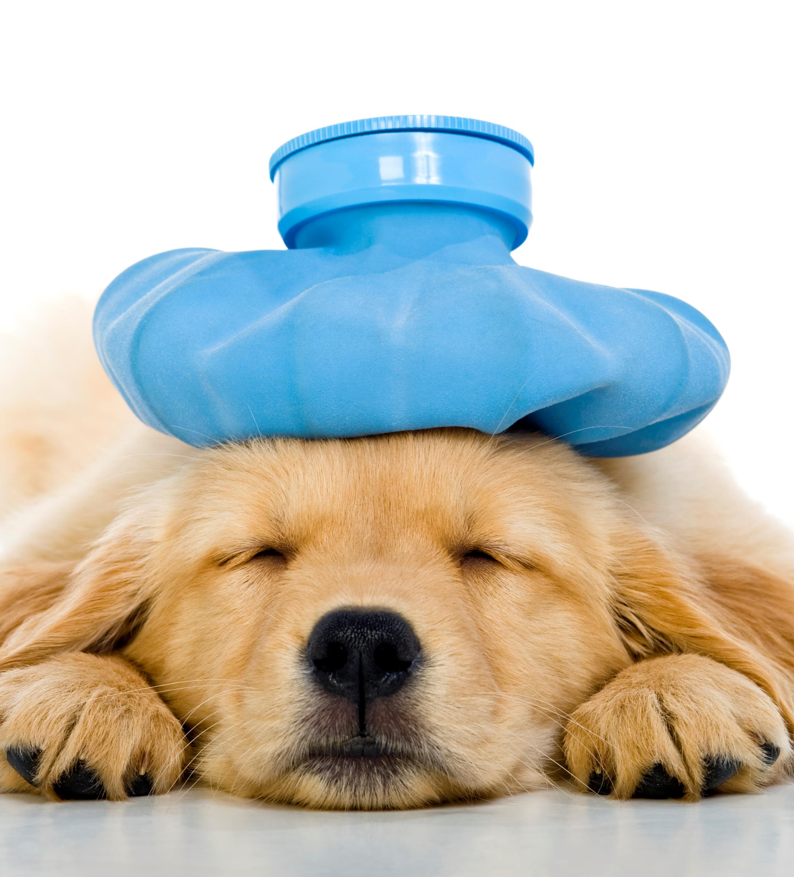
How Our Body Reacts to Stress
Common Effects of Stress on Your Body:
Headache
Muscle tension
Chest pain
Fatigue
Sleep problems

Slide 10
How Our Body Reacts to Stress
Common Effects of Stress on your behavior:
Overeating or undereating
Angry outburst
Drug or alcohol use
Tobacco use
Social withdrawal
Decreased energy

Slide 11
How our Body Reacts to Stress
Common Effects of Stress on Your Mood:
Anxiety
Restlessness
Lack of motivation or focus
Irritability or anger
Sadness or depression

Slide 12
Stress Facts
Stress is one of the main factors affecting insomnia and other sleep disorders.
Laughter lowers levels of cortisol, adrenaline, and epinephrine, which are stress-aggravating hormones. It also releases feel-good hormones, like dopamine.
Cocoa and chocolate are rich in antioxidants and have been said to reduce stress.
Stress balls are believed to alleviate stress because they apply force to pressure points on the hands.
Stress makes us physiologically ready for an emergency. In the moment, it is helpful. But, it can pop up in moments when we are safe, so it can be helpful to learn how to manage stress.

Slide 13
Progressive Muscle Relaxation (PMR)
PMR is a technique that involves tensing and relaxation different muscle groups. This technique is a guided relaxation designed to increase your awareness of tension throughout your body and allow it to slowly be reduced. The goal is to increase awareness while practicing so that you can learn how to reduce it.

Slide 14
Let’s try that now

Slide 15
Relaxation Ideas
Sometimes, it can be helpful to create your own relaxation techniques, so that you have a whole “toolbox” to use when you feel stressed, scared, angry or upset.
Let’s create a list of techniques that can help you!

