Slide 1
BUILDING YOUR Parenting Toolbox

Slide 2
Building your parenting toolbox
Building a Positive Foundation
Praise
Actively Listening
PRIDE Skills
Giving Instructions
Behavior Management
Modeling

Slide 3
Building Positive relationships

Slide 4
Build positive foundation for the caregiver - child relationship
Activities to increasing positive interactions
PRIDE Skills open up doors to increase relationship and control when you are interacting with your child on a daily basis
Using Praise to increase wanted behaviors
Selective Attention
Build
Positive Relationships

Slide 5
Increasing Positive Interactions
Do 5 Minutes a day of child-led time

Slide 6
IDEAS TO BUILD POSITIVE INTERACTION
Play a Game
Color Together
Tell Stories
Read
Go For a Walk
Art/Science Projects
Spend Time in Nature
Go For a Drive

Slide 7
Pride skills

Slide 8
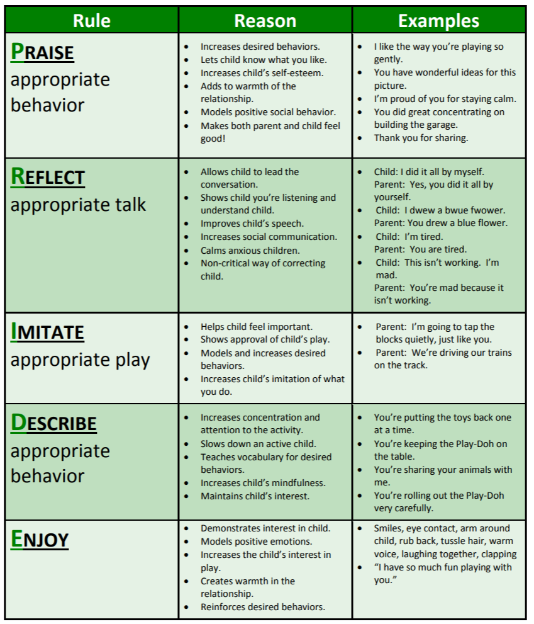
PRIDE Skills

Slide 9
PRIDE Skills

Slide 10
Praise

Slide 11
WHAT MAKES YOU MORE LIKELY TO TRY AND WORK HARD?
Constant criticism
Encouragement and praise
Notes:
We all thrive on positive attention and praise!! Encourage parent to think about how praise/positive attention makes them feel.
Focus of the session on how to give effective commands and praise to increase wanted behaviors!

Slide 12
Think about your previous work experiences WITH BOSSES….
SUPERVISION WITH GREAT BOSS
SUPERVISION WITH DIFFICULT BOSS

Slide 13
FEELINGS ABOUT THOSE RELATIONSHIPS AND INTERACTIONS
GREAT BOSS
DIFFICULT BOSS

Slide 14
Praise
Focus on actively praising the child
Praise a specific behavior
Provide praise ASAP after the behavior occurs
Be consistent
Do not qualify your praise
Provide praise with the same level of intensity as corrective feedback
Notes:
What does your child do well? What are you most proud of the child for doing?
How often do you praise him/her for that behavior? “Okay, so you could tell him/her more often, right? Alright, that is what I am going to ask you to do for next week – praise, praise, praise, and here are some guidelines. Seem reasonable??”
We all thrive on positive attention and praise!! Encourage parent to think about how praise/positive attention makes them feel.
Model praise in therapy with parents!!

Slide 15
Praise
Focus on actively praising the child
Catch your child being good!
Offer global praise generously
- I am so proud to be your parent. I love you!
Increase “labeled” praise
- I like the way you are sitting so quiet in your seat!
Notes:
What does your child do well? What are you most proud of the child for doing?
How often do you praise him/her for that behavior? “Okay, so you could tell him/her more often, right? Alright, that is what I am going to ask you to do for next week – praise, praise, praise, and here are some guidelines. Seem reasonable??”
We all thrive on positive attention and praise!! Encourage parent to think about how praise/positive attention makes them feel.
Model praise in therapy with parents!!

Slide 16
Let’s practice Praising
Issue | Praising Wanted Behaviors
Table Manners | i.e. Excellent job sitting in your seat 1. 2. 3. 4.
Obeying | i.e. Great work following directions 1. 2. 3. 4.
Anger | i.e. I’m proud of you for using your words 1. 2. 3. 4.
Verbal Expression | i.e. I like the way you are using your inside voice 1. 2. 3. 4.
Notes:
What does your child do well? What are you most proud of the child for doing?
How often do you praise him/her for that behavior? “Okay, so you could tell him/her more often, right? Alright, that is what I am going to ask you to do for next week – praise, praise, praise, and here are some guidelines. Seem reasonable??”
We all thrive on positive attention and praise!! Encourage parent to think about how praise/positive attention makes them feel.
Model praise in therapy with parents!!

Slide 17
Let’s practice Praising
Issue | Praising Wanted Behaviors
Carelessness | i.e. Excellent job being gentle with the cat 1. 2. 3. 4.
Fights | i.e. I am so proud of you for taking turns with your friend 1. 2. 3. 4.
High Activity | i.e. Excellent job slowing down with your math problems 1. 2. 3. 4.
Attention Seeking | i.e. I like the way you waited your turn to speak 2. 3. 4.
Notes:
What does your child do well? What are you most proud of the child for doing?
How often do you praise him/her for that behavior? “Okay, so you could tell him/her more often, right? Alright, that is what I am going to ask you to do for next week – praise, praise, praise, and here are some guidelines. Seem reasonable??”
We all thrive on positive attention and praise!! Encourage parent to think about how praise/positive attention makes them feel.
Model praise in therapy with parents!!

Slide 18
Giving Instructions

Slide 19
GIVING INSTRUCTIONS
1. DIRECT
2. POSITIVELY STATED
3. SINGLE COMMAND
4. SPECIFIC
Notes:
Direct not Indirect: Use commands that make it clear that the child is expected to do what has been requested. Commands such as “Let’s clean up now” or “how about getting in line?” should be eliminated because the child may interpret them as meaning she/he has a choice in the matter when in fact there is none. If the oppositional child thinks that the parent/caregiver is merely suggesting that she/he do something that she/her doesn’t want to do, compliance is unlikely. Direct commands should be used when it is important that the child do the requested behavior.
2. Positively Stated: Try to tell the child what TO DO, rather than what NOT TO DO. Replace “Don’t…” and “Stop…” commands with instructions requiring the child to do something incompatible with the problem behavior (e.g., instead of saying “Don’t climb on the furniture”, parents/caregiver should say “Please keep your feet on the floor”).
3. Single Rather Than Compound: Give commands one at a time rather than stringing several together (e.g., avoid commands like “Go put your coat in your closet, your books on the table, and then come to the kitchen.”). Also, break large commands down into smaller parts (e.g., instead of “Get ready for bed”, use a series of smaller commands such as “Put your pajamas on.”, “Please brush your teeth.”, and “Please wash your face”. You can then describe what all of the behaviors “mean”. “Thank you for putting on your pajamas, brushing your teeth, and washing your face, now you are ready for bed.”
4. Specific not Vague: Tell the child specifically what is expected. Replace commands such as “Be good” or Straighten up” with more specific instructions such as “Use your indoor voice” or “Keep your hands to yourself”.
Adapted from handouts by Gurwitch, R. & McNeil, C. (1991). Training Mental Health Professionals in Parent-Child Interaction Therapy.

Slide 20
GIVING INSTRUCTIONS
5. POLITE & RESPECTFUL
6. NEUTRAL VOICE TONE
7. FAIR EXPECTATIONS
8. PROVIDE RATIONALE
9. INCORPORATE CHOICES
Notes:
Direct not Indirect: Use commands that make it clear that the child is expected to do what has been requested. Commands such as “Let’s clean up now” or “how about getting in line?” should be eliminated because the child may interpret them as meaning she/he has a choice in the matter when in fact there is none. If the oppositional child thinks that the parent/caregiver is merely suggesting that she/he do something that she/her doesn’t want to do, compliance is unlikely. Direct commands should be used when it is important that the child do the requested behavior.
2. Positively Stated: Try to tell the child what TO DO, rather than what NOT TO DO. Replace “Don’t…” and “Stop…” commands with instructions requiring the child to do something incompatible with the problem behavior (e.g., instead of saying “Don’t climb on the furniture”, parents/caregiver should say “Please keep your feet on the floor”).
3. Single Rather Than Compound: Give commands one at a time rather than stringing several together (e.g., avoid commands like “Go put your coat in your closet, your books on the table, and then come to the kitchen.”). Also, break large commands down into smaller parts (e.g., instead of “Get ready for bed”, use a series of smaller commands such as “Put your pajamas on.”, “Please brush your teeth.”, and “Please wash your face”. You can then describe what all of the behaviors “mean”. “Thank you for putting on your pajamas, brushing your teeth, and washing your face, now you are ready for bed.”
4. Specific not Vague: Tell the child specifically what is expected. Replace commands such as “Be good” or Straighten up” with more specific instructions such as “Use your indoor voice” or “Keep your hands to yourself”.
Adapted from handouts by Gurwitch, R. & McNeil, C. (1991). Training Mental Health Professionals in Parent-Child Interaction Therapy.

Slide 21
Modeling

Slide 22
Importance of being a good role model
Practice what you preach
01
Parent out loud
02
Demonstrate good coping skills
03
Notes:
Practice what you preach. Kids are watching and learning all the time. They will listen more to what you do than what you say
Parent out loud. A very simple, yet effective parenting technique is to say out loud what you are doing when using positive coping skills. If you’ve had a bad day and come home and take a walk to clear your head. Say it out loud. “I’ve had a bad day, I just need 30 minutes to take a walk and clear my head”. This not only communicates to the child what you are doing and why it makes a connection in their brain – when you have a bad day you should take a walk. When we don’t communicate those things we risk the chance of assumption. A child might think, she is grumpy and is avoiding me. Which makes an unhelpful connection in their brain – when you are grumpy you avoid things.
Practice and demonstrate the coping skills you are trying to teach your child. Not only will it make you feel better it will reinforce that learning for your child.

Slide 23
Active Listening

Slide 24
ACTIVELY LISTENING
When you are listening actively you are…
• Facing the speaker with your body.
• Making good eye contact with the speaker.
• Showing interest through nods or verbal expression (“hmm”).
• Reflecting what they have said for clarification.

Slide 25
Active listening is valuable because it communicates to the speaker
You have heard their message.
You understand what they are saying.
You care about the feelings they are communicating.

Slide 26
Tell about time you felt listen to
How about a time you didn’t
Notes:
Have caregivers tell about a time they really felt listened too. How did that feel? What did the person do?
Now have them tell of a time they didn’t feel listened too. How did that feel? What did the person do?
Talk about the importance of making their child feel like they are listened to and what they could specifically do to make them feel that way (in good times and bad)

Slide 27
USING REFLECTION
• Labels the feelings the child may be directly or indirectly expressing
• Clarifies the listener’s understanding of what has been said
“You feel frustrated, its sounds like you don’t feel like the teacher listen to your side of the story”

Slide 28
Behavior Management

Slide 29
Matching Parenting Techniques to Behaviors
Behavior Type | What Makes it Better | What Makes it Worse
Positive Behavior (want to increase) | Giving attention, “Catch them being good”, Praise, Rewards | Ignoring, “Don’t mess with it when they are being good”
Annoying Behavior (want to decrease) | Ignoring, Natural and logical consequences | Giving attention
Dangerous Behavior (want to remove) | Immediate punishment or consequence (Time out, Loss of privilege), Contracts | Ignoring, Aggression
AFCBT

Slide 30
Selective Attention
No reaction to certain negative behaviors
Walk away, busy oneself with an activity
Regulate and be calm
Expect a reaction of more provocative behavior (known as the “extinction burst”)
Describe appropriate behavior and praise desired behavior
Notes:
Based on the idea that kids want focused, emotionally intense attention from their parents (even if negative).
We tend to respond to misbehavior more than positive behavior therefore unintentionally reinforcing the very negative behavior that we want to discourage.
EXCEPTION: Dangerous behavior or very young children (2 and under)
Beware of extinction burst…If you know you can’t follow through – don’t do it – try to use a time-out.

Slide 31
Tips for ignoring
Ignoring is best for new behaviors. It is usually not helpful for behaviors that have been happening for a long time (example: temper tantrums)
Use only if the behavior will not cause harm to people or property
Use for irritating behaviors, like whining
Be sure you can tolerate the behavior and ignore it 100% of the time. Once you pay attention to it you have taught the child to be more persistent in the future
Ignore the behavior completely but when it stops, praise the child for something specific (example: I like it when you use your regular voice)
It may get worse before it gets better.
Reminder: When you pay attention to behavior , it will likely increase

Slide 32
Removing Privileges
Specify the behavior that will result in a loss and when the privilege will be returned.
Should be one that the child likes and often gets.
Should be something that can be easily removed by you.
Should be one that they child does not otherwise have access to.
Be fair and quick - no extra nagging, arguing, etc.
Make the loss brief. Typically, no more than 24 hours is the most effective.
If child continues with problem behavior, they may lose a second privilege.

