Slide 1

Construyendo una caja de herramientas para la crianza

Slide 2

Construyendo una caja de herramientas para la crianza
Crear una Base Positiva
Elojios
Audición Activa
Habilidades PRIDE
Dando Instrucciones
Manejo de Comportamiento
Modelaje

Slide 3

Establecer Relaciones Positivas

Slide 4

Construir una base positiva para la relación cuidador-niño
Actividades para aumentar las interacciones positivas
Las Habilidades PRIDE abren puertas para aumentar la relación y el control cuando interactúa con su hijo a diario
Utilizar el Elogio para aumentar los comportamientos deseados
  Atención Selectiva
Establecer Relaciones Positivas

Slide 5

Aumentar las Interacciones Positivas
5 minutos al día de tiempo dirigido por el niño

Slide 6




IDEAS PARA FOMENTAR UNA INTERACCIÓN POSITIVA
Jugar un Juego
Colorear Juntos
Contar Cuentos
Leer
Pasear
Proyectos Artísticos/Científicos
Pasar Tiempo en la Naturaleza
Ir en Coche

Slide 7

HABILIDADES Pride

Slide 8
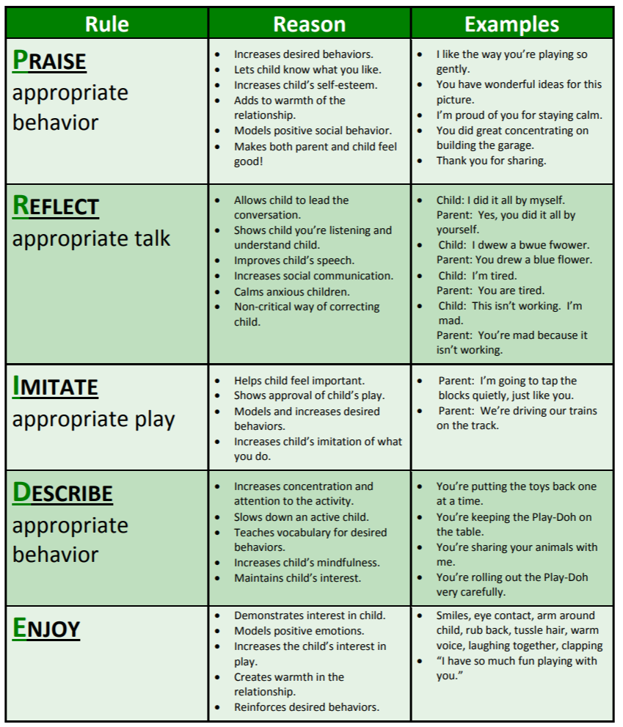
HABILIDADES PRIDE

Slide 9
HABILIDADES PRIDE

Slide 10

ELOJIOS

Slide 11
¿QUÉ LE HACE MÁS PROPENSO/A A ESFORZARSE Y TRABAJAR DURO?
Crítica constante
Estímulo y elogio
Notes:
We all thrive on positive attention and praise!! Encourage parent to think about how praise/positive attention makes them feel.
Focus of the session on how to give effective commands and praise to increase wanted behaviors!

Slide 12
Piense en sus experiencias laborales anteriores CON JEFES ….
SUPERVISIÓN CON UN BUEN JEFE
SUPERVISIÓN CON UN JEFE DIFÍCIL

Slide 13
SENTIMIENTOS SOBRE ESAS RELACIONES E INTERACCIONES
BUEN JEFE
JEFE DIFÍCIL

Slide 14
ELOGIOS ETIQUETADOS
Concéntrese en elogiar activamente al niño
Elogie un comportamiento específico
Elogie el comportamiento lo antes posible
Sea coherente
No matizar los elogios
Elogie con la misma intensidad que los comentarios correctivos
Notes:
What does your child do well? What are you most proud of the child for doing?
How often do you praise him/her for that behavior? “Okay, so you could tell him/her more often, right? Alright, that is what I am going to ask you to do for next week – praise, praise, praise, and here are some guidelines. Seem reasonable??”
We all thrive on positive attention and praise!! Encourage parent to think about how praise/positive attention makes them feel.
Model praise in therapy with parents!!

Slide 15
ELOJIOS
Centrarse en elogiar activamente al niño
¡Pille a su hijo portándose bien!
Ofrecer generosamente un elogio global
- Estoy muy orgulloso/a de ser tu padre/madre. ¡Te amo!
Aumentar los elogios “etiquetados”
- ¡Me gusta la forma en que estás sentado/a tan tranquilo/a en tu asiento!
Notes:
What does your child do well? What are you most proud of the child for doing?
How often do you praise him/her for that behavior? “Okay, so you could tell him/her more often, right? Alright, that is what I am going to ask you to do for next week – praise, praise, praise, and here are some guidelines. Seem reasonable??”
We all thrive on positive attention and praise!! Encourage parent to think about how praise/positive attention makes them feel.
Model praise in therapy with parents!!

Slide 16
Practiquemos el elogio
Problema | Elogiar Comportamientos Deseados
Modales | i.e. Excelente trabajo sentándote en tu asiento1. 2. 3. 4.
Obedecer | i.e. Gran trabajo siguiendo las instrucciones1. 2. 3. 4.
Enojo | i.e. Estoy orgulloso/a de ti por usar tus palabras 1. 2. 3. 4.
Expresión Verbal | i.e. Me gusta cómo utilizas tu voz interior. 1. 2. 3. 4.
Notes:
What does your child do well? What are you most proud of the child for doing?
How often do you praise him/her for that behavior? “Okay, so you could tell him/her more often, right? Alright, that is what I am going to ask you to do for next week – praise, praise, praise, and here are some guidelines. Seem reasonable??”
We all thrive on positive attention and praise!! Encourage parent to think about how praise/positive attention makes them feel.
Model praise in therapy with parents!!

Slide 17
Practiquemos el elogio
Problema | Elogiar Comportamientos Deseados
Descuido | i.e. Excelente trabajo siendo amable con el gato 1. 2. 3. 4.
Peleas | i.e. Estoy tan orgulloso/a de ti por turnarte con tu amigo 1. 2. 3. 4.
Hiperactividad | i.e. Excelente trabajo ralentizando con tus problemas de matemáticas1. 2. 3. 4.
Búsqueda de Atención | i.e Me gusta la forma en que esperaste tu turno para hablar2. 3. 4.
Notes:
What does your child do well? What are you most proud of the child for doing?
How often do you praise him/her for that behavior? “Okay, so you could tell him/her more often, right? Alright, that is what I am going to ask you to do for next week – praise, praise, praise, and here are some guidelines. Seem reasonable??”
We all thrive on positive attention and praise!! Encourage parent to think about how praise/positive attention makes them feel.
Model praise in therapy with parents!!

Slide 18

DANDO InstrucCionEs

Slide 19

dando INSTRUCcIONeS
1. DIRECTO
2. AFIRMADO POSITIVAMENTE
3. MANDATO ÚNICO
4. ESPECÍFICO
Notes:
Direct not Indirect: Use commands that make it clear that the child is expected to do what has been requested. Commands such as “Let’s clean up now” or “how about getting in line?” should be eliminated because the child may interpret them as meaning she/he has a choice in the matter when in fact there is none. If the oppositional child thinks that the parent/caregiver is merely suggesting that she/he do something that she/her doesn’t want to do, compliance is unlikely. Direct commands should be used when it is important that the child do the requested behavior.
2. Positively Stated: Try to tell the child what TO DO, rather than what NOT TO DO. Replace “Don’t…” and “Stop…” commands with instructions requiring the child to do something incompatible with the problem behavior (e.g., instead of saying “Don’t climb on the furniture”, parents/caregiver should say “Please keep your feet on the floor”).
3. Single Rather Than Compound: Give commands one at a time rather than stringing several together (e.g., avoid commands like “Go put your coat in your closet, your books on the table, and then come to the kitchen.”). Also, break large commands down into smaller parts (e.g., instead of “Get ready for bed”, use a series of smaller commands such as “Put your pajamas on.”, “Please brush your teeth.”, and “Please wash your face”. You can then describe what all of the behaviors “mean”. “Thank you for putting on your pajamas, brushing your teeth, and washing your face, now you are ready for bed.”
4. Specific not Vague: Tell the child specifically what is expected. Replace commands such as “Be good” or Straighten up” with more specific instructions such as “Use your indoor voice” or “Keep your hands to yourself”.
Adapted from handouts by Gurwitch, R. & McNeil, C. (1991). Training Mental Health Professionals in Parent-Child Interaction Therapy.

Slide 20
dando INSTRUCcIONeS
5. CORTÉS Y RESPETUOSO
6. TONO DE VOZ NEUTRAL
7. EXPECTATIVAS JUSTAS
8. EXPLICAR LOS MOTIVOS
9. INCORPORAR OPCIONES
Notes:
Direct not Indirect: Use commands that make it clear that the child is expected to do what has been requested. Commands such as “Let’s clean up now” or “how about getting in line?” should be eliminated because the child may interpret them as meaning she/he has a choice in the matter when in fact there is none. If the oppositional child thinks that the parent/caregiver is merely suggesting that she/he do something that she/her doesn’t want to do, compliance is unlikely. Direct commands should be used when it is important that the child do the requested behavior.
2. Positively Stated: Try to tell the child what TO DO, rather than what NOT TO DO. Replace “Don’t…” and “Stop…” commands with instructions requiring the child to do something incompatible with the problem behavior (e.g., instead of saying “Don’t climb on the furniture”, parents/caregiver should say “Please keep your feet on the floor”).
3. Single Rather Than Compound: Give commands one at a time rather than stringing several together (e.g., avoid commands like “Go put your coat in your closet, your books on the table, and then come to the kitchen.”). Also, break large commands down into smaller parts (e.g., instead of “Get ready for bed”, use a series of smaller commands such as “Put your pajamas on.”, “Please brush your teeth.”, and “Please wash your face”. You can then describe what all of the behaviors “mean”. “Thank you for putting on your pajamas, brushing your teeth, and washing your face, now you are ready for bed.”
4. Specific not Vague: Tell the child specifically what is expected. Replace commands such as “Be good” or Straighten up” with more specific instructions such as “Use your indoor voice” or “Keep your hands to yourself”.
Adapted from handouts by Gurwitch, R. & McNeil, C. (1991). Training Mental Health Professionals in Parent-Child Interaction Therapy.

Slide 21

Modelaje

Slide 22
Importancia de ser un buen modelo
Practicar lo que predica
01
Criar en voz alta
02
Demostrar buenas habilidades de afrontamiento
03
Notes:
Practice what you preach. Kids are watching and learning all the time. They will listen more to what you do than what you say
Parent out loud. A very simple, yet effective parenting technique is to say out loud what you are doing when using positive coping skills. If you’ve had a bad day and come home and take a walk to clear your head. Say it out loud. “I’ve had a bad day, I just need 30 minutes to take a walk and clear my head”. This not only communicates to the child what you are doing and why it makes a connection in their brain – when you have a bad day you should take a walk. When we don’t communicate those things we risk the chance of assumption. A child might think, she is grumpy and is avoiding me. Which makes an unhelpful connection in their brain – when you are grumpy you avoid things.
Practice and demonstrate the coping skills you are trying to teach your child. Not only will it make you feel better it will reinforce that learning for your child.

Slide 23

AUDICIÓN ACTIVA

Slide 24
Escuchar activamente
Cuando escuchas activamente estás…
• Mirar a la persona que habla con el cuerpo.
• Mantener un buen contacto visual con el hablante
• Mostrar interés mediante asentimientos o expresiones verbales (“hmm”).
Reflejar lo que han dicho para aclararlo.

Slide 25

Escuchar activamente es algo valioso porque comunica al hablante
Ha escuchado su mensaje.
Entiende lo que dice.
Le importan los sentimientos que transmite.

Slide 26

Cuente alguna vez que se haya sentido escuchado/a
¿Qué tal una vez que no?
Notes:
Have caregivers tell about a time they really felt listened too. How did that feel? What did the person do?
Now have them tell of a time they didn’t feel listened too. How did that feel? What did the person do?
Talk about the importance of making their child feel like they are listened to and what they could specifically do to make them feel that way (in good times and bad)

Slide 27
UTILIZAR LA REFLEXIÓN
• Etiqueta los sentimientos que el niño puede estar expresando directa o indirectamente
• Aclara al oyente la comprensión de lo que se ha dicho
“You feel frustrated, its sounds like you don’t feel like the teacher listen to your side of the story”

Slide 28

MANEJO DE COMPORTAMIENTO

Slide 29
Adecuar las Técnicas de Crianza a los Comportamientos
Tipo de Comportamiento | Lo Que Lo Mejora | Lo Que Lo Empeora
Comportamiento Positivo (quiere aumentar) | Dar atención, “Píllalos siendo buenos”, Elojios, Premios | Ignorar, "No se metacon él cuando estánportándose bien”
Comportamiento Molestoso (quiere disminuir) | Ignorar, Consecuencias naturales y lógicas | Dar atención
Comportamiento Peligroso (quiere remover) | Castigo inmediato oconsecuencia (time out, pérdida de privilegios), Contratos | Ignorar, Agresión
AFCBT

Slide 30
Atención SelectivA
No reaccione ante determinados comportamientos negativos
Alejarse, ocuparse en una actividad
Regule y mantenga la calma
Esperar una reacción de comportamiento más provocativo (conocido como "estallido de extinción”)
Describir el comportamiento adecuado y elogiar el comportamiento deseado
Notes:
Based on the idea that kids want focused, emotionally intense attention from their parents (even if negative).
We tend to respond to misbehavior more than positive behavior therefore unintentionally reinforcing the very negative behavior that we want to discourage.
EXCEPTION: Dangerous behavior or very young children (2 and under)
Beware of extinction burst…If you know you can’t follow through – don’t do it – try to use a time-out.

Slide 31

Consejos para ignorar
Ignorar es lo mejor para los comportamientos nuevos. No suele ser útil para comportamientos que llevan mucho tiempo produciéndose (ejemplo: rabietas)
Utilizar sólo si el comportamiento no causará daños a personas o propiedades.
Utilizar para comportamientos irritantes, como los lloriqueos
Asegúrese de que puede tolerar el comportamiento e ignorarlo el 100% del tiempo. Una vez que le preste atención habrá enseñado al niño a ser más persistente en el futuro
Ignora por completo el comportamiento, pero cuando cese, elogia al niño por algo concreto (ejemplo: Me gusta cuando usas tu voz normal)
Puede empeorar antes de mejorar.
Recordatorio: Cuando se presta atención al comportamiento , es probable que aumente

Slide 32
Eliminación de Privilegios
Especificar el comportamiento que dará lugar a una pérdida y cuándo se devolverá el privilegio.
Debe ser uno que le guste al niño y que reciba a menudo.
Debe ser algo que usted pueda quitar fácilmente.
Debe ser uno al que el niño no tenga acceso de otro modo.
Sé justo y rápido: no regañe, discuta, etc.
Haga que la pérdida sea breve. Normalmente, no más de 24 horas es lo más eficaz.
Si el niño continúa con el comportamiento problemático, puede perder un segundo privilegio.

