Slide 1
Therapy Trivia

Slide 2
Instructions for Therapy Trivia
Therapy Trivia is a game that can be used to get to know your clients while also beginning to assess your clients' knowledge of therapeutic themes.
To play, put your PowerPoint in “presentation mode,” share your screen with the client, and go to slide 3- which contains a board with five categories with point values ranging from 10 to 50.
Explain to your client that the purpose of the game is to get to know more about them and for them to learn about some of the topics that will be a focus for therapy moving forward.
Take turns with your client selecting numbers and responding to questions.
When selecting a number, it is important to click on the numbers themselves- rather than simply clicking in the cell where the numbers are located.
When you click on a number, you will be taken to a page that contains the question corresponding to that category and point value. After your client answers, advance to the next slide by clicking on the slide.
Correct answer - click anywhere on the screen to prompt an animation with applause and information about the points earned. Then click on the “Home” button to return to the Trivia Board.
Incorrect answer - click directly on the “Home” button to return to the Trivia Board without the applause animation.
If keeping score, you will need to keep score manually because the PowerPoint does not have an option to tally the score.
When you are ready to end the game, click the “End Game” button on the Trivia Board.
Click anywhere on the last screen for a “Congratulations” and drum roll celebration.
Feel free to adapt this resource to include your own questions!

Slide 3
ALL ABOUT ME | FEELINGS | SAFETY | MY FAMILY | RANDOM
10 | 10 | 10 | 10 | 10
20 | 20 | 20 | 20 | 20
30 | 30 | 30 | 30 | 30
40 | 40 | 40 | 40 | 40
50 | 50 | 50 | 50 | 50
END GAME

Slide 4
all about me 10 points
What’s your favorite color?

Slide 5
You get 10 points!

Slide 6
FEELINGS 10 pts
What can you do to calm yourself down?

Slide 7
You get 10 points!

Slide 8
SAFETY 10 points
Do you know what “okay” and “not okay” touches are?

Slide 9
You get 10 points!

Slide 10
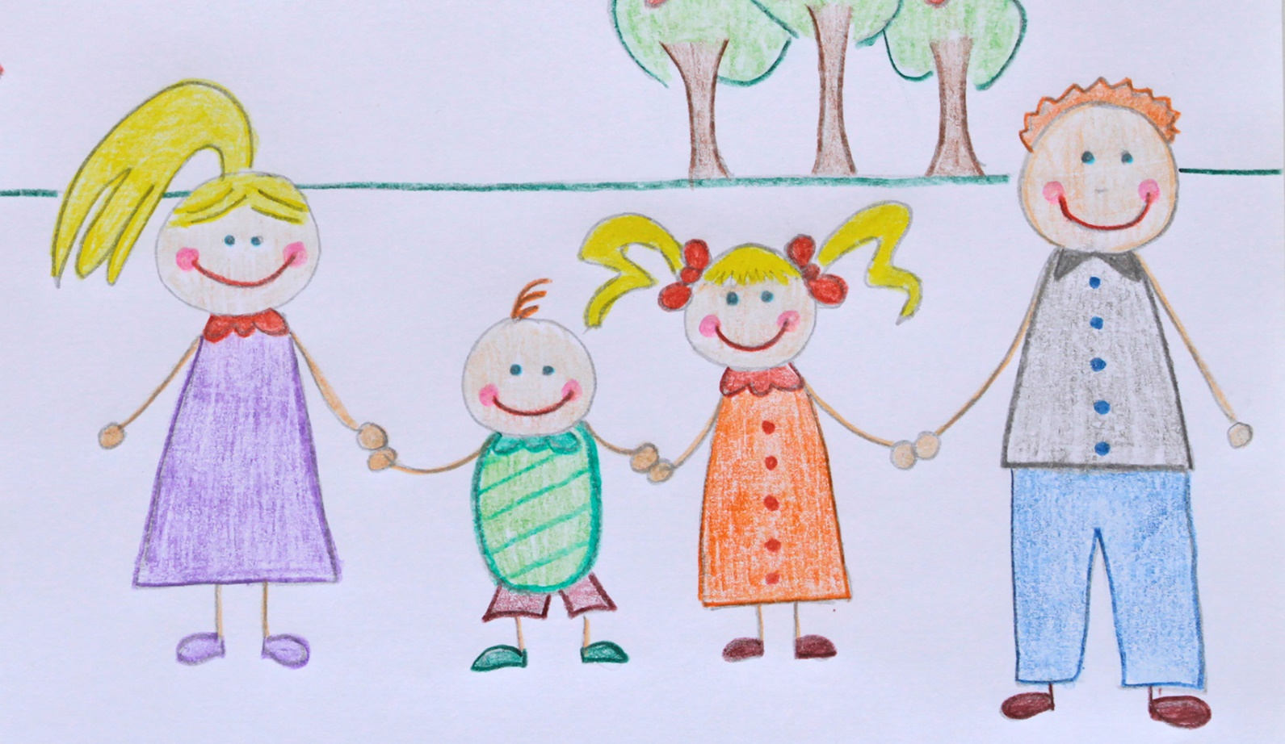
MY FAMILY 10 points
Who is in your family?

Slide 11
You get 10 points!

Slide 12
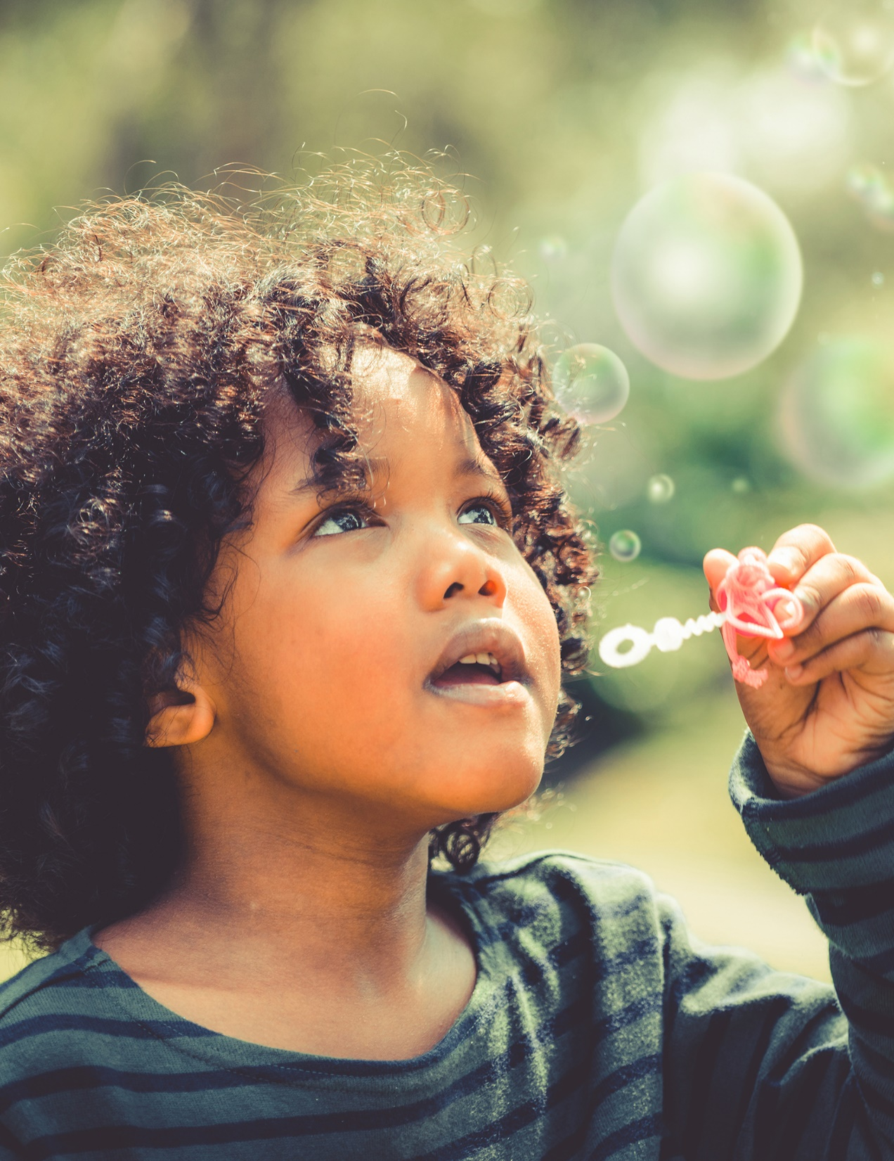
RANDOM 10 pOINts
What do you do to help yourself feel better?

Slide 13
Daily double!!!! You get 2o points!

Slide 14
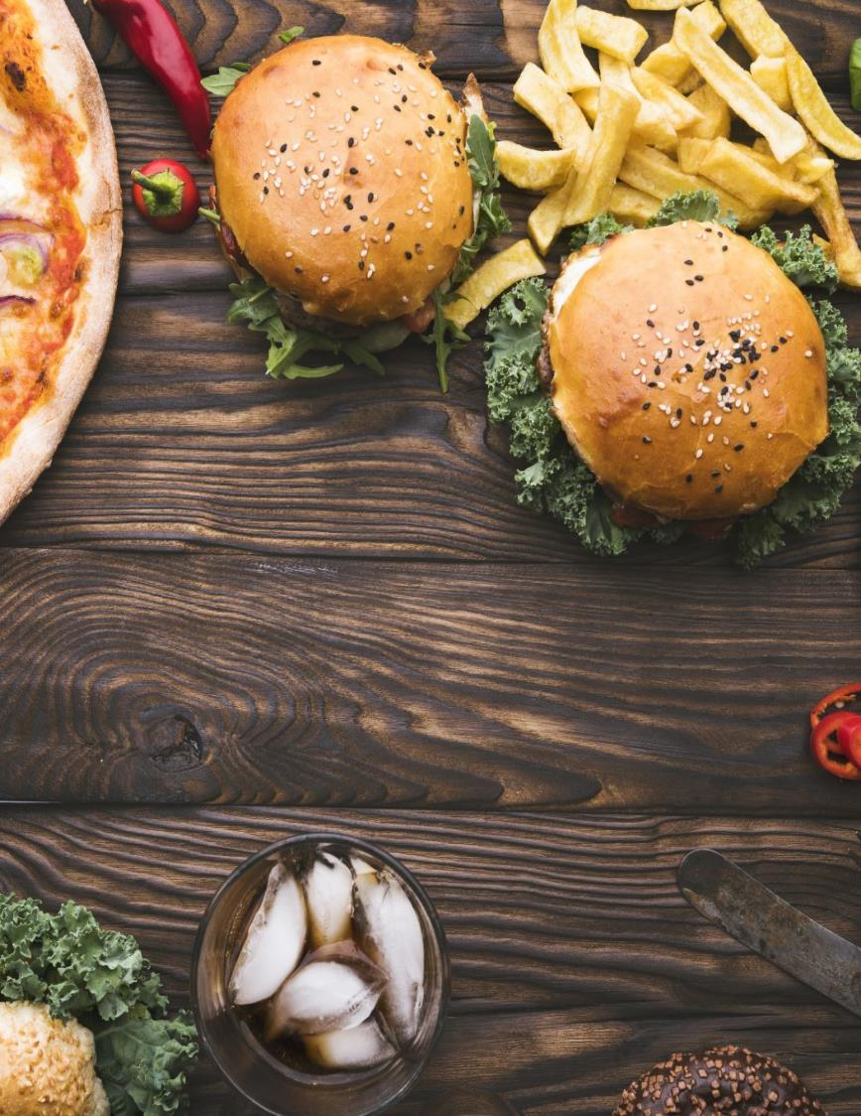
All about me 20 points
What is your favorite food to eat?

Slide 15
you get 20 points!

Slide 16
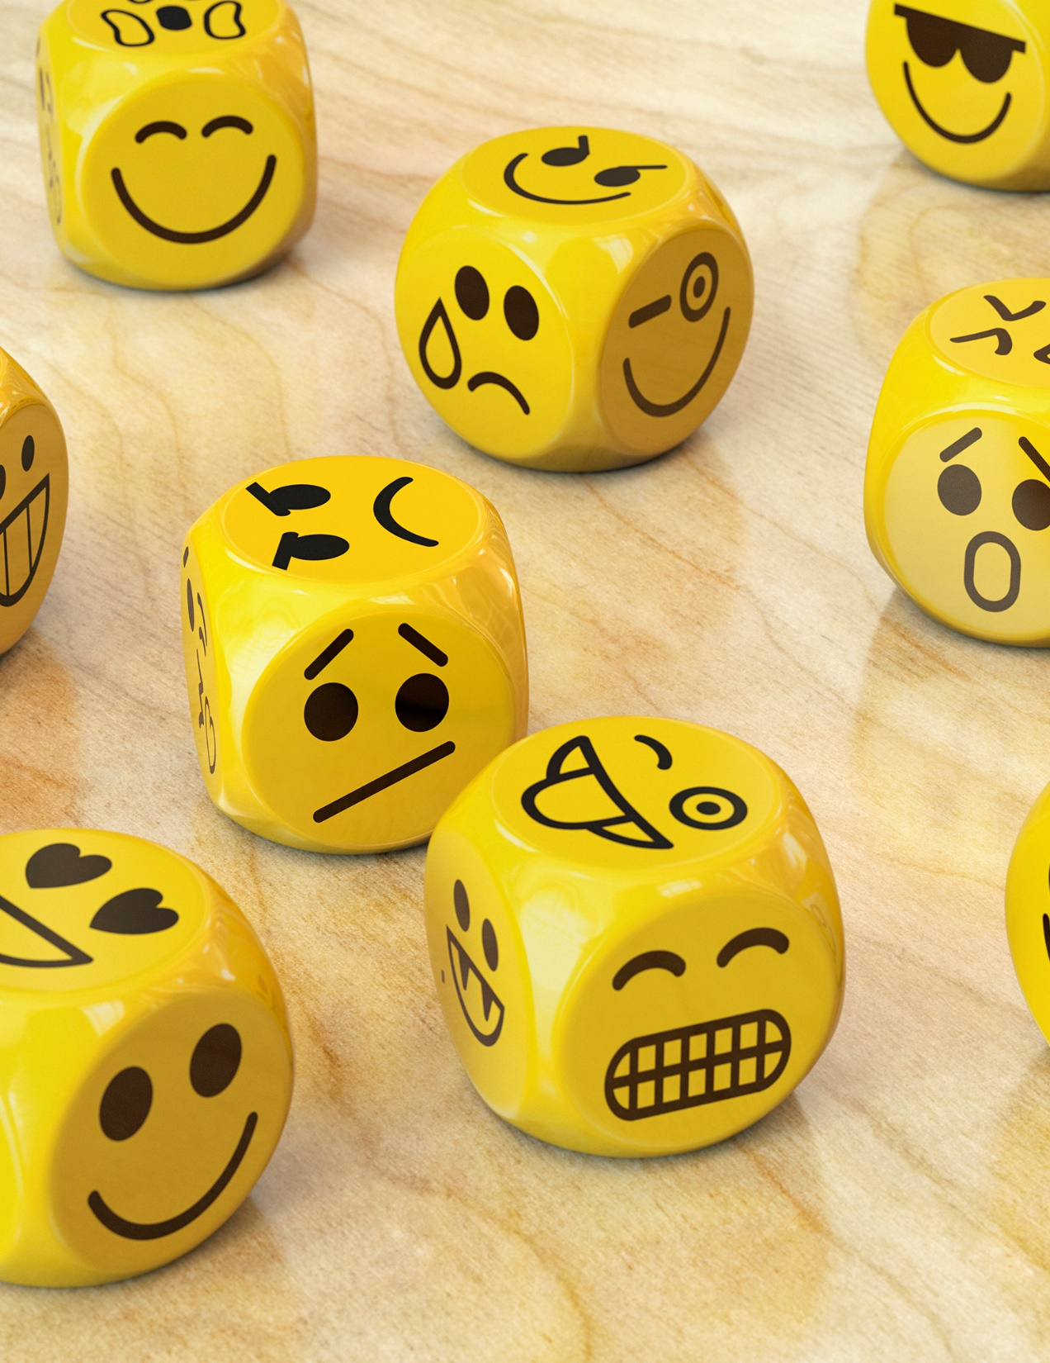
Feelings 20 points
How can you tell when someone is feeling “mad?"

Slide 17
You get 20 points!

Slide 18
Who can you tell if someone gives you a “not okay” touch?
safety 20 points

Slide 19
You get 20 points!

Slide 20
My family 20 points
Where does your family live?

Slide 21
You get 20 points!

Slide 22
random 20 points
What can an adult say to help a kid feel better?

Slide 23
You get 20 points!

Slide 24
All about me 30 points
What is your favorite movie, book, or TV show?

Slide 25
You get 30 points!

Slide 26
Feelings 30 points
Can you feel more than one feeling at a time?

Slide 27
You get 30 points!

Slide 28
safety 30 points
What should you do if the adult you tell about something scary doesn’t help you?

Slide 29
You get 30 points!

Slide 30
My family 30 points
Who is the person in your family you talk to the most?

Slide 31
You get 30 points!

Slide 32
random 30 points
How do kids feel when adults say mean things to them?

Slide 33
You get 30 points!

Slide 34
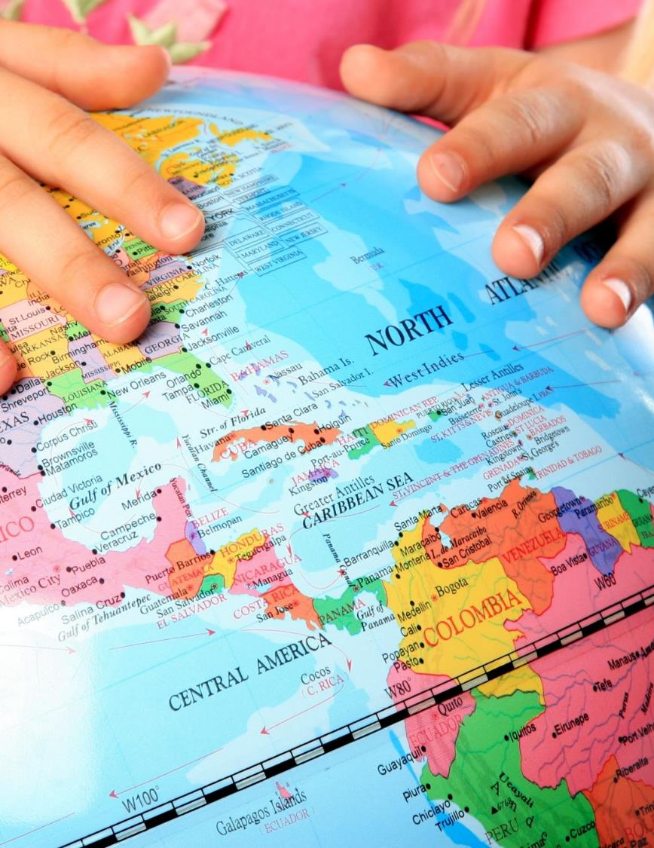
All about me 40 points
If you could go anywhere in the world, where would you go?

Slide 35
You get 40 points!

Slide 36
feelingS 40 points
What does your body feel like when you are scared?

Slide 37
You get 40 points!

Slide 38
safety 40 points
How do kids feel when someone gives them a “not okay” touch?

Slide 39
You get 40 points!

Slide 40
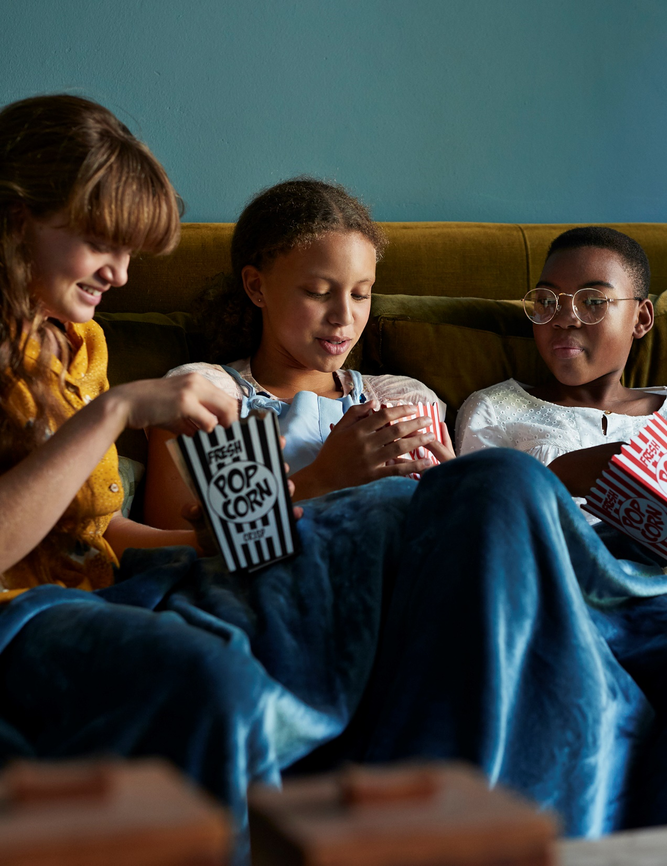
My family 40 points
What are some things you like to do with your family?

Slide 41
You get 40 points!

Slide 42
RandoM 40 points
What is your favorite part of school? What is your least favorite part?

Slide 43
You get 40 points!

Slide 44
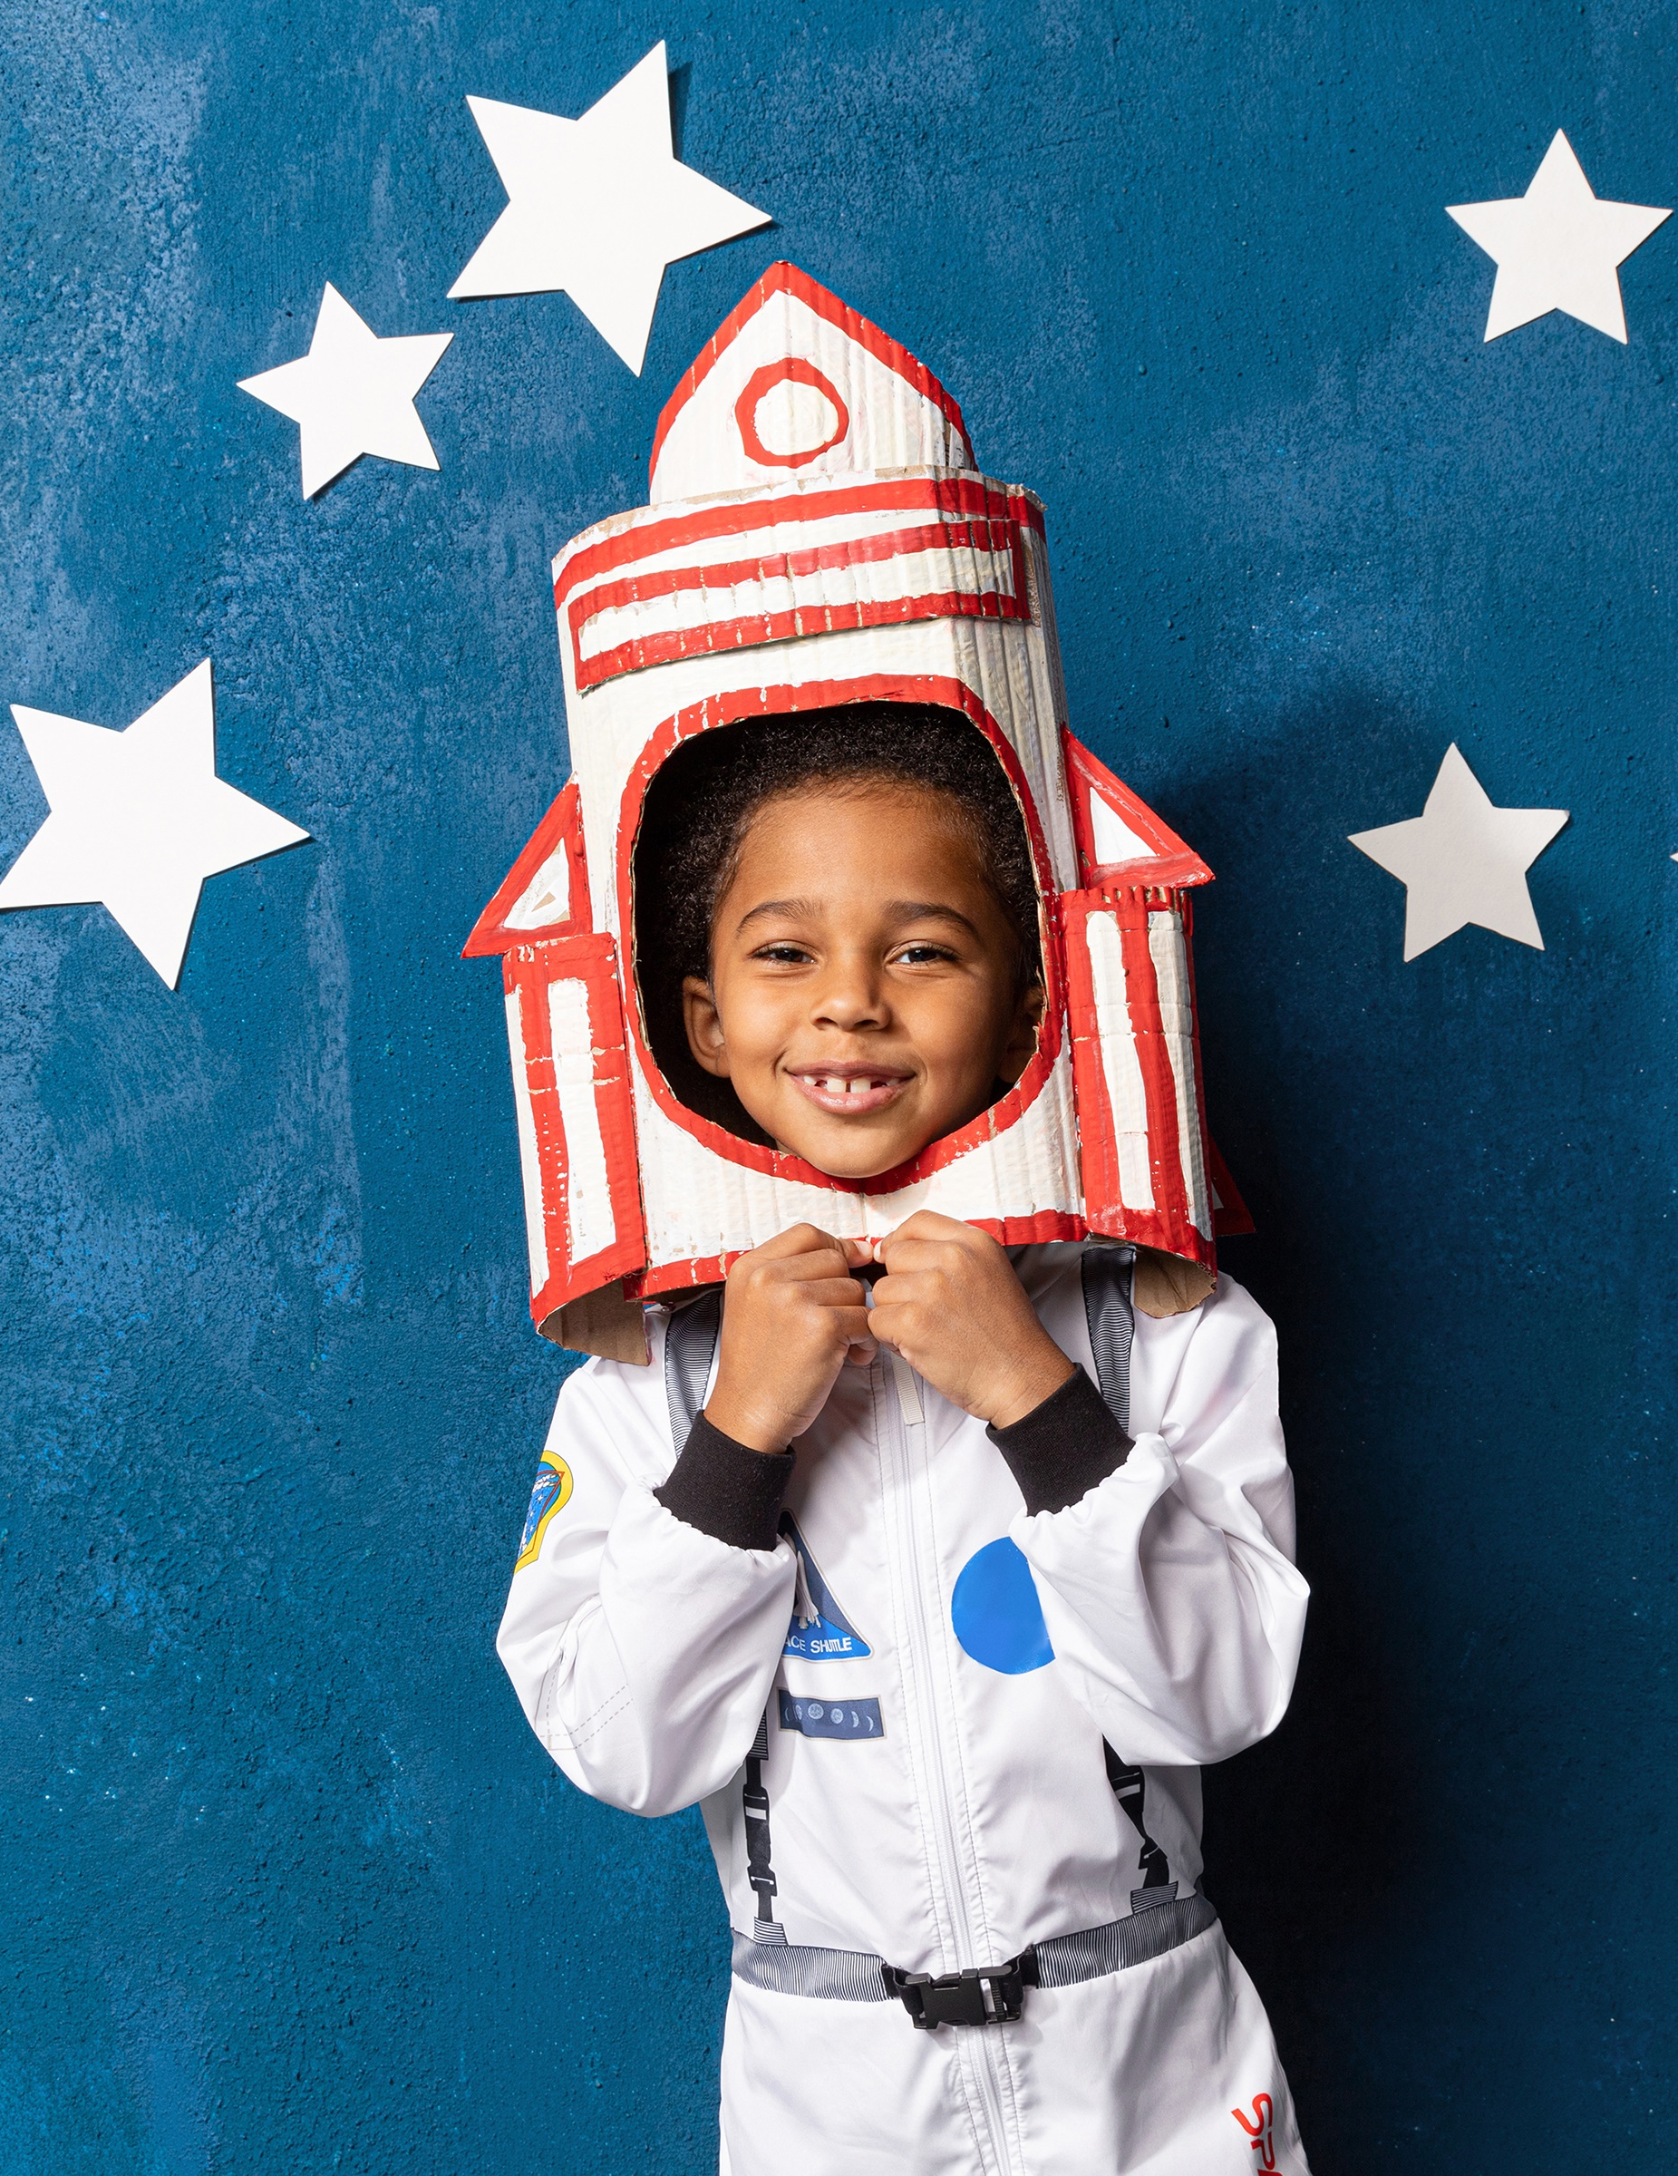
All about me 50 points
What do you want to be when you grow up?

Slide 45
You get 50 points!

Slide 46
feelings 50 points
How can you tell when you feel happy?

Slide 47
You get 50 points!

Slide 48
safety 50 points
Who are three people you can tell if someone gives you a “not okay” touch?

Slide 49
You get 50 points!

Slide 50
My family 50 points
What do you and your family do to celebrate things (holidays, birthdays)?

Slide 51
You get 50 points!

Slide 52
Random 50 points
What makes you proud of yourself?

Slide 53
You get 50 points!

Slide 54
Congratulations!

