Slide 1
Relaxation & Sports

Slide 2
Content
Basketball Breathing
Breathing and Soccer
Weight Lifting Progressive Muscle Relaxation Activity

Slide 3
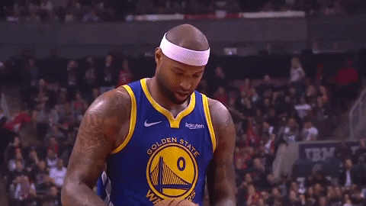
Free Throw Breathing

Slide 4
Breathing and Soccer
Notes:
Photo by <a href="/photographer/aklepsteen-45254">Adam Klepsteen</a> from <a href="https://freeimages.com/">FreeImages</a>

Slide 5
Provider’s Instructions
This presentation explains the importance of relaxation practices in sports.
This is ideal for a child who is interested in sports.
Share the slides in the order they appear as each slide builds from the previous one.
You will be teaching 3 types of relaxation exercises, but you can add other ones as you see fit.
If you have time, find a video of a soccer player taking a deep breath before a penalty kick to show in conjunction with this presentation.
You can end this activity by practicing with the child one of the relaxation exercises.

Slide 6
Did you know!?!
Soccer players practice controlled breathing
Why?
It helps them feel calm
It helps them focus
It helps prepare them for the game

Slide 7
3 Things Players to do relax…
(1) Controlled Breathing
(2) Visualization
(3) Progressive Muscle Relaxation
Notes:
Photo by <a href="/photographer/byronh1-51313">byron hardy</a> from <a href="https://freeimages.com/">FreeImages</a>

Slide 8
What happens when a player takes a penalty kick?

Slide 9
Penalty Kick
How does he know how many steps to take?
How does he know where the ball is going to go?
What does he do in the video?

Slide 10
Soccer is a “mental game”
Visualize where the ball is going to go
Concentrate on your goal
Take deep, calming breaths
Notes:
Photo by <a href="/photographer/surfapimp-44425">Andreas Schmidt</a> from <a href="https://freeimages.com/">FreeImages</a>

Slide 11
But, he only took one breath…
Why doesn’t he have to take lots of deep, calming breaths?

Slide 12
PRACTICE!!!!

Slide 13
How do we build our skills?
We practice using tools!
Notes:
Photo by <a href="/photographer/Jaymarr-42913">Jennifer Marr</a> from <a href="https://freeimages.com/">FreeImages</a>

Slide 14
Controlled Breathing is the same in therapy!
We practice using tools
Bubble Breathing
Belly Breathing with a cup
We PRACTICE, PRACTICE, PRACTICE
That way we are ready for the game!

Slide 15
Let’s Practice!
Slow, deep breath in.
Slow, deep breath out.
Watch the air fill up your tummy like a balloon!
Notes:
Photo by <a href="/photographer/winjohn-50474">John evans</a> from <a href="https://freeimages.com/">FreeImages</a>

Slide 16
Weight Lifting PMR

Slide 17
Directions:
This exercise to help you learn the ways your muscles tense and relax. I will ask you tense specific muscle groups for 5-10 seconds, and then let it relax for 5-10 seconds. While relaxing, try to do so completely and let the muscle go completely limp.
Sit comfortably in your chair.
If you are comfortable, close your eyes and try to imagine the scenarios we are practicing.

Slide 18
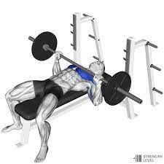
Bench Press
Imagine you are laying back on a bench during weight training. Your back is straight and you have the bar in your hands just above your chest. Now push the bar directly out in front of you. You want to this in a very controlled manner- just as you would in your weight training.
Hold the tension (5-10 seconds).
Then relax your arms and let them drop to your side (5-10 seconds).
Repeat.

Slide 19
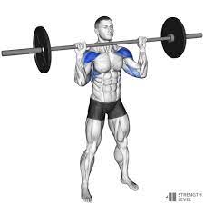
Overhead Press
Imagine you are doing an overhead press in your weight training class. Your arms are holding the bar in front of your chest and your muscles in your neck and back tense as you push the bar upwards over your head.
Hold the tension (5-10 seconds).
Then relax your arms and let them drop to your side (5-10 seconds).
Repeat.

Slide 20
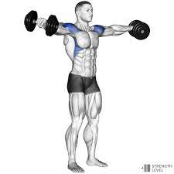
Lateral Raise
Imagine you are doing a lateral raise from a seated position. Holding the “weights” in your hands, squeeze your shoulder blades together to raise your arms about 90 degrees (your arms will be parallel to the floor).
Hold the tension (5-10 seconds).
Relax your arms and let them drop to your side (5-10 seconds).
Repeat.

Slide 21
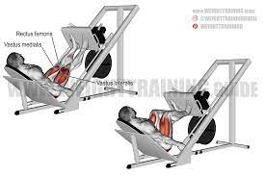
Leg Press
Imagine you are doing a leg press from a seated position and the floor is the machine. Put your feet flat on the floor and tense the muscles in your thighs like you are going to leg press the floor.
Hold the tension (5-10 seconds).
Relax your legs (5-10 seconds).
Repeat.

Slide 22
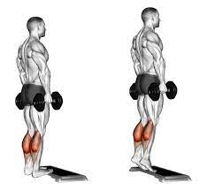
Calf Raise
Next, imagine that you are doing a calf raise from a seated position. Put your feet flat on the floor, spaced apart. Then, using your calf muscles, raise your heels off of the floor.
Hold the tension (5-10 seconds).
Relax your legs (5-10 seconds).
Repeat.

Slide 23
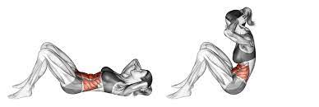
Sit Up
Now, I want you to imagine what it would be like to do a sit up from your chair. Tense your abdominal muscles and pull towards your core.
Hold the tension (5-10 seconds).
Relax your stomach muscles (5-10 seconds).
Repeat.

Slide 24
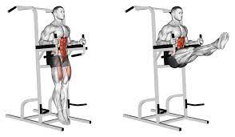
Leg Raise
Finally, imagine that you will be doing a leg raise from your chair. Sit with your back straight and using your leg and core muscles, lift your leg where it is completely extended, parallel to the floor.
Hold the tension (5-10 seconds).
Relax your muscles (5-10 seconds).
Repeat.

